Slide 1
Experiences from Developing Concurrent Multi-Disciplinary MBSE
Hans Peter de Koning
European Space Agency
European Space Research and Technology Centre (ESTEC)
Noordwijk, The Netherlands

Slide 2
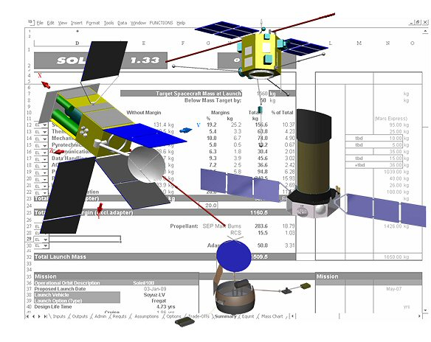
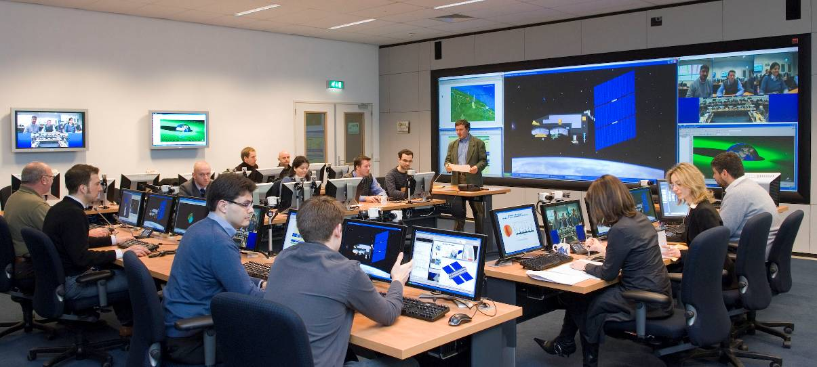
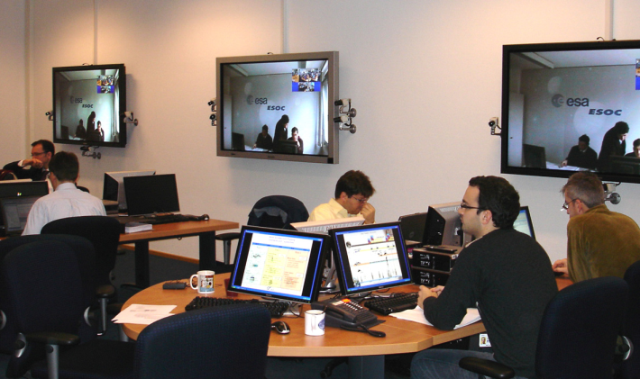
ESA Concurrent Design Facility (CDF)
Concurrent engineering of conceptual design of almost all candidate ESA missions
10 to 20 studies per year
~20 domains-of-expertise per study team
including cost, risk, programmatics
For details see http://www.esa.int/cdf

Slide 3
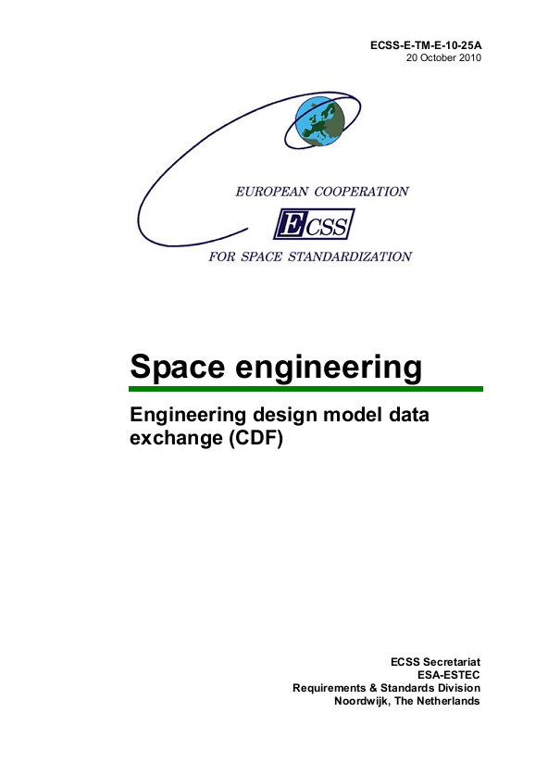
ECSS-E-TM-10-25 Based Model Driven Architecture
Standardized Semantic / Conceptual Data Model
Semantic Data Model
“Master Definition of Concepts”
addresses “what” not “how”
“Reference Data Libraries (RDLs) “
Runtime loadable
predefined objects,
including QUDV and Categories
Used small subset of UML2
Automated transformations
Similar to UML / SysML Model Libraries
Generated
Software Implementations
Database
Database
Tool
Derived Logical and
Physical Data Models
Database A
Interoperable tools and databases
(including adapters to enable existing tools)
Tool
Tool X

Slide 4
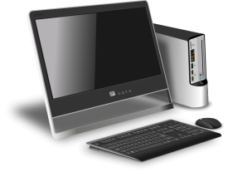
Open Concurrent Design Tool (OCDT) Architectural Overview
Domain 1
ConCORDE
PostgreSQL
Protocol
over TCP/IP
http(s) REST protocol
(on standard ports 80 or 443)
GET, POST, content is JSON
Domain 2
ConCORDE
Persistent Data Store
(PostgreSQL RDBMS)
Firewall
(optional)
ConCORDE
Web Services Processor
(nodejs on Google V8)
DST
(Domain Specific Tool)
Domain 3
OpenLDAP Server
(optional)
ConCORDE
OCDT Server
OCDT Clients
Domain N

Slide 5
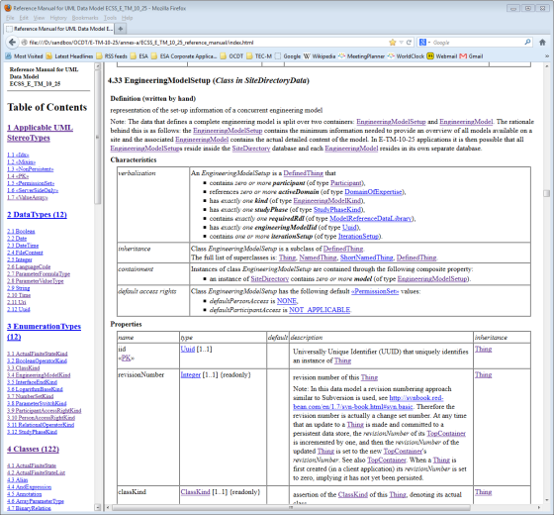
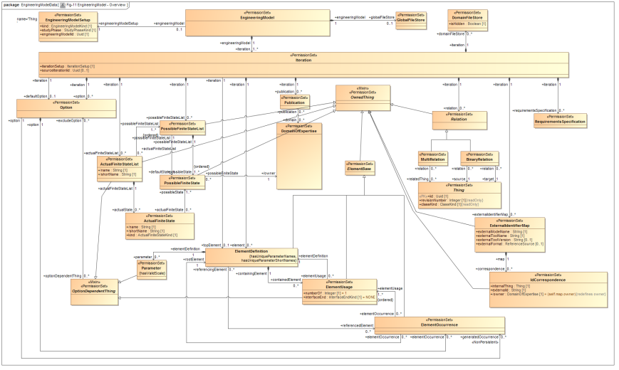
OCDT implements ECSS-E-TM-10-25A through code generation
Annex A
Standard Semantic Data Model
in UML (MagicDraw)
Annex A at version 2.4.1
(12 Nov 2013)
SQL database scripts
JSON meta-model
xmi_verter
(OCDT
code generator)
C# class library
Python class library
XML Schema
Excel workbook
for data model analysis

Slide 6
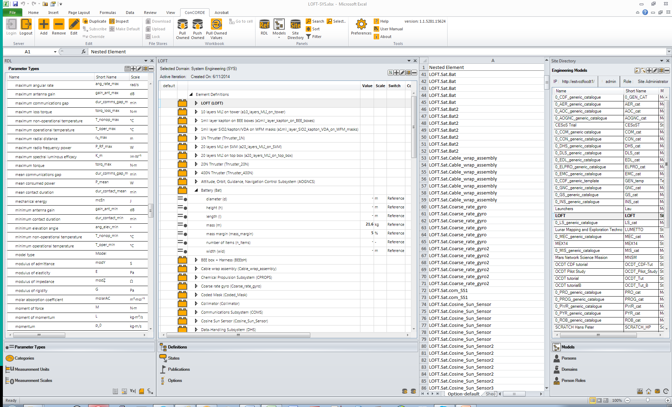
ConCORDE Screenshots (1/2)
Use of Excel as front-end UI
with ConCORDE Ribbon Tab
to reduce learning curve
z
Reference Data
(Parameter Types,
Categories,
Units & Scales,
Rules, …)
Site Directory Data
(Models, Catalogues,
Persons, Participants, …)

Slide 7
ConCORDE Screenshots (2/2)
All team members automatically sync to latest state of model at 30 second intervals
Engineering Model or Catalogue
(Options,
Element Definitions and Usages, Parameters, …)
Excel Workbook

Slide 8
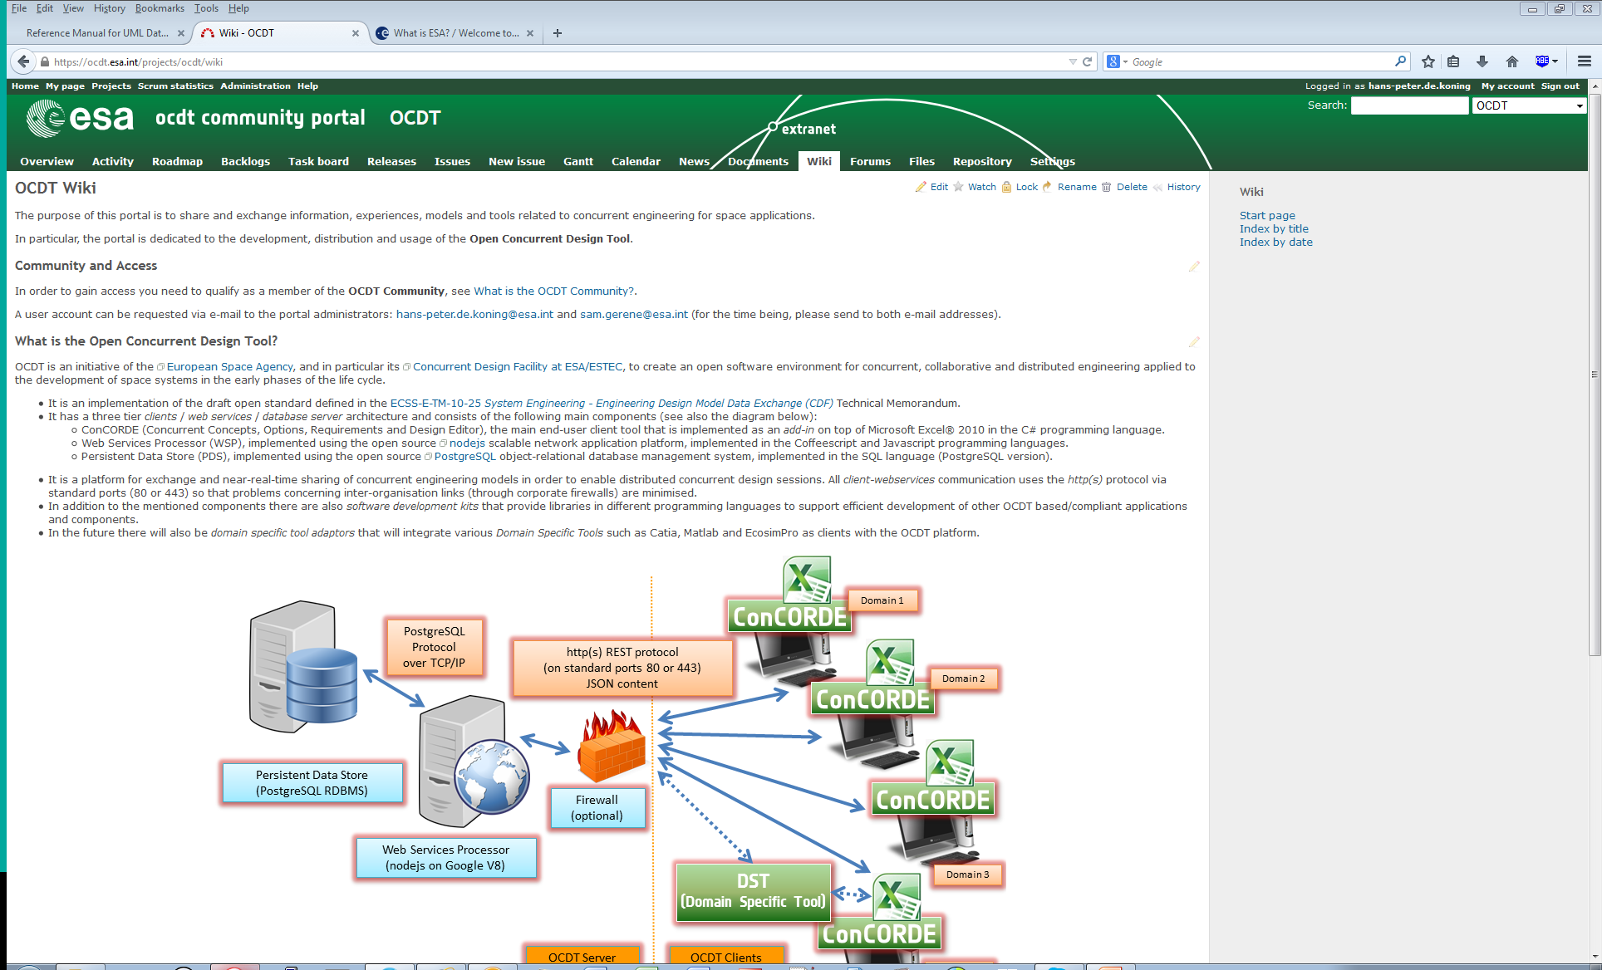
Community Portal
https://ocdt.esa.int

Slide 9
Initial list of desirable improvements in a future SysML (1/2)
Significantly better “semantic quality” of SysML meta-model
Must be founded in formal logic – ideally provide basis for automated reasoning
Clean up impeding “artificial” UML heritage
Consider a SysML-Light – a pure subset of a SysML-Full
Help reduce the learning curve for “normal” engineers
SysML-Light usable for less complex systems, early life-cycle phase
Fits with web-app / desktop tool?
Support fine-grained ownership of (responsibility for) model elements by domain-of-expertise and/or multi-disciplinary team-member
Provides solid basis for role-based access rights management
E-TM-10-25 / OCDT shows it is doable at Block, Usage, Value Property level
Support fine-grained version / revision control
Enable full revision history
Could (should?) be an orthogonal concept to rest of meta-model
At object level? Need to validate potential scaleability issues.
Learn from success of git and github

Slide 10
Initial list of desirable improvements in a future SysML (2/2)
Support compound value properties / types
To represent richer datatypes (records, vectors, matrices, n-dimensional tensors, generic capture of variable length lists, time series data, …)
Upgrade QUDV model with full support for “measurement scales”
So that more than just ratio scales can be accurately represented: ordinal, interval, logarithmic, cyclic ratio scales …
This is needed for future automated unit/scale conversion when integrating models coming from many different sources
Reference implementation available in E-TM-10-25 and OCDT
Support finite-state-dependent value properties
I.e. allow a different value for each state
Very useful in early concept design/formulation
Natural language presentation of relationships and their inverse
Direction / arrow is immediately clear
e.g. «satisfy» becomes “A «is satisfied by» B” and “B «satisfies» A”
OCDT has a fast REST Web-Services API
Experience can be shared

