Slide 1
SECM - Requirements Concepts - Draft
John Watson
9/14/2016 Rev A

Slide 2
What’s New
Slide 3, 4, 5, 6, 8 – No significant Change, Maybe typos
Slides 7 – New – Context Diagram - Vehicle Weight Verification Via Analysis Example
Slide 9 – New - Design Constraint Requirement Example
From request on email
Slide 10 – Transform a Text based Behavior Requirement to a Formal Requirement Example
Made changes per email

Slide 3
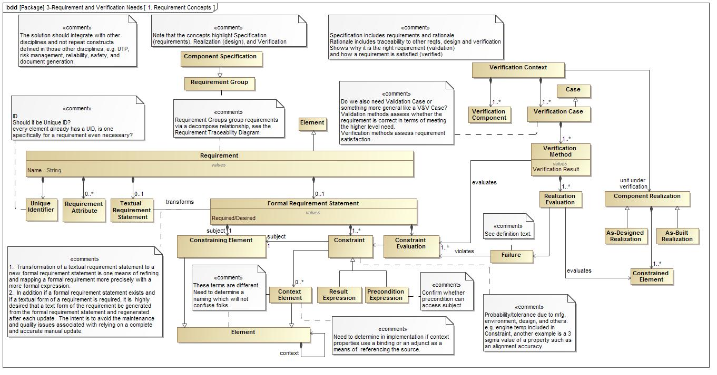
Requirement Concepts – Copied 9/12/16

Slide 4
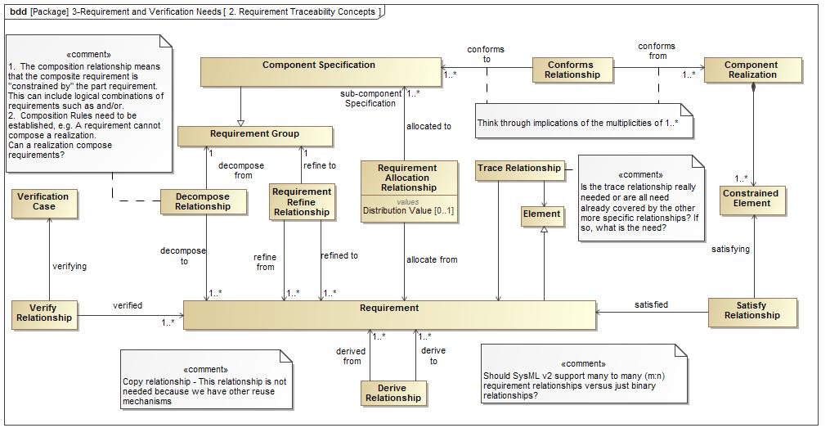
Requirement Traceability Diagram - Copied 9/12/2016

Slide 5
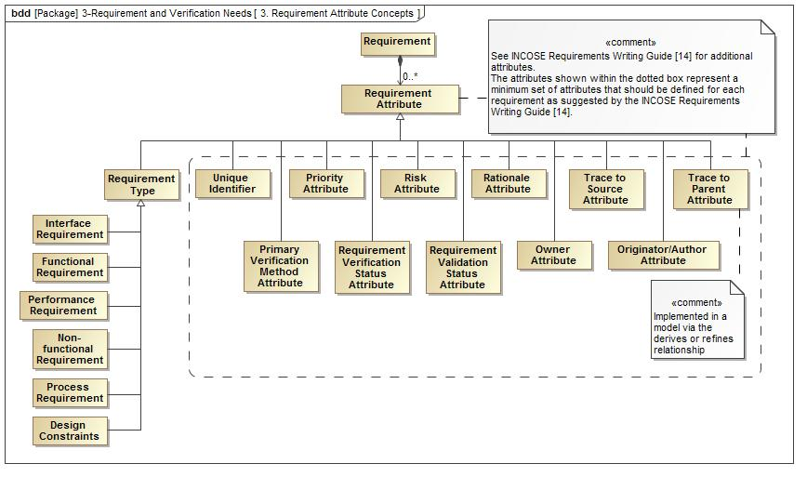
Requirements Attributes - Copied 9/12/2016

Slide 6
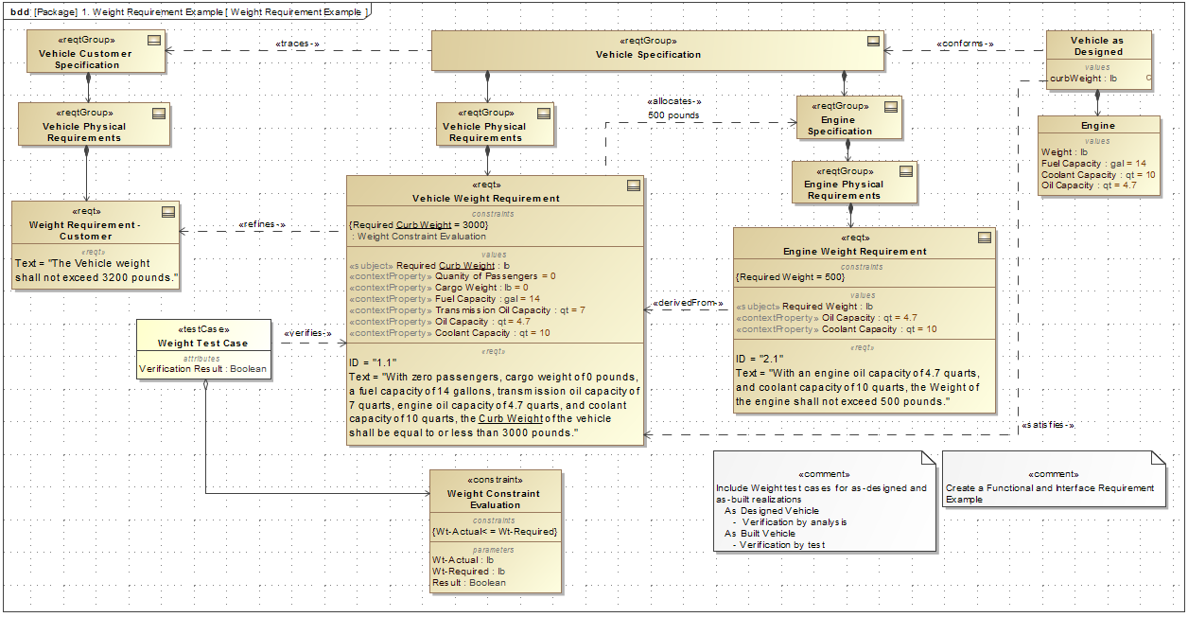
Vehicle Weight Performance Requirement Example - Copied 9/12/2016

Slide 7
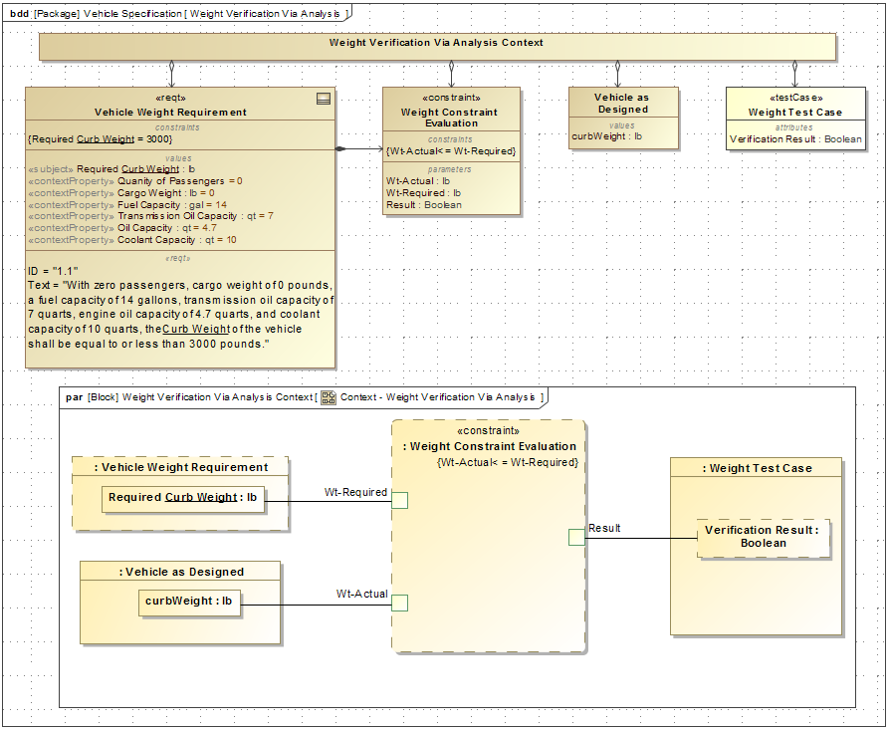
Context Diagram - Vehicle Weight Verification Via Analysis Example - Copied 9/14/2016

Slide 8
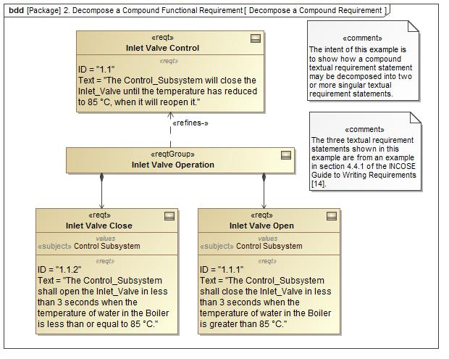
Decompose a Compound Text Based Requirement Example - Copied 9/12/2016

Slide 9
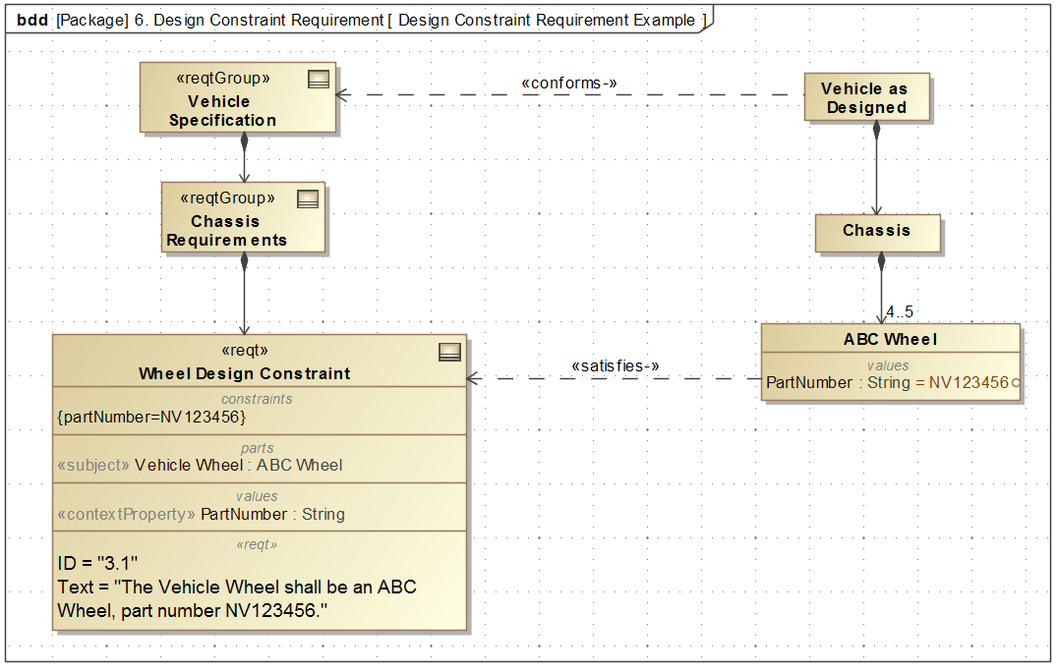
Design Constraint Requirement Example - Copied 9/14/2016

Slide 10
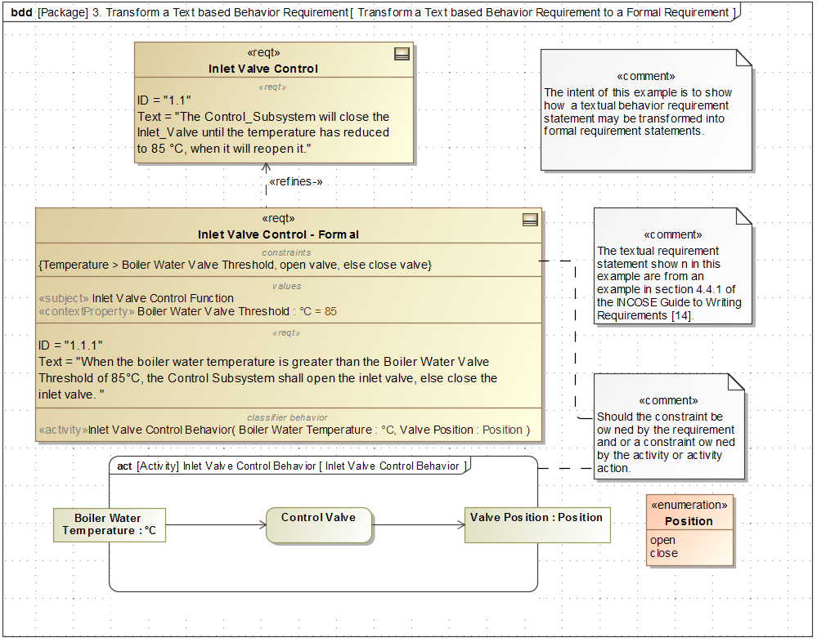
Transform a Text based Behavior Requirement to a Formal Requirement Example - Copied 9/12/2016

Slide 11
Functional Requirement Example -Updated 9/xx/2016

Slide 12
Interface Requirement Example -Updated 9/xx/2016

Slide 13
Derived Required Requirement Example Engine Power from Vehicle Weight & Vehicle Acceleration
Constraint can be reused for
defining the power requirement
and the weight requirement
Pwr-actual
Engine
Power
Pwr-reqd = k * Wt-reqd
Pwr-actual>Pwr-reqd
Accel = 0-60 in 10 sec
Wt-reqd
Vehicle Weight

Slide 14
Derived Desired Requirement Example Engine Power from Vehicle Weight & Vehicle Acceleration
Constraint can be reused for
defining the power requirement
and the weight requirement
Pwr-actual>Pwr-desired
Engine
Power
Pwr-reqd = k * Wt-reqd
Pwr-actual
Accel = 0-60 in 5 sec
Accel = 0-60 in 10 sec
Wt-reqd
Vehicle Weight

Slide 15
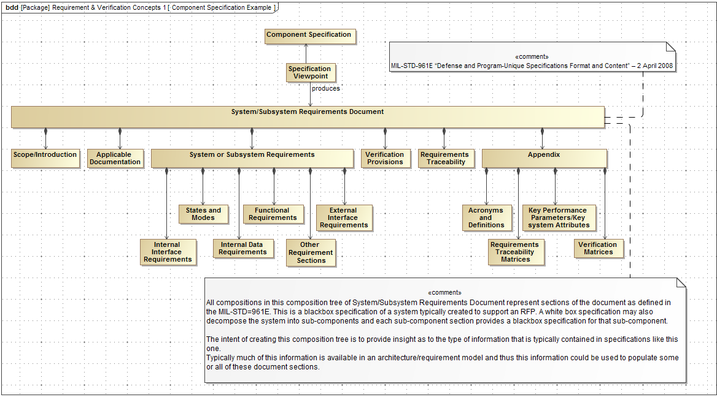

Slide 16
To Be Reviewed

Slide 17
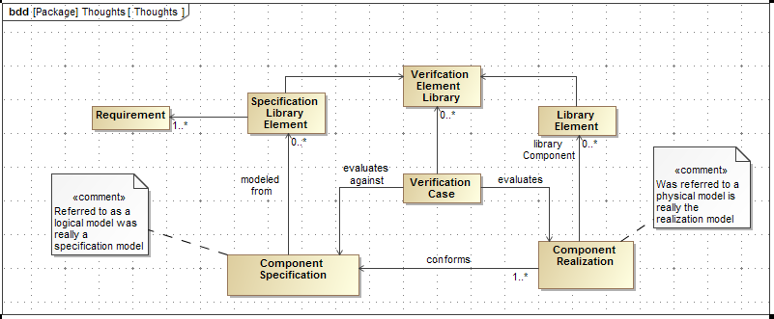
Requirement Library Concepts
This diagram surfaces concepts of specification vs. realization and the use of libraries.
The next diagram is a quick and dirty activity of some of library usage

Slide 18
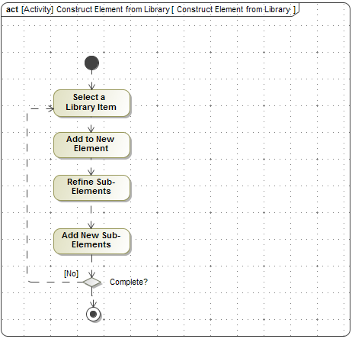
Library Usage

Slide 19
Dated Examples

Slide 20
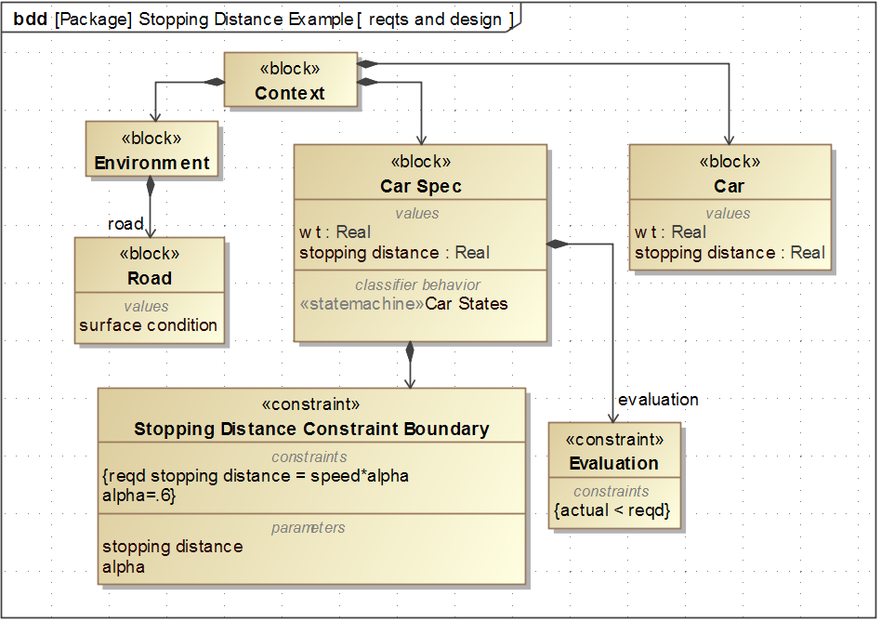
Performance Example – Stopping Distance
THIS IS A VERY INITIAL EXAMPLE FOR OUR EARLY DISCUSSIONS
WHICH NEEDS TO BE REWORKED

Slide 21
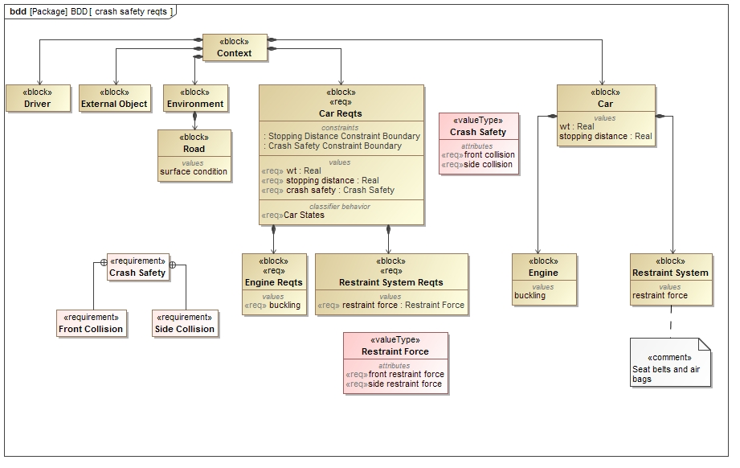
Performance Example - Crash Safety with Child and Derived Requirements

Slide 22
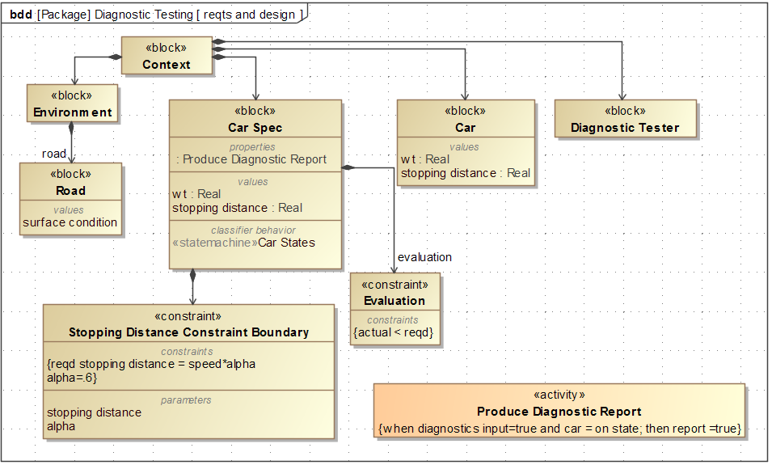
Behavior Example – Produce Diagnostic Report

