Slide 1
Verification Concepts for SysmL v2
David Haines, Boeing
Brian Selvy, LSST

Slide 2
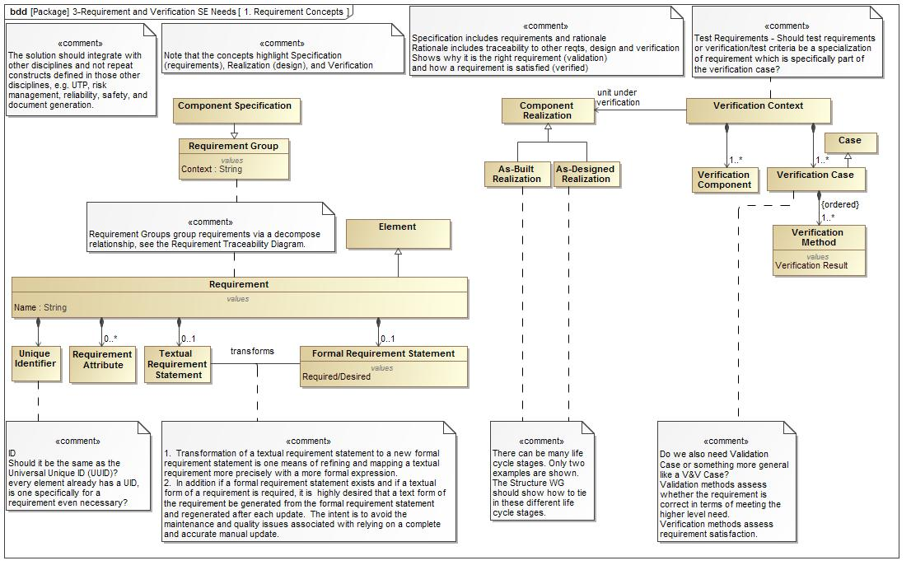
Initial Proposal

Slide 3
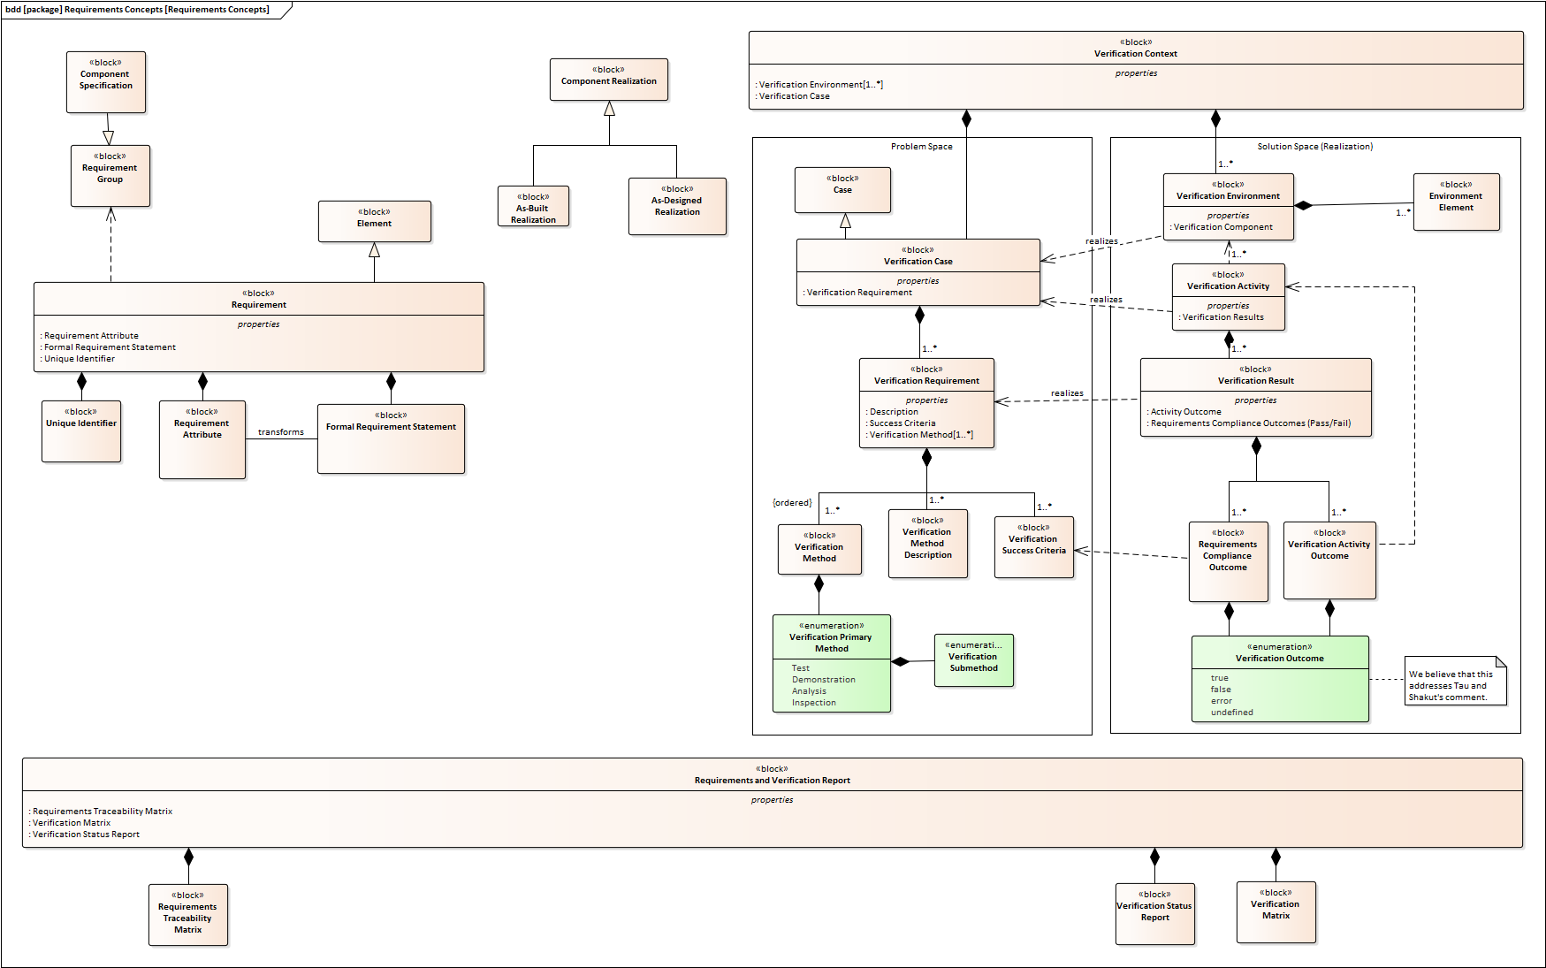
Proposed Update

Slide 4
Proposed Update Highlights
Maintains the Problem Space vs. Solution Space paradigm previously discussed
Covers known aspects of a verification program through the full project life cycle for complex systems development.
Tailorable to smaller, more commercial and agile projects by not using all detailed elements
The verification concepts can be used recursively moving up the right hand side of the Vee
Open Items
Define the relationships between the verification domain and requirements domain at various levels of abstraction
Review the Assembly, Integration, and Verification (AIV) concepts (next slides) and ensure relationships and diagram types support the needs
Address if anything additional is needed for validation.
To first order, the defined concepts should cover the needs of validation, as the environment elements can be appropriately defined to address validation
May require some unique connector types?

Slide 5
AIV Pattern
Input Objects
Output Objects
Verification
(Next Slide)
Verification
(Next Slide)
VERIFICATION
Transformation
Processes
Integration
Processes

Slide 6
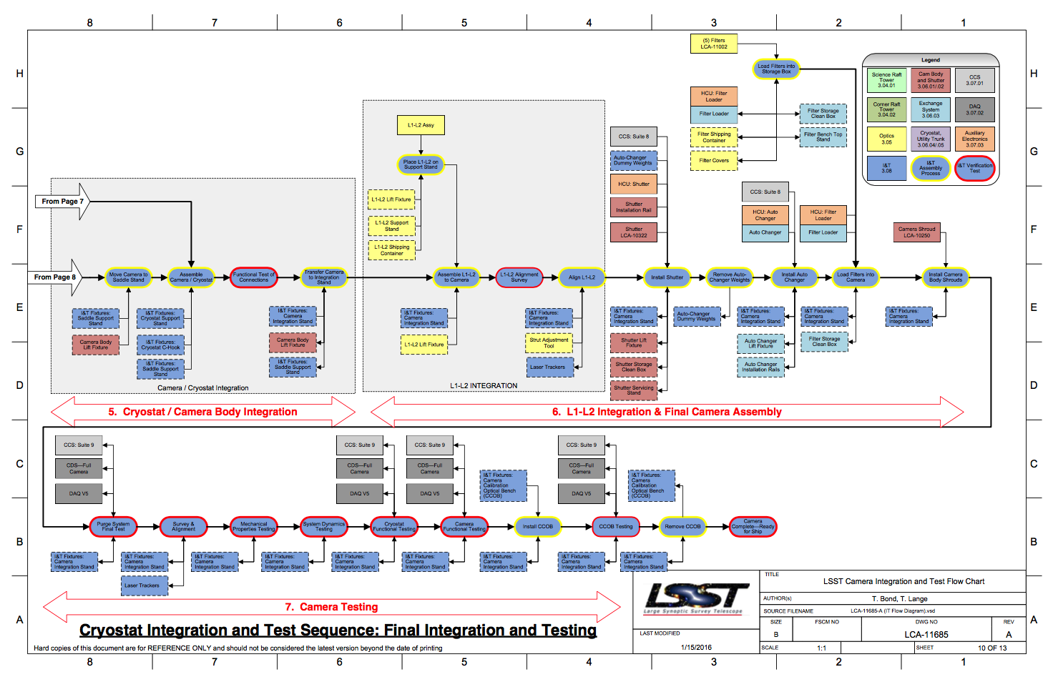
An AIV Example from LSST (in Visio)

Slide 7
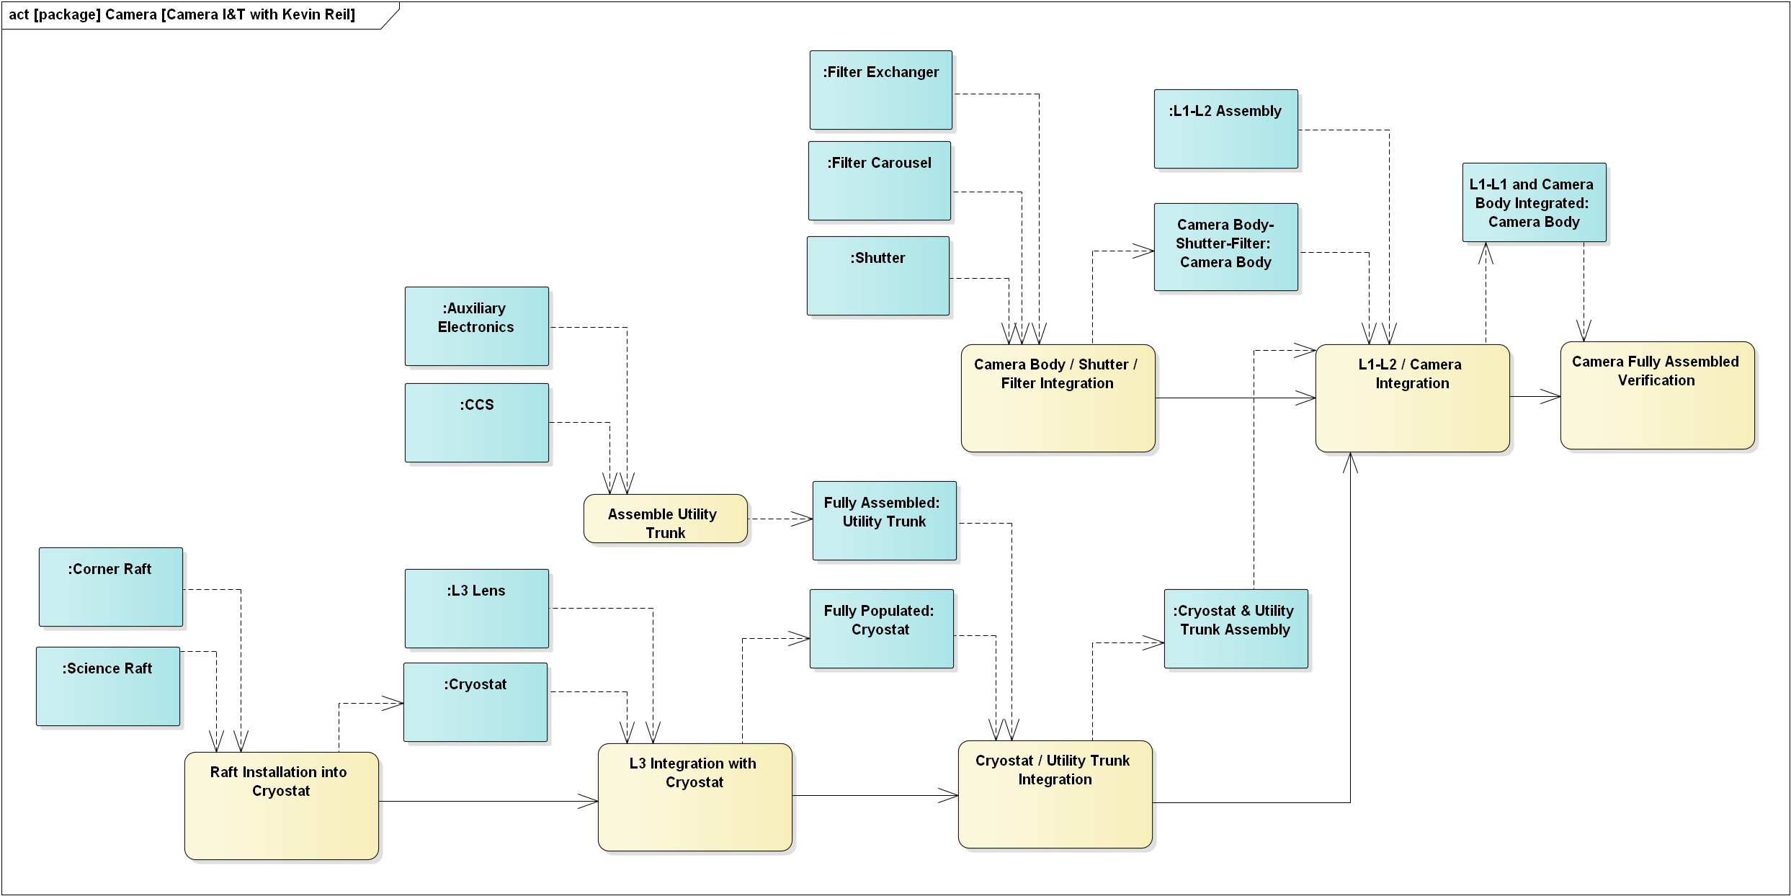
An Incomplete example from LSST (in EA)

Slide 8
An Incomplete example from LSST (in EA)
Shows assembly and integration steps. Does not yet include verification activities.

