Slide 1
FDTF DLT WG Activities and PoC Report
OMG Finance Domain Task Force
Seattle, WA
December 11 2018
Mike Bennett – Hypercube Ltd. – EDM Council Inc.

Slide 2
Overview
New Blockchain PSIG to be chartered this week
Replaces FDTF Distributed Leger Technology WG
This deck:
Summary of DLTWG Activities
DLTWG Proof of Concept (See September for more details)

Slide 3
Blockchain / Distributed Ledger Technology
The value in Blockchain is in the architecture
Not only used for cryptocurrency
Anything that benefits from non-repudiable data records
Anonymity versus performance
Not every application needs to be done on Distributed Ledgers
But there are many new opportunities that do
And many new architectures that open up the potential application space

Slide 4
Discovery: Key Points
A distributed ledger is not a ledger
Though it can be
A Smart Contract is not a contract
BitCoin is not really money
It’s a commodity used as currency, like any mined commodity
It is not a fiat currency, as most modern money is.

Slide 5
Different Block-thing Architectures
Blockchain
Bitcoin
Ethereum
Hyperledger
Block Graphs
IOTA – the Tangle
Hashgraph – gossip protocol
Blockchain Menu
CORDA / R3
Solutions to the bottleneck issues
Proof of Stake v Proof of Work
Use of cryptocurrency for mining reward etc. v Tangle Proof of Work

Slide 6
The “Blockchain Bundle” Menu
Ref
https://gendal.me/2016/04/05/introducing-r3-corda-a-distributed-ledger-designed-for-financial-services/
Consensus
Validity
Uniqueness
Immutability
Authentication

Slide 7
R3 Proposal for FiServ Bundle
Consensus
Between parties – not to all
Validity
Stakeholders
Validation logic
Uniqueness
Uniqueness service implementations
Trade-offs and prioritization
Immutability and Authentication
As per Blockchain

Slide 8
IOTA
New architecture in the Distributed Ledger space
“Tangle” replaces Block
Proofs of work done on two randomly chosen upstream items
Moves forward as a connected set (tangle) of transactions
Thin layer architecture
Layer 2 protocols can be developed on top of Node
Existing Layer 2 (MAM, Flash Channels); can develop extensions on these
Will release open source software plus open standards
IXI, Trinary, IoT, Domain messaging (MAM) etc. – via OMG
May submit some (protocol related) items via other bodies (TBC) e.g. ETSI
Code – open source via eCore

Slide 9
DLTWG Standards Exploration
Standards bodies (ISO, OMG etc.)
De facto standards (e.g. ERC-20 wallet standard)
CORDA: the “Blockchain Menu”
Selected features of Bitcoin Blockchain as needed
Not necessarily anonymous

Slide 10
IOTA Imminent standards proposals
IOTA Node Implementation Standard
IXI – the IOTA eXtending Interface
Binary to Trinary Conversion
Industry Verticals (MAM2 extensions etc.)
Internet of Things (with eCl@ss)
Healthcare

Slide 11
Standards Activities and Liaisons
ISO TC307
BSI WG for ISO 307
OMG MARS PTF: DIDO-RA

Slide 12
DIDO Reference Architecture
Reference architecture for distributed ledgers
Sets out many of the findings and issues we have identified, in much more detail
This is being presented this week at the MARS meetings on Thursday (10:15 – 10:55)
Seems to be convergence with what we have been trying to do
We have focused more on the conceptual modeling opportunities – these are not in DID but can be added?

Slide 13
ISO/TC 307
New ISO Technical Committee (from which projects will come)
Proposal from Australia: ISO/TS/P 258 April 2016
Standardisation of blockchains and distributed ledger technologies to support interoperability and data interchange among users, applications and systems.
Very broad in scope; maturity and readiness for standards questioned
ISO/TC 307 established September 2016
https://www.iso.org/committee/6266604.html
Mirror committees began to prepare
First meeting in Sydney, April 2017

Slide 14
British Standards Organization
There is a BSI WG on DLT.
This Feeds into ISO TC307, the ISO activity we heard about recently.
Outcomes of the BSI Work
BSI commissioned a report to identify areas related to DLT that would potentially require standardization based on stakeholder needs in the UK.

Slide 15
Need for standards:
Short-term:
terminology and vocabulary, taxonomy, ontology, identification – all things that establish what different terms actually mean, how they inter-relate, and how they are codified.
Medium term:
security and data governance to ensure safely and privacy
Long-term:
Tech - language or protocol (long term; it’s too early to think now, the industry has to work it out gradually)
Interoperability is deemed to be a priority for the financial industry. Specifically, reconciliation and asset safekeeping within the financial industry would be important.
Digital identity is one of the key application areas for DLT that can help with KYC/AML. However, there is a possible need for changes to existing standards to reflect evolving business practices. There are already such new identifier standards as OpenID (from CA Technologies) or 3SKey for banks (from SWIFT).

Slide 16
DLTWG Insight:
A formal ontology provides a good point of reference for other formalisms such as business rules
Where the rule can refer to the ontology elements as predicates for those rules, in preference to referring to data elements.
The same thinking can be carried over to formal requirements specifications, in Blockchain and anywhere else where formal requirements are needed.

Slide 17
Proof of Concept Overview
Premise: Use FIBO ontology as standard concept model for Smart Contracts in Blockchain
Exploration of concept model parameters
Chosen PoC; Interest Rate Swaps
FIBO exploration and extension

Slide 18
OMG Motivation
Are there aspects of Blockchain where some standardization would be of value?
If so, what to introduce as OMG standards v what to coordinate with other WGs
Potential value of FIBO for Blockchain / DLs

Slide 19
A Model Driven Approach to Blockchain/DL
We see things happening at a physical or logical design level
Smart Contracts code in e.g. Python, defining required behaviors, conditions etc. when a thing is posted
Physical architecture of the different Blockchain and DLs
We see the need for and benefits of a common business view
Computational independent of “Conceptual”
Business semantics
Conceptual view for both structural and behavioral
FIBO as the conceptual model for contract terms

Slide 20
IR Swaps Proof of Concept
Based on a simple vanilla IR Swap example
Mapped out the process workflow
Use FIBO for representation of contractual terms
Extend for other conceptual matter (process and events)

Slide 21
What is an Interest Rate Swap?
Two loans
Interest: Fixed rate
Interest: Floating rate
Principal
Principal
Party A
Party B

Slide 22
What is an Interest Rate Swap?
Party A and Party B want to exchange interest cashflows
Interest: Fixed rate
Interest: Floating rate
Principal
Principal
Party A
Party B

Slide 23
What is an Interest Rate Swap?
IR Swap
Common Trade / Contract terms
Fixed Rate Leg
Floating Rate Leg
Principal
Principal
Party A
Party B

Slide 24
Structural and Behavioral Business Content
Structural: terms of the contract
Mappable to or derived from FIBO
Behavioral
Payments process flow
off-Blockchain behaviors and activities
Events in the life of the swap and possible block postings for those events
Smart Contract program flow

Slide 25
IR Swap Process Analysis
At first we defined a swimlane for ‘The Block’
What gets posted to ‘The Block’?
It turns out this depends very much on the block architecture and performance constraints
Come material might go on separate data stores sometimes called ‘oracles’
Latest: Swimlane defined by function not by form:
Time-variable information about the contract

Slide 26
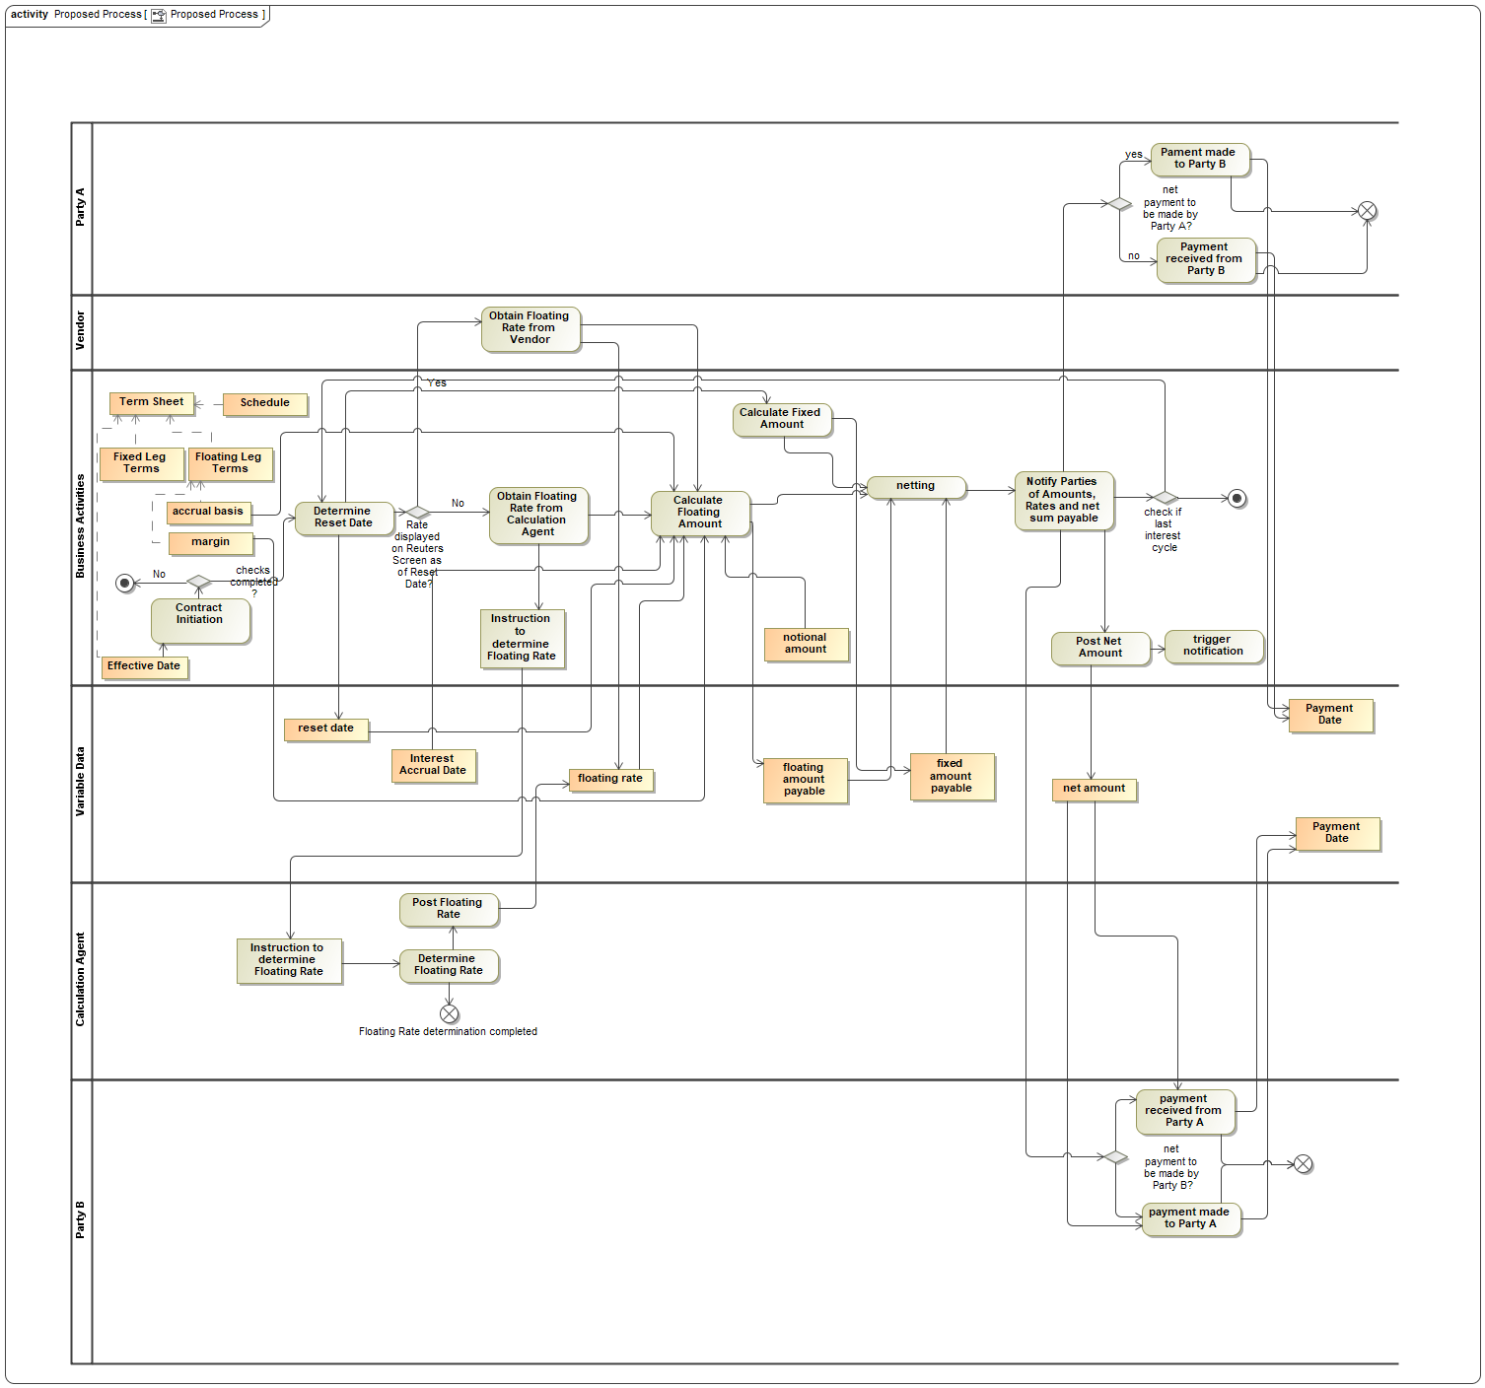
Updated Process

Slide 27
Refining this
Final process model with variable data
Static contract terms (term sheets) in FIBO IR Swaps
Variable terms
Process activities that generate and use this data
Prescriptive: process definition
Descriptive: events that happen
These originate each piece of variable data

Slide 28
Next Step: Conceptual to Physical
Need indicative physical implementation(s)
Show how conceptual model specifies these
Need to get to know the languages used

Slide 29
Data typing questions
Any kind of data ca be posted to the ‘Block’ or ledger
E.g. numbers, for money
Also text etc.
BUT how do we deal with posting of complex or qualified data
Monetary amounts (qualified by currency)
Interest amounts – (on what, for what period)
How to identify related contract etc. in a hige and growing block of stuff?
Also provenance and ther metadata

Slide 30
Breakthrough Moment
If any kind of datatype can be posted to the block, then
XML can be posted (as a complete XML Document)
E.g. ISO 20022
XML includes RDF/XML
So can post a semantic graph
e.g. instance data referenced to FIBO and others

Slide 31
Then
XML / ISO 20022 can be used directly were appropriate
Each ISO 20022 message type accompanies a process definition
If you are following that part of a process, this tells you all the data elements needed to accompany and qualify that element
Can also use the ISO 220022 content as analysis for an ontology representation of the same stuff

Slide 32
Then
Post RDF graphs with qualifying information for each data item
USE existing analysis where available
e.g. ISO 20022 or FpML
IR Swaps PoC: Analyze the qualifying terms needed
This will compete our PoC conceptual model exercise

Slide 33
Term Sheet Semantics
This stuff: Contractual commitments
and agreed terms (triggers etc.)
= the semantics of the Contract
= FIBO IR Swaps

Slide 34
FIBO PoC Extension
FIBO
Conceptual Ontology
Foundations
Upper Ontology
Derivatives
Occurrent Concepts
Swaps
Rate Derivatives
Process
Occurrences
IR Swaps
Swap Events

Slide 35
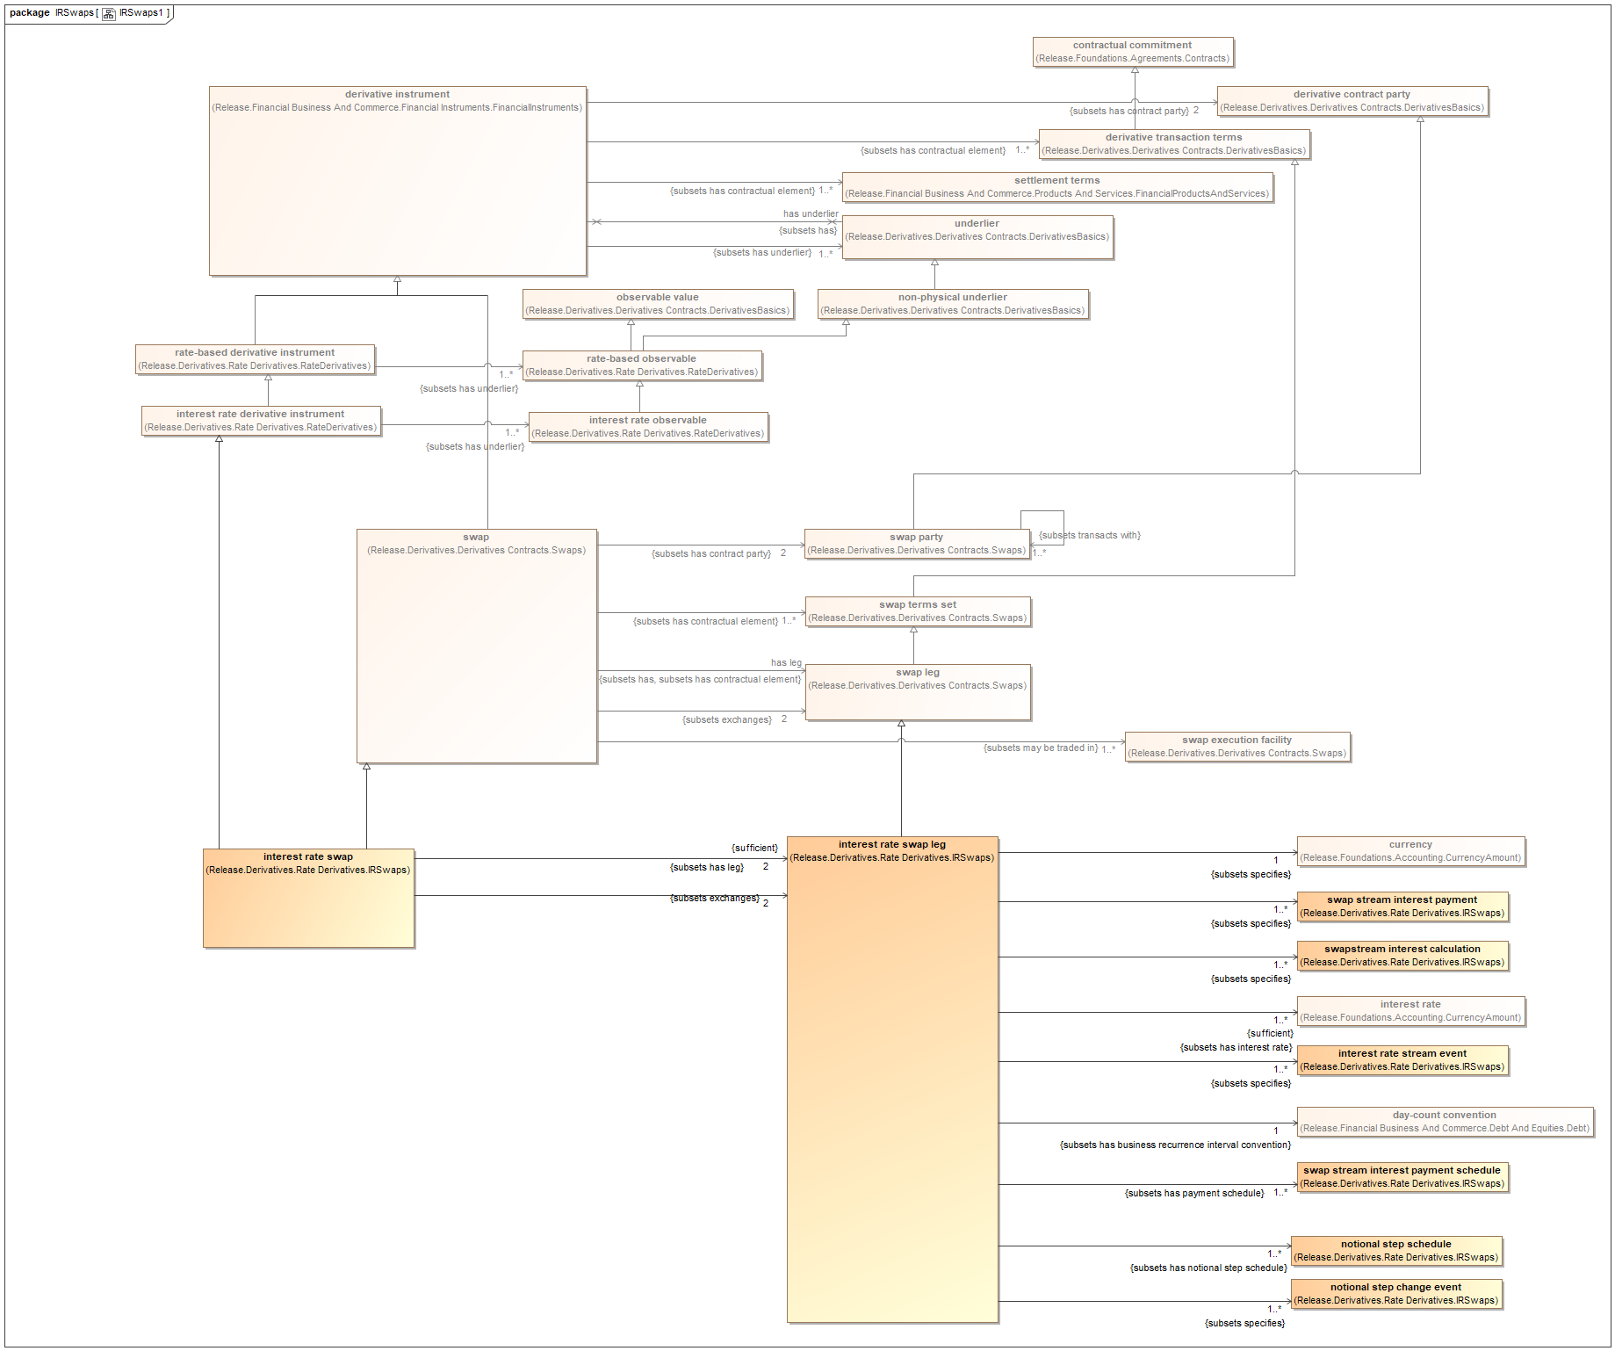
FIBO IR Swaps exploration
Showing locations
Most swap and IR terms inherited from more general contract types

Slide 36
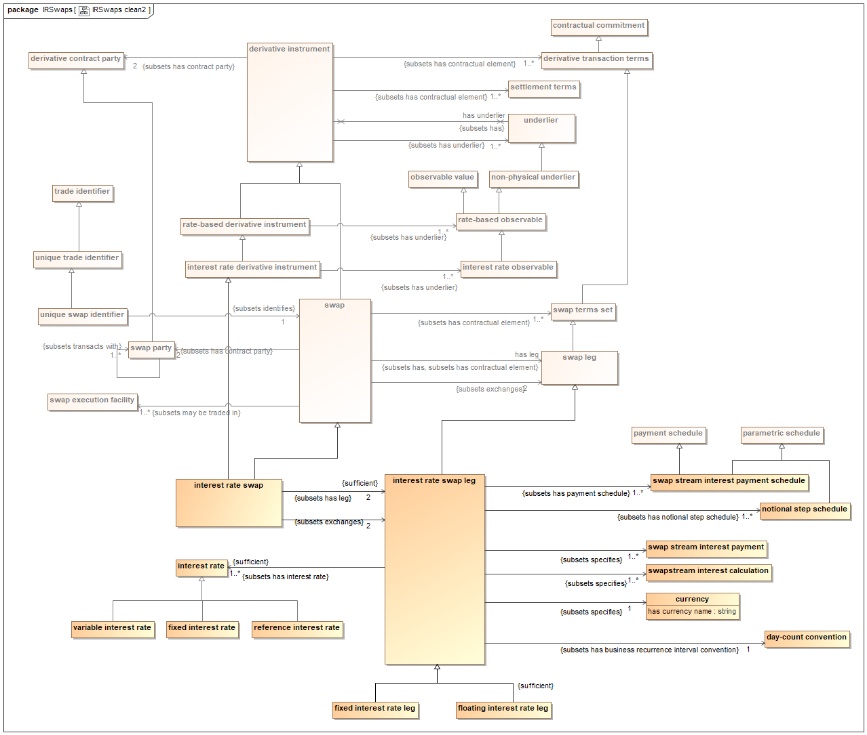
FIBO IR Swaps

Slide 37
Process Ontology with Occurrences

Slide 38
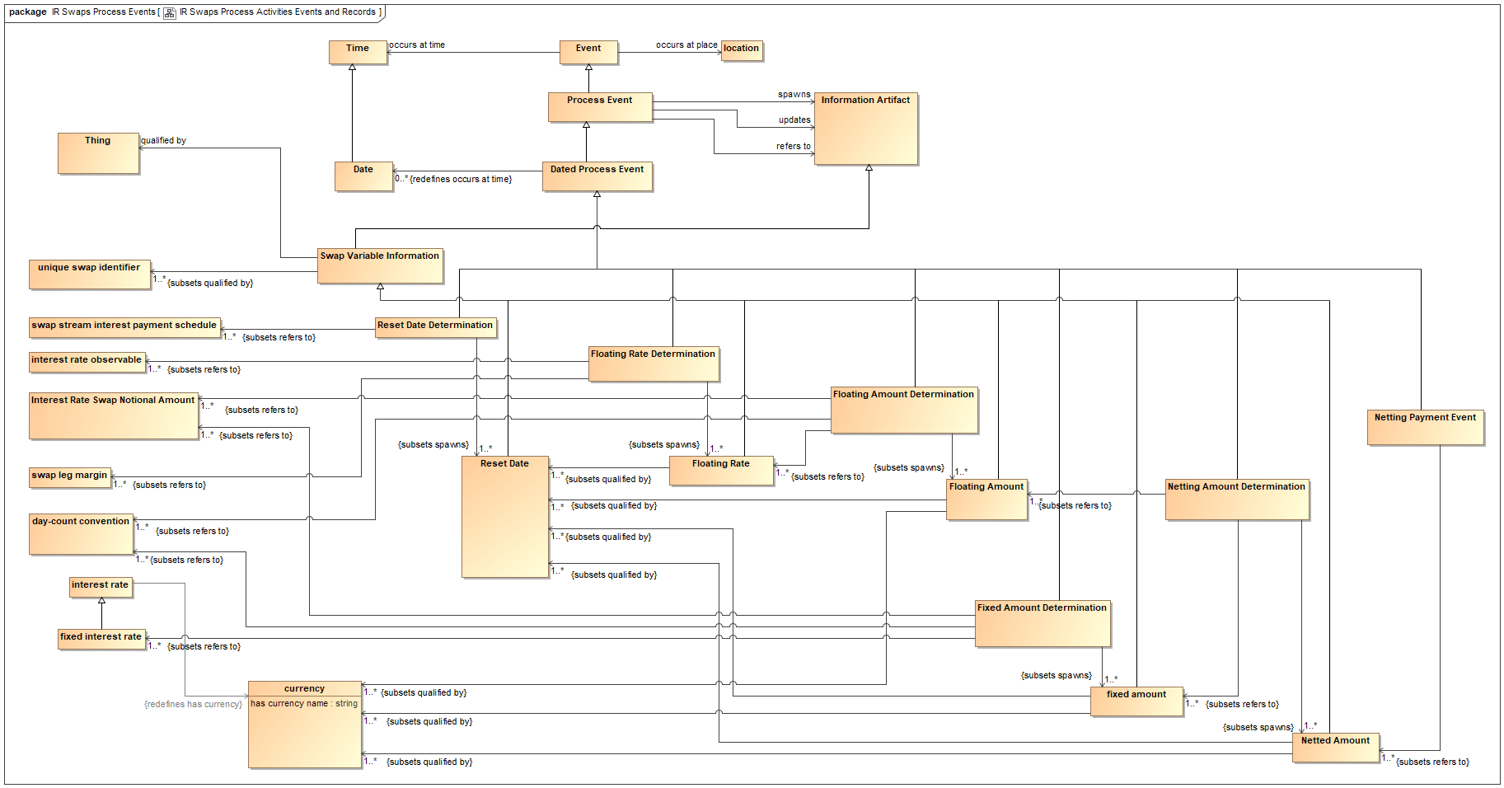
Information Records from Occurrences

Slide 39
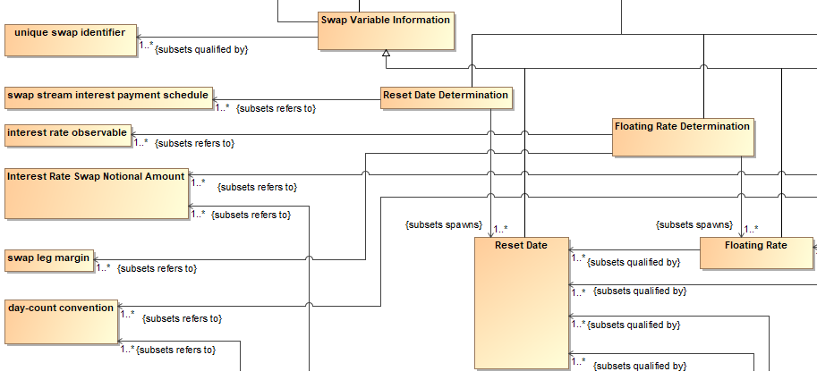
Records and Occurrences Closeup
Occurrences of events make reference to IR Swaps terms

Slide 40
Records and Occurrences Closeup
Occurrences of events make reference to IR Swaps terms
Variable data qualified by specific other data

Slide 41
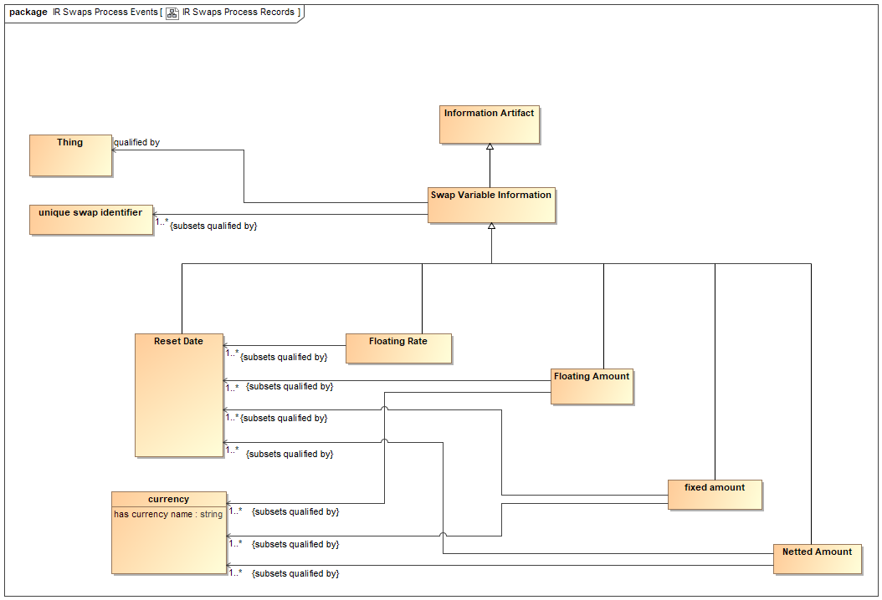
Variable Data Qualifying Information
This is the data accompanying each record that may get posted

Slide 42
Conclusions
We know what needs to be posted to [something e.g. Block] at any given point in the process
This is posted as a textual record
Where the text is XML and the XML is RDF
We are posting graphs!
Narrows the search for physical code in different languages and architectures

Slide 43
Smart Contracts Specification
The part where it posts something is now simple enough
RDF graph with the qualifying terms identified
The other part of the Smart Contracts is the calculations etc.
The calculations within the boxes are well enough understood
Ontology provides formal declaration of the concepts involved
There is also plain mathematics:
Interest rate = Base + Margin
Accrued amounts – as defined for Accrual Basis
Mathematics is another computationally independent way of saying things
Some things we can’t say in Ontology but we can declare the parameters used

Slide 44
Conclusions
Computationally independent representations
Formal process
Ontology
Mathematics
Ontology can represent processes, events and activities given the right upper ontology and semantics treatment
(the meaning of things that happen)
Ontology provides the connective glue into the mathematical content
FIBO provides the ontology of the contractual terms
Extend FIBO for additional concepts
Conceptual underpinnings for Smart Contracts
Architecturally agnostic

Slide 45
Take Aways
You need computationally independent models for complex developments like blockchain / Smart Contract
The more wild the technology, the more you need mature governance to get ahead and mitigate risk
Ontology provides ‘first order’ concept modeling
Semantic analysis yields process, events, records ontology
FIBO provides ontology of contract and trade terms sheet

Slide 46
Thank you!
Mike Bennett
mbennett@hypercube.co.uk
mbennett@edmcouncil.org
Twitter: @MikeHypercube

