Slide 1
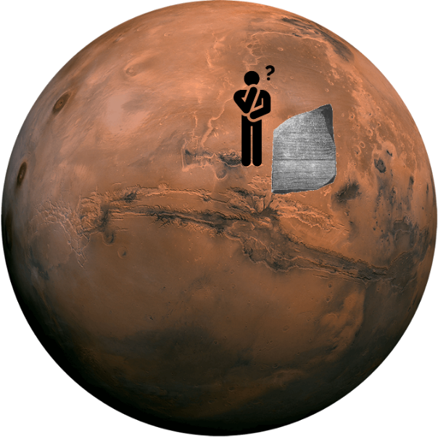


Update and Pathway for UPR 1.0 Evolution
UPR: UML Profile for ROSETTA
Presented to the MARS PTF
30th September 2021
Charles Dickerson Zahir Ismail Siyuan Ji
Formerly of ZTI Systems
OMG Mathematical Formalisms SIG

Slide 2

Background and Context
OMG Mathematical Formalisms SIG
Purpose: introduce plans to evolve the UML profile for the modelling and simulation framework called ROSETTA*.
OMG discovered ROSETTA on MARS.
UPR 1.0 is concerned with structuring information in support of model-based analysis for architecture optimization and constraint driven system design.
In the development of the UML profile for ROSETTA [1] the question was asked at MARS: can constraints also be logical?
* ROSETTA: the Relational Oriented Systems Engineering Technology Trade-off and Analysis Framework [2, 3, 4, 5]

Slide 3
Agenda
OMG Mathematical Formalisms SIG
Mathematical Basis of ROSETTA
  Constraint driven design in UPR 1.0
  Application to commercialisation of EV wireless charging
  Concepts from UPR 1.0
Relation to Kernel Modeling Language and Predicates
Discussion of Pathway for UPR 1.0 Evolution
EV: Electric Vehicle

Slide 4
OMG Mathematical Formalisms SIG
Constraint Driven Design (CDD) in UPR 1.0
UPR 1.0 facilitates the modelling of metric constraints for CDD [6]
A Variable is a measurable attribute that represents an element being constrained and can take on a range of real values.
A Constraint is a constant that limits the values of a variable.
A Comparison Operator, such as ‘<‘, is used to model constraints.
A Design Objective is a measurable attribute of a system that the system is intended to have or achieve e.g., a requirement.
A Design Variable is a variable under the design authority of the engineer. It imparts system properties that achieve objectives e.g., a vehicle speed of > 100 mph can be achieved by reduced weight.

Slide 5
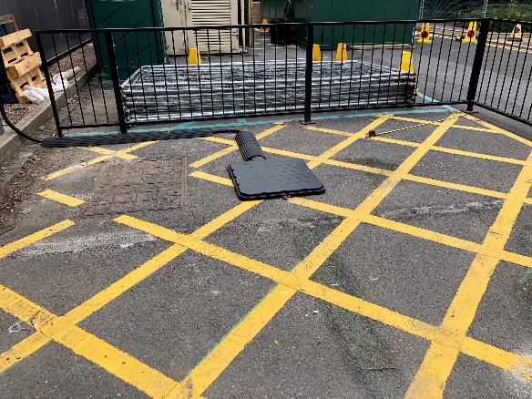
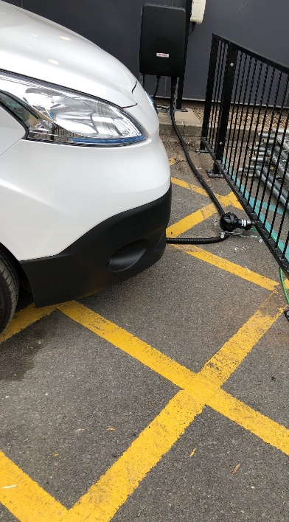
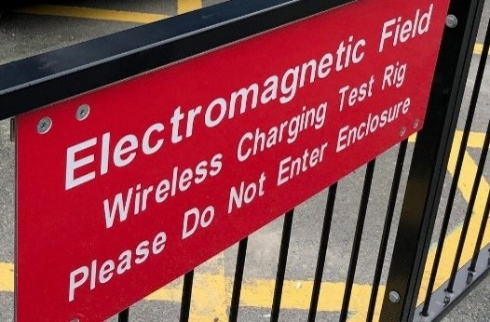
Application of UPR to Electric Vehicle(EV) Charging
Home - AMiCC - Amicable Charging Research Project (projectamicc.com)
OMG Mathematical Formalisms SIG
AMiCC is a commercialisation project for EV wireless charging supported by Innovate UK and funded by the Office for Zero Emission Vehicles (OZEV).
UPR facilities are being developed for metric constraints but are also needed for logical constraints (e.g., topologies).
Design objective constraints include
  Rate of power transfer
  Electromagnetic field strength
Design variable constraints include
  VA size and circuit topologies
  Cooling for power transfer
  Communication protocols
Ground assembly for WPT
EV retrofitted with VA, VIU and HMI for WPT
VA: Vehicle assembly GA: Ground assembly
WPT: Wireless power transfer
VIU: Vehicle interface unit
HMI: Human Machine Interface

Slide 6
Extensibility of UPR Facilities to WPT
OMG Mathematical Formalisms SIG
The emissions control example in UPR is extensible
  Emissions → MFD emissions
  The UPR facility is the same for both
  Metric constraints are a class of design problems
WPT has new design features for emission control
  Coupling of induction coils
  Circuit topologies are mixed metric and logical
UPR 2.0 seeks software examples of logical constraints.
Radar is a simple example of transmission/emissions.
WPT: Wireless power transfer
MFD: Magnetic flux density

Slide 7
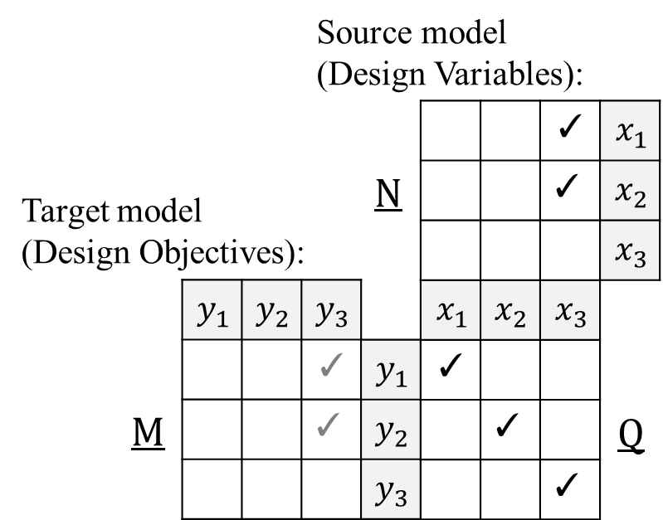
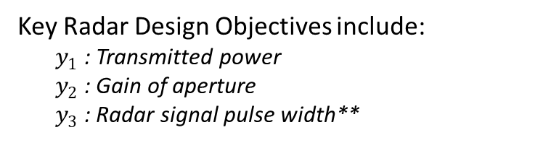
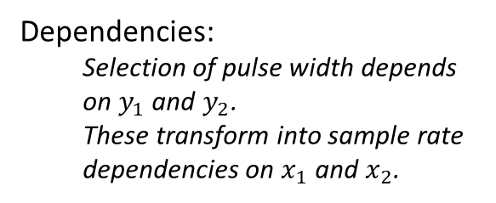
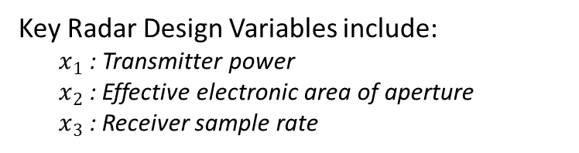
ROSETTA Framework* for Modelling and Analysis Radar System Example of Power Transfer
OMG Mathematical Formalisms SIG
Key Radar Design Variables include:
  $x_{1}$: Transmitter power
  $x_{2}$: Effective electronic area of aperture
  $x_{3}$: Receiver sample rate
Target Model
Source Model
Key Radar Design Objectives include:
  $y_{1}$: Transmitted power
  $y_{2}$: Gain of aperture
  $y_{3}$: Radar signal pulse width**
Dependencies:
Selection of pulse width depends on $y_{1}$ and $y_{2}$.
These transform into sample rate dependencies on $x_{1}$ and $x_{2}$.
$$\left(y_{i},y_{j}\right)∈M \text{with} \left(y_{i},x_{k}\right),(y_{j},x_{l})∈Q \text{implies} \left(x_{k},x_{l}\right)∈N$$
**Pulse width could also be treated as a design variable but is given as a design objective because it determines frequency sidebands (emissions).
*Refer to UPR 1.0 Figure 6-1 [6].

Slide 8
Relational Orientation
OMG Mathematical Formalisms SIG
Relational orientation as presented in [5] is a general systems methodology for system specification, analysis, and design that
Employs a principle of model specification and relational transformation (an example being the ROSETTA framework on previous slide),
Is similar to but more formal than the methodology of Klir [7], which rests upon a principle of alternatively using abstraction and interpretation, and
Generalizes the functional and hierarchical viewpoint of legacy systems engineering, which rests upon a principle of definition and decomposition for system specification.

Slide 9
Relational Structure of Metric Constraints
OMG Mathematical Formalisms SIG
UPR [6] models mathematical-based constraints, referred to as Mathematical Constraints, using the following generic mathematical relation: ‘a variable’ is related to ‘a value’ by a ‘comparison operator’, where:
A Variable represents the element being constrained. It can take on any real number when being unconstrained.
A Comparison Operator, such as ‘=’ and ‘<’, are mathematical symbols defined to indicate equality and inequalities.
A Value is a real number. In UPR, it is unitless.

Slide 10
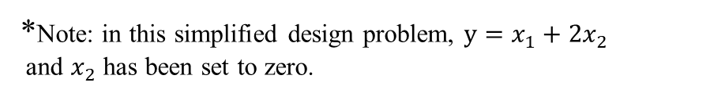
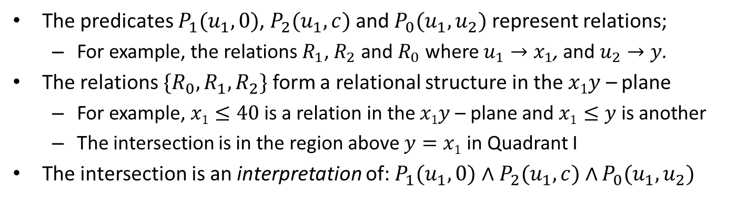



Predicates, Relations and Relational Structures
Simplified radar example with metric constraints*
OMG Mathematical Formalisms SIG
The predicates $P_{1}(u_{1},0)$, $P_{2}(u_{1},c)$ and $P_{0}(u_{1},u_{2})$ represent relations;
  For example, the relations $R_{1}$, $R_{2}$ and $R_{0}$ where $u_{1}→x_{1}$, and $u_{2}→y$.
The relations ${{\{R}_{0},R}_{1},R_{2}\}$ form a relational structure in the $x1y$ – plane
  For example, $x1≤40$is a relation in the $x1y$ – plane and $x1≤y$is another
  The intersection is in the region above $y=x1$in Quadrant I
The intersection is an interpretation of: $P_{1}(u_{1},0)∧$ $P_{2}(u_{1},c)∧$ $P_{0}(u_{1},u_{2})$
c
$$R_{1}\left(x_{1},0\right):x_{1}≥0$$
y
$R_{2}\left(x_{1},c\right):x_{1}≤c=40$
$R_{0}\left(x_{1},y\right):x_{1}≥y=20$
40
40
20
20
x₁
x₁
40
40
*Note: in this simplified design problem, $y=x_{1}+2x_{2}$
and $x_{2}$ has been set to zero.

Slide 11


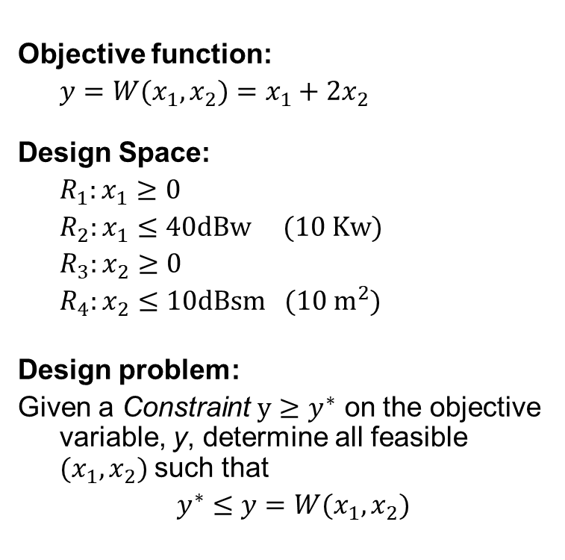



OMG Mathematical Formalisms SIG
Example of UPR model based analysis for system design:
Radar power aperture product (1 of 2)
Objective function:
$y=W(x_{1}, x_{2})=x_{1}+2x_{2}$
Design Space:
$R_{1}:x_{1}≥0$
$R_{2}:x_{1}≤40dBw (10 Kw)$
$R_{3}:x_{2}≥0$
$R_{4}:x_{2}≤10dBsm (10 m^{2})$
Design problem:
Given a Constraint $y≥y^{∗}$ on the objective variable, y, determine all feasible $(x_{1}, x_{2})$such that
$y^{∗}≤y=W(x_{1}, x_{2})$
Computer
$$x_{2}$$
Feasible Region with one Constrained Objective
$$R_{2}:x_{1}≤40$$
$$R_{4}:x_{2}≤10$$
$$x_{1}$$
$$W\left(x_{1}, x_{2}\right)≥y^{∗}=20$$

Slide 12
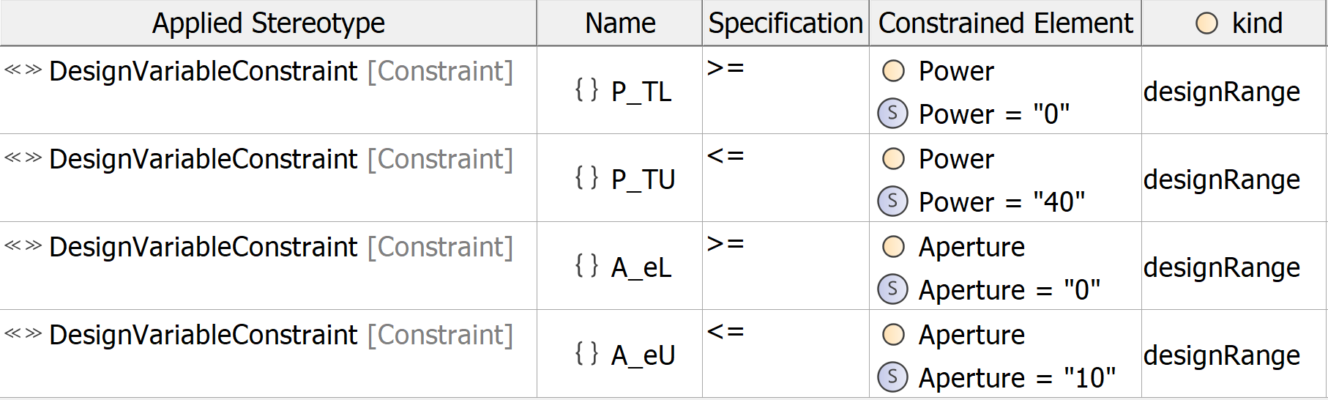
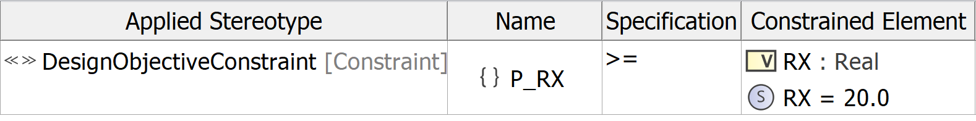

OMG Mathematical Formalisms SIG
Example of UPR model based analysis for system design:
Radar power aperture product (2 of 2)
Objective function:
$y=W(x_{1}, x_{2})=x_{1}+2x_{2}$
Design Space:
$R_{1}:x_{1}≥0$
$R_{2}:x_{1}≤40 dBw$
$R_{3}:x_{2}≥0$
$R_{4}:x_{2}≤10 dBsm$
Design problem:
Given a Constraint $y≥y^{∗}$ on the objective variable, y, determine all feasible $(x_{1}, x_{2})$such that
$y^{∗}≤y=W(x_{1}, x_{2})$

Slide 13
Agenda
OMG Mathematical Formalisms SIG
Mathematical Basis of ROSETTA
Relation to Kernel Modeling Language and Predicates
  KerML 1.0 Element Hierarchy
  What is a Predicate?
  The Predicate Calculus
Discussion of Pathway for UPR 1.0 Evolution

Slide 14
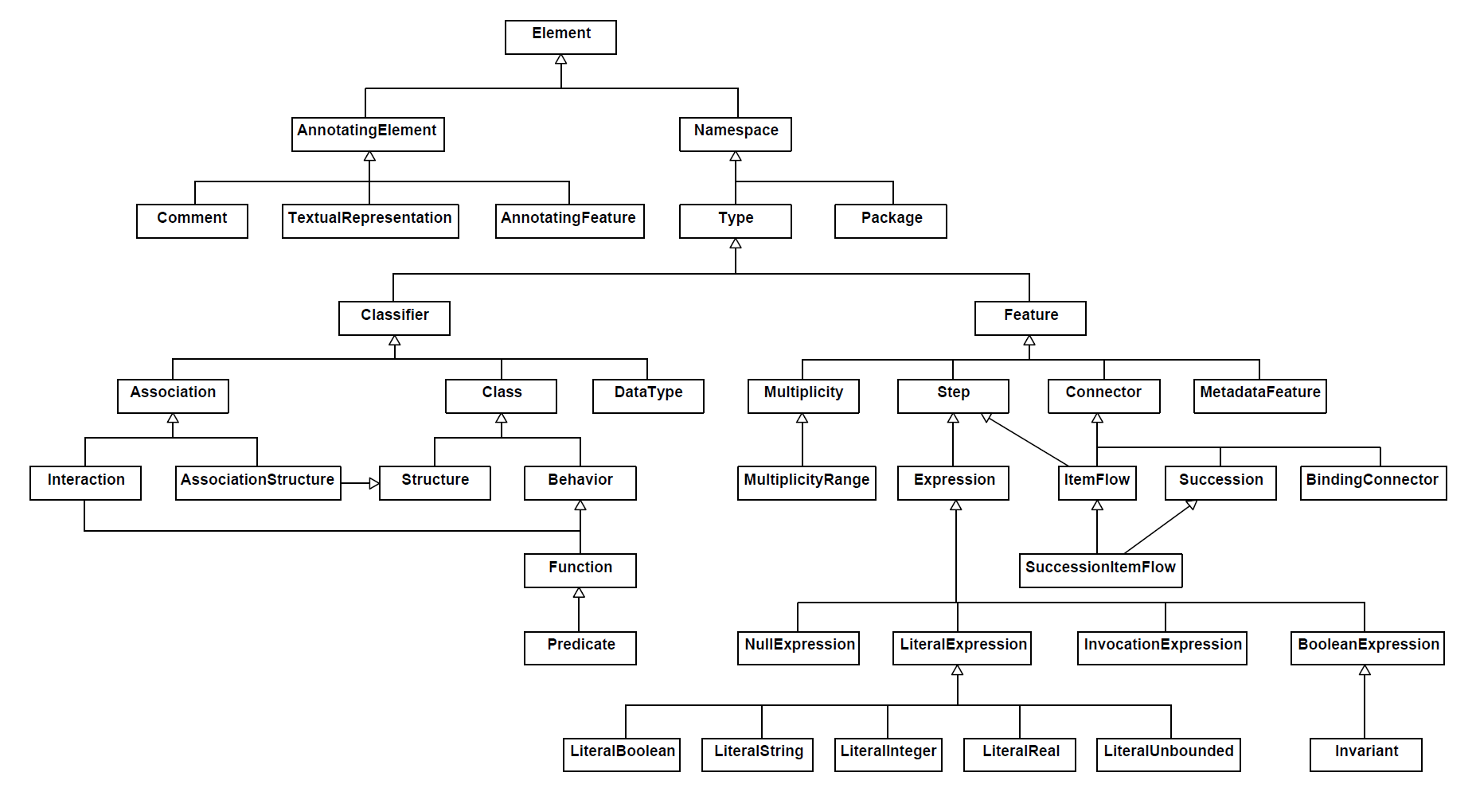
KerML [8]
[6.2 Document Conventions] Core mathematical semantics are generally expressed in terms of notations from first order logic.
UPR 1.0 is mathematically based; and conforms to first order model theory in logic.
KerML Element Hierarchy [8, Figure 3]
Predicates are central to formalising object-oriented models.

Slide 15
What is a Predicate? [9, 10]
Example of use cases for a radar system
OMG Mathematical Formalisms SIG
Note that the System and <verb - noun> phrase always form a sentence.
ATC <request detection> from system.
System
System <detect aircraft>.
<Verb – Noun> Phrase 1
<Verb – Noun> Phrase 2
Actor 1 (ATC)
(e.g., subject of verb)
Actor 2 (Aircraft)
(e.g., object of verb)
A predicate is that part of a sentence containing a verb and stating something about the subject.
ATC: Air Traffic Control

Slide 16
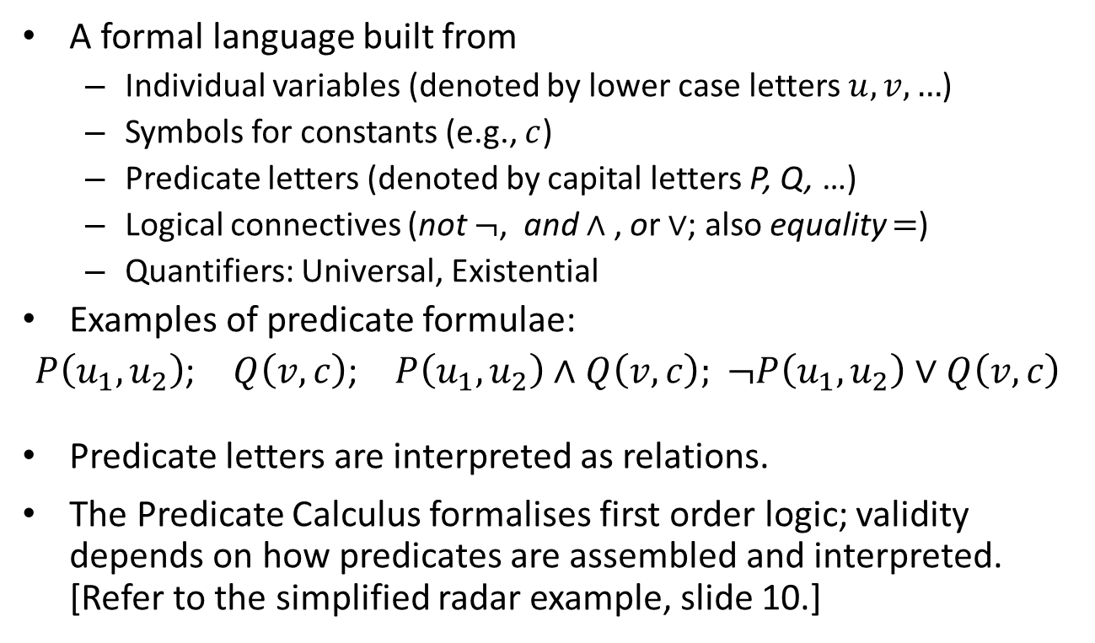
What is the Predicate Calculus? [11]
OMG Mathematical Formalisms SIG
A formal language built from
  Individual variables (denoted by lower case letters $u, v, …$)
  Symbols for constants (e.g., $c$)
  Predicate letters (denoted by capital letters P, Q, …)
  Logical connectives (not $¬$, and $∧$ , or $∨$; also equality $=$)
  Quantifiers: Universal, Existential
Examples of predicate formulae:
$P\left(u_{1},u_{2}\right)$; $Q\left(v,c\right)$; $P\left(u_{1},u_{2}\right)$ $∧$ $Q\left(v,c\right);$ $¬P\left(u_{1},u_{2}\right)∨Q\left(v,c\right)$
Predicate letters are interpreted as relations.
The Predicate Calculus formalises first order logic; validity depends on how predicates are assembled and interpreted. [Refer to the simplified radar example, slide 10.]

Slide 17
Agenda
OMG Mathematical Formalisms SIG
Mathematical Basis of ROSETTA
Relation to Kernel Modeling Language and Predicates
Discussion of Pathway for UPR 1.0 Evolution

Slide 18
Pathway for UPR 1.0 Evolution
OMG Mathematical Formalisms SIG
Scope of evolution is beyond UPR 1.0 RTF due to
  Inclusion of logical constraints
  Alignment of formal semantics with KerML/Predicates
  Utilising SysML 2.0 for design analysis
  Supporting CDD automation
Therefore, UPR 2.0 seeks to
  Collaborate with key stakeholders to formulate RFP Tentatively Dec 2021 – March 2022
  A team to put forward a proposal Aiming for Dec 2022 for submission

Slide 19
References (1 of 2)
OMG Mathematical Formalisms SIG
[1] Dickerson, C.E. and S. Ji, Mathsig/2015-09-01, Profiling a Software Architecture for the Relational Oriented Systems Engineering Technology Trade-off and Analysis Framework (ROSETTA) v4.3.
[2] Dickerson, C.E. and D. Mavris, “Relational Oriented Systems Engineering (ROSE): Preliminary report,” in Proc. IEEE SoSE '11, Albuquerque, 2011.
[3] Dickerson, C.E., “A relational oriented approach to system of systems assessment of alternatives for data link interoperability,” IEEE Systems Journal, 16 May 2013.
[4] Mavris, D., K. Griendling and C. Dickerson, “Relational-Oriented Systems Engineering and Technology Trade-off Analysis Framework,” AIAA Journal of Aircraft, 28 August 2013.
[5] Dickerson, C.E., and D. Mavris, “A Brief History of Models and Model Based Systems Engineering and the Case for Relational Orientation,” IEEE Systems Journal, vol. 7, no. 4, 2013.
[6] (OMG) Object Management Group 2019, UML Profile for ROSETTA (UPR) Version 1.0
[7] G. Klir, Facets of Systems Science, New York: Plenum Press, 1991.
[8] (OMG) Object Management Group 2021, Kernel Modeling Language (KerML) Version 1.0 Release 2021-05

Slide 20

References (2 of 2)
OMG Mathematical Formalisms SIG
[9] Dickerson, Charles E. et al, 2021. “Architecture definition in complex system design using model theory.” IEEE Systems Journal 15, no. 2: 1847 – 1860.
[10] Dickerson, C.E. and Siyuan Ji, Essential Architecture and Principles of Systems Engineering. Boca Raton Florida: CRC Press Auerbach Publication, September 2021.
[11] Bell, John and Alan Slomson, Models and Ultraproducts. Amsterdam: North Holland 1969

