Slide 1


Review, Update and Pathway for UPR 1.0 Evolution
OMG Mathematical Formalisms SIG
UPR: UML Profile for ROSETTA
Presented to the ADTFPTF
23rd March 2022
Charles Dickerson Zahir Ismail Siyuan Ji
Formerly of ZTI Systems

Slide 2
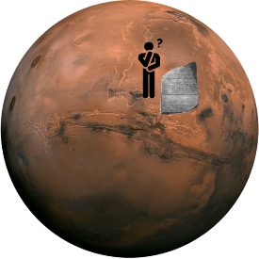
Background and Context
OMG Mathematical Formalisms SIG
Purpose: introduce discuss plans to evolve the UML profile for the modelling and simulation framework called ROSETTA*.
OMG discovered ROSETTA on MARS.
UPR 1.0 is concerned with structuring information in support of model-based analysis for architecture optimization and constraint driven system design.
In the development of the UML profile for ROSETTA [1] the question was asked at MARS: can constraints also be logical?
* ROSETTA: the Relational Oriented Systems Engineering Technology Trade-off and Analysis Framework [2, 3, 4, 5]

Slide 3
Agenda
OMG Mathematical Formalisms SIG
UPR 1.0
  Constraint Driven Design (CDD)
  Relational Transformation
  Application to commercialisation of EV wireless charging
Relation to Kernel Modeling Language and Predicates
Discussion of Pathway for UPR 1.0 Evolution
EV: Electric Vehicle

Slide 4
UPR 1.0
UPR aims to
  Fill the gaps by accessing, structuring and integrating information across multiple system models for support of CDD
  Identify conflicting and harmonious requirements
  Support optimization and transformation of System Architecture into Detailed Design
UPR 1.0 proposed
  10 stereotypes, and 1 library
  Facilitating annotation of models to identify information
  But the intent is Not to define new analysis techniques

Slide 5
OMG Mathematical Formalisms SIG
Constraint Driven Design (CDD) in UPR 1.0
UPR 1.0 facilitates the modelling of metric constraints for CDD [6]
A Variable is a measurable attribute that represents an element being constrained and can take on a range of real values.
A Constraint is a constant that limits the values of a variable.
A Comparison Operator, such as ‘<‘, is used to model constraints.
A Design Objective is a measurable attribute of a system that the system is intended to have or achieve e.g., a requirement.
A Design Variable is a variable under the design authority of the engineer. It imparts system properties that achieve objectives e.g., a vehicle speed of > 100 mph can be achieved by reduced weight.

Slide 6
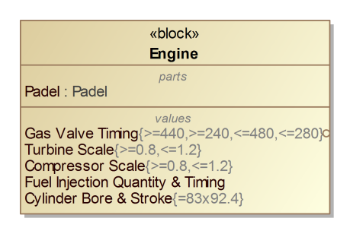
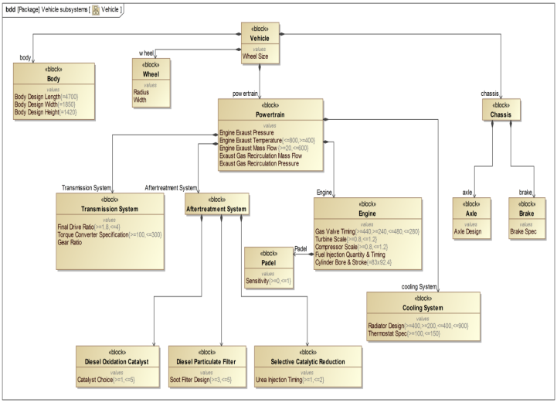
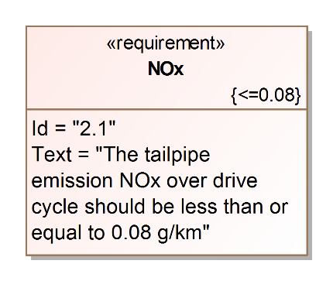
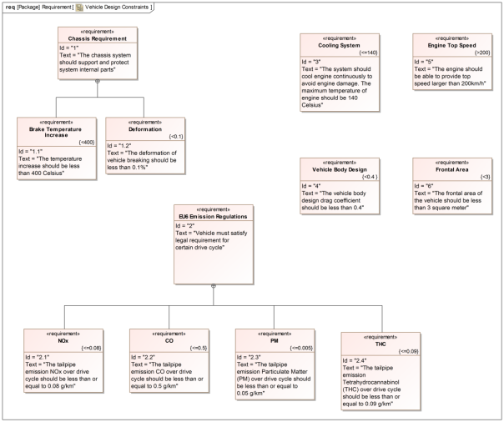
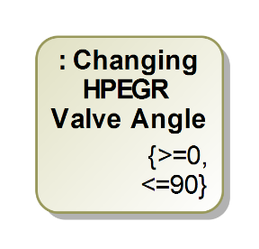
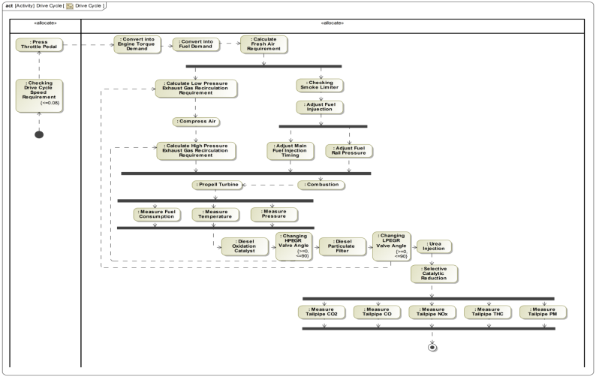
UPR for CDD Modeling
Model annotation for information extraction
OMG Mathematical Formalisms SIG
Design
Variable
Constraints
UPR Stereotypes
DOtoDV
Sensitivities
Design
Objective Constraints
Annotation
Design
Variable
Constraints
Existing System Model
Notes:
r

Slide 7
OMG Mathematical Formalisms SIG
Constraint Driven Design
Radar system design with design space
Power Aperture² = PA² in linear units for bistatic detection
Power Aperture = PA in linear units for radiation safety.
Design Variables:
x₁ : Radar Power
x₂ : Radar Aperture
Design Ranges:
S₁: x₁ > 0
S₂: x₁ < 40 dBw (10 Kw)
S₃: x₂ > 0
S₄: x₂ < 10 dBsm (10 m²)
Design Space is bounded by Design Ranges
x₂
Design Space
10dBsm
x₁
0
40 dBw

Slide 8
OMG Mathematical Formalisms SIG
Constraint Driven Design
Feasible Design Space for radar system design
Analytic Equations:
y₁ = W₁(x₁, x₂) = x₁ + 2x₂
y₂ = W₂(x₁, x₂) = x₁ + x₂
Design Constraints:
A design solution for (x₁, x₂) must simultaneously satisfy the Design Constraints:
y₁ > 20 (e.g. for detection)
y₂ < 30 (e.g. for safety)
Power Aperture² = PA² in linear units for bistatic detection
Power Aperture = PA in linear units for radiation safety.
x₂
Design Objective Constraint
(y₂): y₂ < 30
Feasible Design Space
x₁
Design Objective Constraint (y₁): y₁ > 20

Slide 9
OMG Mathematical Formalisms SIG
Constraint Driven Design
Information required
Mathematical Viewpoint
ROSETTA seeks to access and annotate key information from MBSE System Model.
Design algorithms use the information a Feasible Design Space to seek solutions.
Information Required
Design Objective Constraints: y₁, …, y_{m}
Design Variables: x₁, …, x_{n}
with Design Ranges
S₁ , S₂ , …
Analytic Equations:
y₁ = W₁(x₁, …, x_{n})
y₂ = W₂(x₁, …, x_{n})
…
y_{m} = W_{m}(x₁, …, x_{n})
Feasible Design Space expressed in terms of
Feasible Ranges
x₂
y₂ < 30
Feasible Design Space
x₁
y₁ > 20

Slide 10
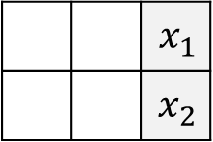
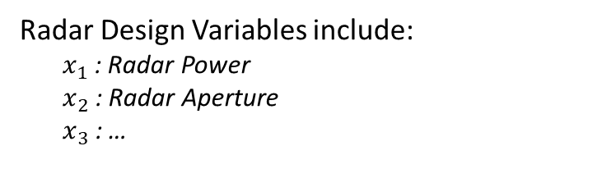
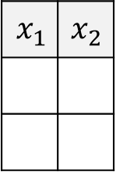


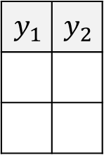

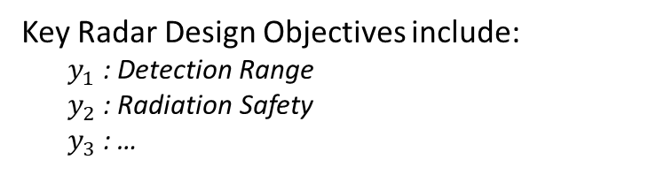

ROSETTA Framework* for Modelling and Analysis Radar System Example of Power Transfer
OMG Mathematical Formalisms SIG
Radar Design Variables include:
  $x_{1}$: Radar Power
  $x_{2}$: Radar Aperture
  $x_{3}$: …
Source model
(Design Variables):
 |  | $$x_{1}$$
 |  | $$x_{2}$$
Target model
(Design Objectives):
Key Radar Design Objectives include:
  $y_{1}$: Detection Range
  $y_{2}$: Radiation Safety
  $y_{3}$: …
$$N$$
$$y_{1}$$ | $$y_{2}$$
$$x_{1}$$ | $$x_{2}$$
$$y_{1}$$
$$y_{2}$$
Sensitivities captured as matrix elements in the ROSETTA Framework
$$M$$
$$Q$$
$$\left(y_{i},y_{j}\right)∈M \text{with} \left(y_{i},x_{k}\right),(y_{j},x_{l})∈Q \text{implies} \left(x_{k},x_{l}\right)∈N$$

Slide 11
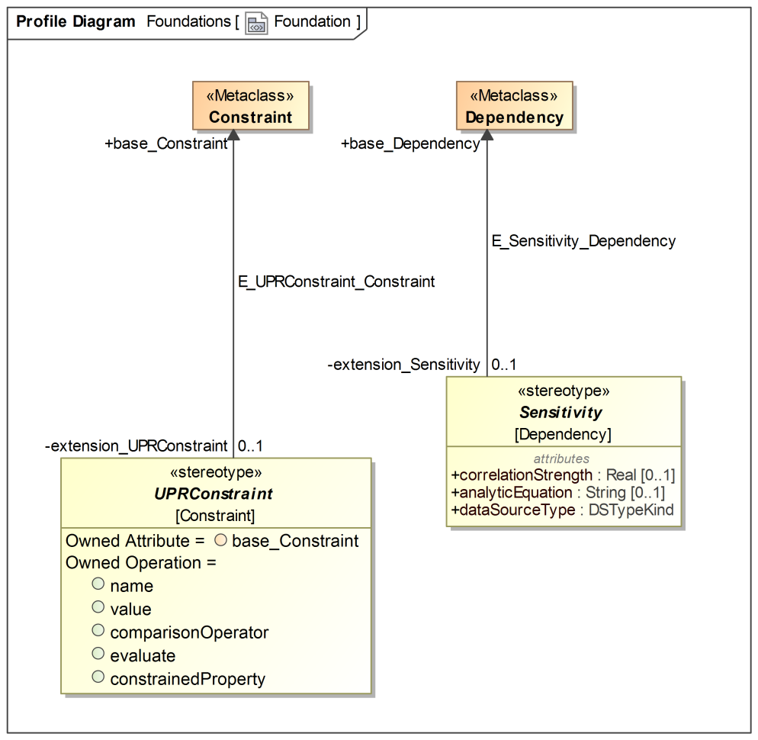
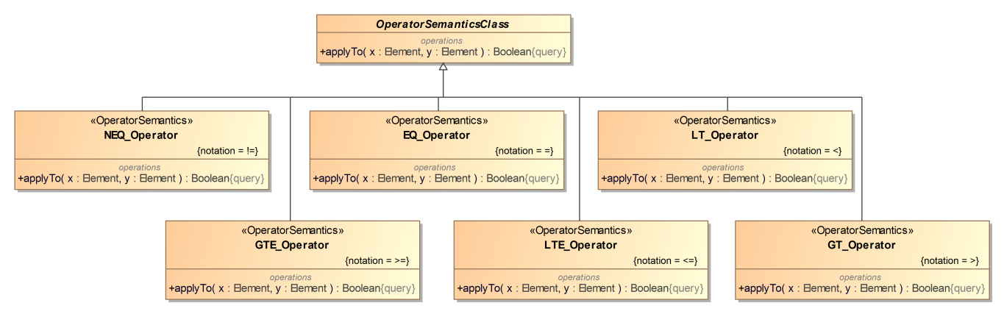
Capturing CDD information using UPR Stereotypes
UPR Foundation & Operator Library
OMG Mathematical Formalisms SIG
UPRConstraint & Sensitivity (Clause 7)
    Extend UML Constraint and UML Dependency to facilitate the modeling of Design Constraint and Design Variable; the mathematical relations between them.
Operator Library (Clause 8)
    A library of comparison operators to be used for modeling a UPRConstraint
    e.g. =, >, <, etc.

Slide 12
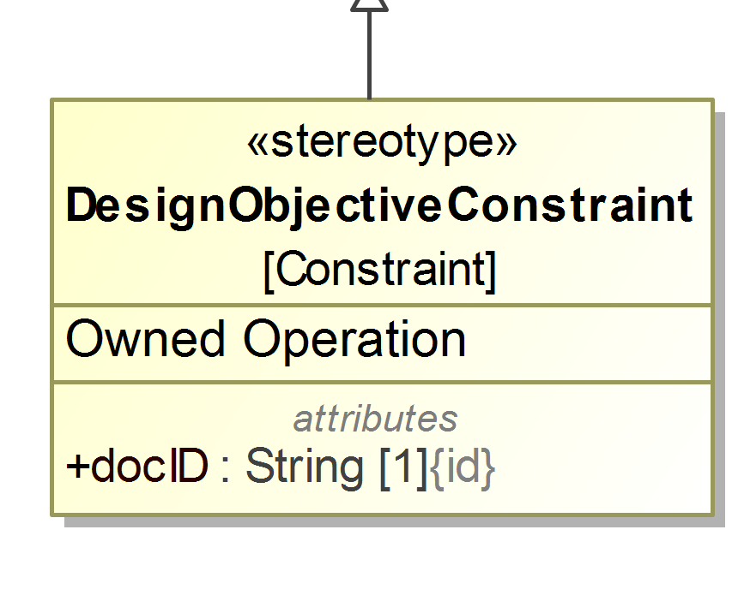
Capturing CDD information using UPR Stereotypes
Design Constraints
OMG Mathematical Formalisms SIG
Design Constraints Package (Clause 9):
  Design Constraint extends UPRConstraint using
  2 additional operations and 1 attribute for model annotation and traceability
Mathematical Element Traceability
DOC, y₁:
y₁ > 20
System Elements Traceability
Constrains the Property of
Class (SysML Requirement)
UseCase
DOC, y₂:
y₂ < 30
DOC: Design Objective Constraint

Slide 13
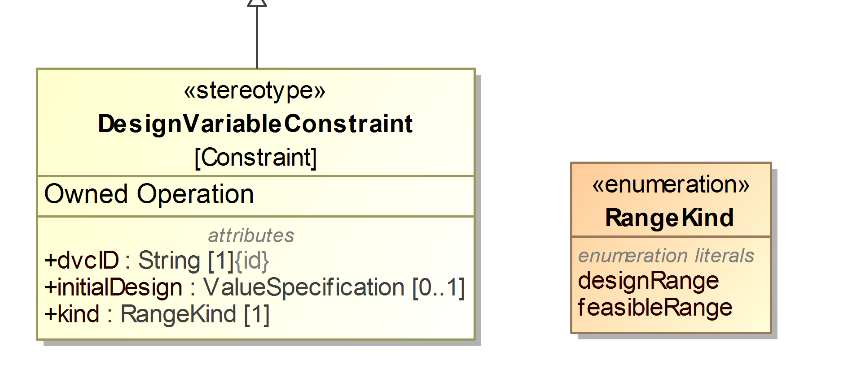
Capturing CDD information using UPR Stereotypes
Design Variables
OMG Mathematical Formalisms SIG
Design Variable Package (Clause 10):
  Design Variable extends UPRConstraint using
  2 additional operations and 3 attributes for model annotation and traceability
Mathematical Element Traceability
Design Ranges:
DR₁: x₁ > 0
DR₂: x₁ < 40
System Elements Traceability
Constrains the Property of
Class
State
Action
Initial Design:
ID: x₁ = 20
Feasible Ranges:
FR₁: x₁ > 15
FR₂: x₁ < 30

Slide 14
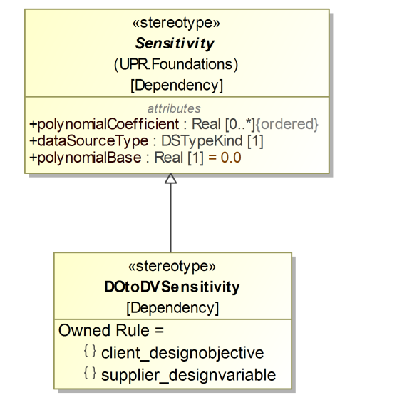
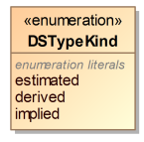
Capturing CDD information using UPR Stereotypes
Analytic Equations
OMG Mathematical Formalisms SIG
Relational Structure and Design Modeling (Clause 11):
  DO to DV Sensitivity extends Sensitivity to model relations between Design Constraint and Design Variable using
  3 additional rules and 1 (refined) attributes for model annotation and traceability
  Object oriented modeling of “mathematical models” *
Analytic Equation(s):
y₁ = W₁(x₁, x₂) = x₁ + 2x₂
DO: Design Objective
DV: Design Variable
* ... using constants, variables, and types of
mathematical expressions (e.g. RSE)

Slide 15
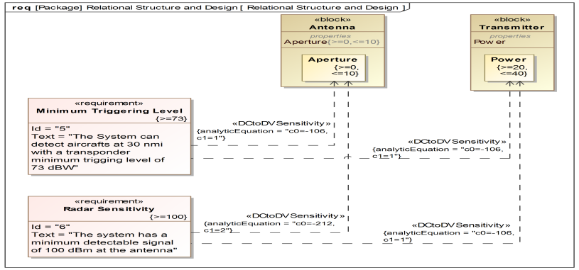
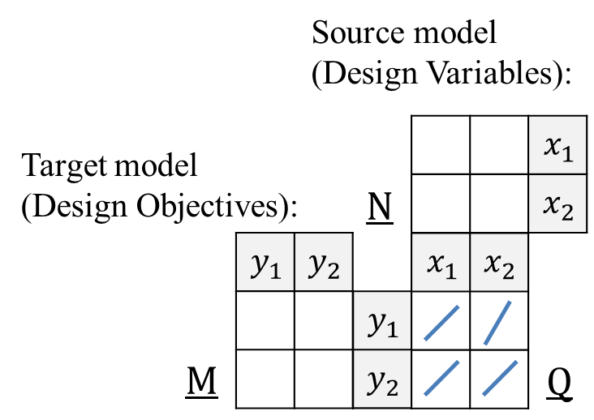
A Facility to Support Relational Transformation
Unary Transformation
OMG Mathematical Formalisms SIG
Unary Transformation (RT-U):
  Based on specified Analytic Equations, such as RSE, RT-U transforms Design Constraints to a Feasible Range of the each Design Variables
  (c.f. Clause 11.3.3 Example)
15
RSE: Response Surface Equation

Slide 16
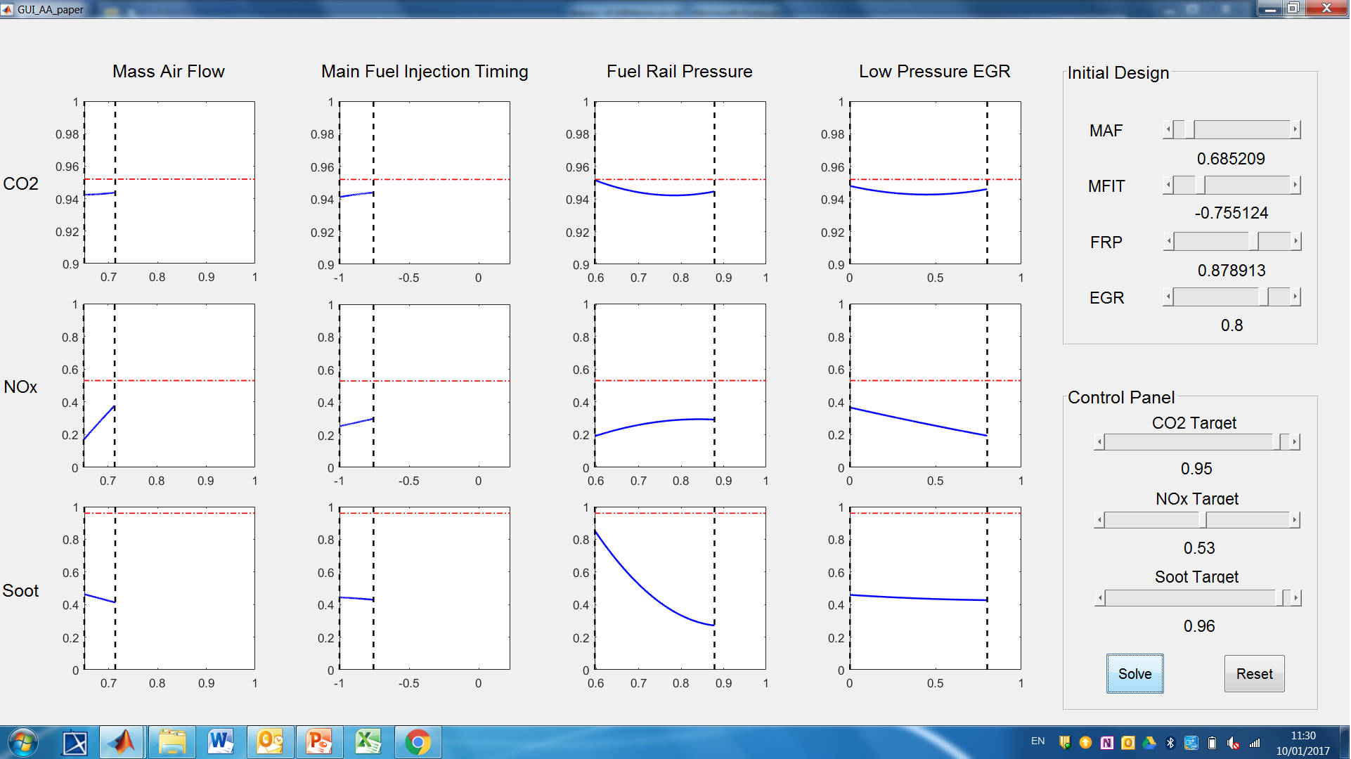
ROSETTA Mathematical Analyses Capability
Implementation algorithms for RT-U transformations
OMG Mathematical Formalisms SIG

Slide 17
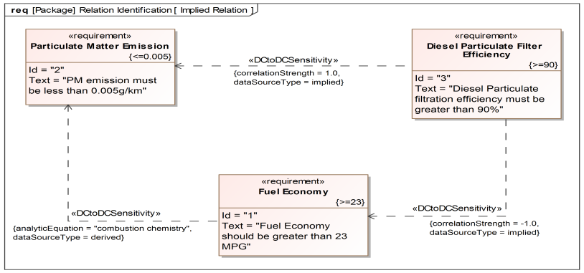
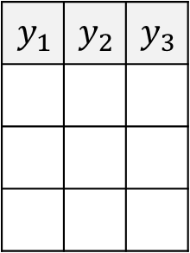


A Facility to Support Relational Transformation
Binary Transformation
OMG Mathematical Formalisms SIG
Binary Transformation (RT-B):
  Based on specified relations and associated Sensitives, RT-B identifies (harmonious/conflicting) relations between Design Constraints
  (c.f. Clause 9.3.3 Example)
Target model
(Design Objectives):
$$y_{1}$$ | $$y_{2}$$ | $$y_{3}$$
$$y_{1}$$
$$y_{2}$$
$$y_{3}$$
$$M$$
17
RSE: Response Surface Equation

Slide 18
Agenda
OMG Mathematical Formalisms SIG
UPR 1.0
  Constraint Driven Design (CDD)
  Relational Transformation
  Application to commercialisation of EV wireless charging
Relation to Kernel Modeling Language and Predicates
Discussion of Pathway for UPR 1.0 Evolution

Slide 19
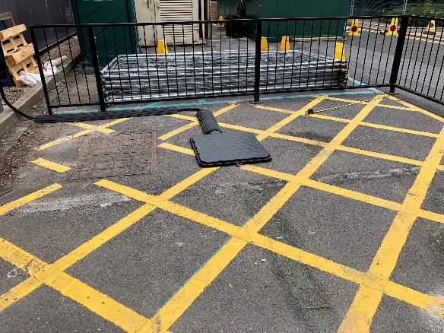
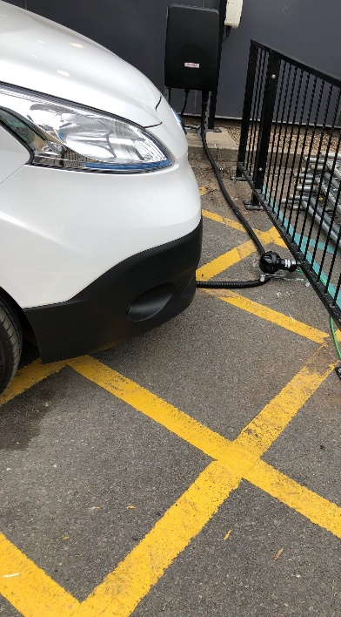
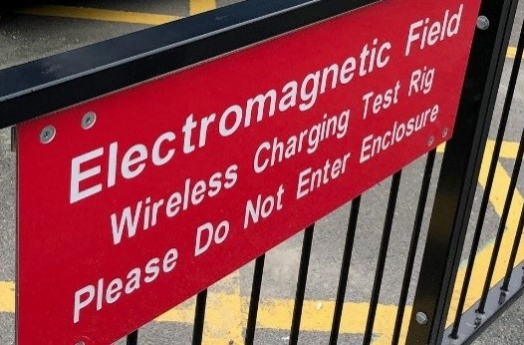
Application of UPR to Electric Vehicle(EV) Charging
Home - AMiCC - Amicable Charging Research Project (projectamicc.com)
OMG Mathematical Formalisms SIG
AMiCC is a commercialisation project for EV wireless charging supported by Innovate UK and funded by the Office for Zero Emission Vehicles (OZEV).
UPR facilities are being developed for metric constraints but are also needed for logical constraints (e.g., topologies).
Design objective constraints include
  Rate of power transfer
  Electromagnetic field strength
Design variable constraints include
  VA size and circuit topologies
  Cooling for power transfer
  Communication protocols
Ground assembly for WPT
EV retrofitted with VA, VIU and HMI for WPT
VA: Vehicle assembly GA: Ground assembly
WPT: Wireless power transfer
VIU: Vehicle interface unit
HMI: Human Machine Interface

Slide 20
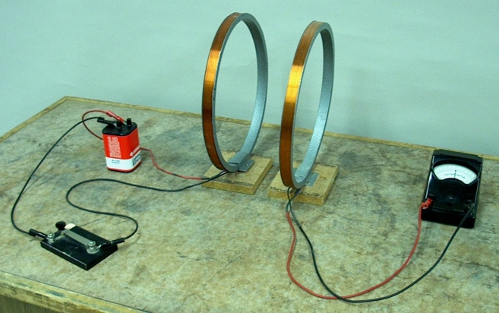
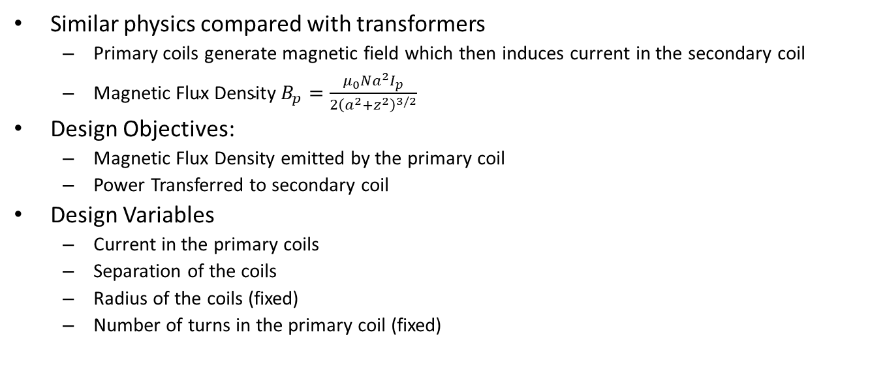

Experimental Setup for Wireless Power Transfer (WPT)
OMG Mathematical Formalisms SIG
Similar physics compared with transformers
  Primary coils generate magnetic field which then induces current in the secondary coil
  $\text{Magnetic} \text{Flux} \text{Densit}$y $B_{p}=\frac{μ_{0}Na^{2}I_{p}}{2{\left(a^{2}+z^{2}\right)}^{3/2}}$
Design Objectives:
  Magnetic Flux Density emitted by the primary coil
  Power Transferred to secondary coil
Design Variables
  Current in the primary coils
  Separation of the coils
  Radius of the coils (fixed)
  Number of turns in the primary coil (fixed)
$$z$$

Slide 21
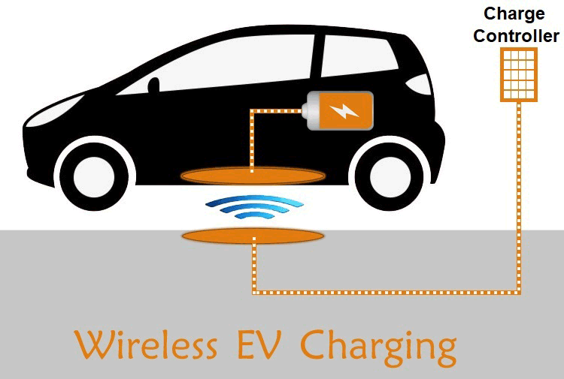
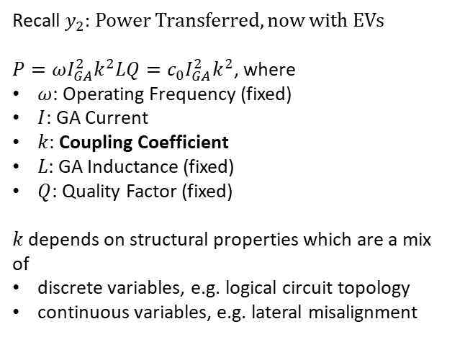
Wireless Charing for Electric Vehicle (EV)
OMG Mathematical Formalisms SIG
Recall $y_{2}$: Power Transferred, now with EVs
$P=ωI_{GA}^{2}k^{2}LQ=c_{0}I_{GA}^{2}k^{2}$, where
$ω$: Operating Frequency (fixed)
$I$: GA Current
$k$: Coupling Coefficient
$L$: GA Inductance (fixed)
$Q$: Quality Factor (fixed)
$k$ depends on structural properties which are a mix of
discrete variables, e.g. logical circuit topology
continuous variables, e.g. lateral misalignment
VA: Vehicle Assembly
GA: Ground Assembly
Wireless Charging for EV

Slide 22
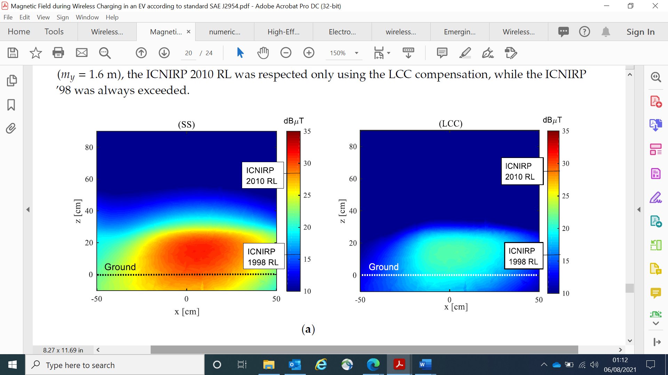
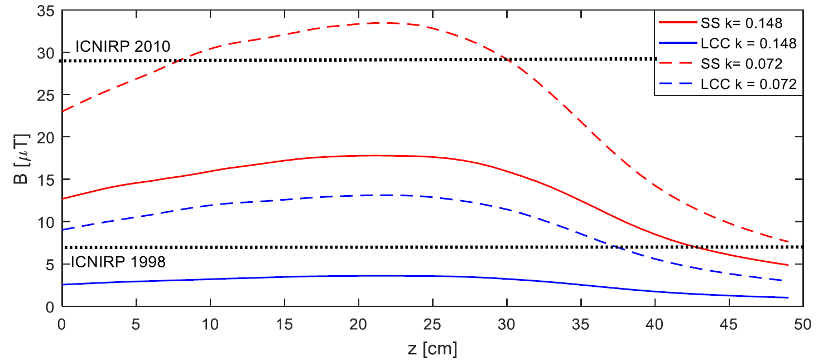
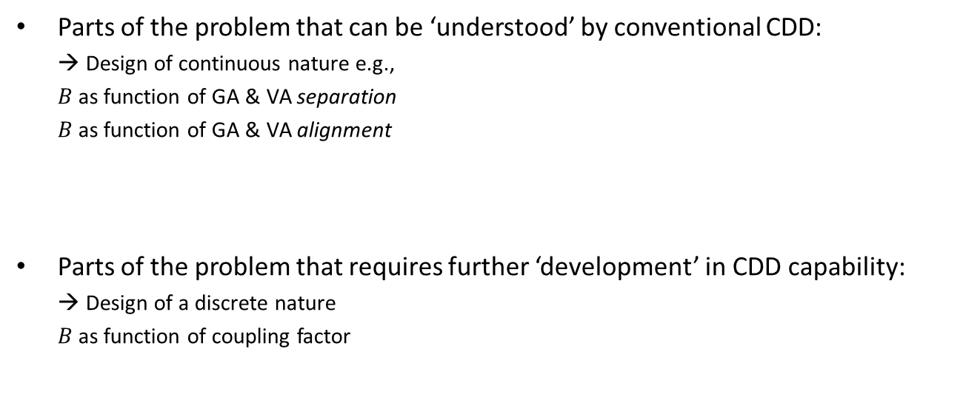
Complex System Design Solutions
Example of Electromagnetic Field Emissions¹
OMG Mathematical Formalisms SIG
Parts of the problem that can be ‘understood’ by conventional CDD:
  → Design of continuous nature e.g.,
  $B$ as function of GA & VA separation
  $B$ as function of GA & VA alignment
Parts of the problem that requires further ‘development’ in CDD capability:
  → Design of a discrete nature
  $B$as function of coupling factor
¹Campi T, Cruicani S, Maradei F, Feliziani M. Magnetic Field during Wireless Charging in an Electric Vehicle According to Standard SAE J2954. Energies. 2019;12:1795 [7]

Slide 23
Agenda
OMG Mathematical Formalisms SIG
UPR 1.0
  Constraint Driven Design (CDD)
  Relational Transformation
  Application to commercialisation of EV wireless charging
Relation to Kernel Modeling Language and Predicates
Discussion of Pathway for UPR 1.0 Evolution

Slide 24
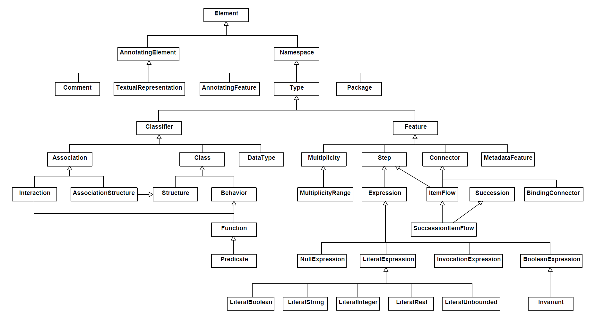
KerML [8]
OMG Mathematical Formalisms SIG
[6.2 Document Conventions] Core mathematical semantics are generally expressed in terms of notations from first order logic.
UPR 1.0 is mathematically based; and conforms to first order model theory in logic.
KerML Element Hierarchy [8, Figure 3]
Predicates are central to formalising object-oriented models.

Slide 25
What is a Predicate? [9, 10]
Example of use cases for a radar system
OMG Mathematical Formalisms SIG
Note that the System and <verb - noun> phrase always form a sentence.
ATC <request detection> from system.
System
System <detect aircraft>.
<Verb – Noun> Phrase 1
<Verb – Noun> Phrase 2
Actor 1 (ATC)
(e.g., subject of verb)
Actor 2 (Aircraft)
(e.g., object of verb)
A predicate is that part of a sentence containing a verb and stating something about the subject.
ATC: Air Traffic Control

Slide 26
Architecture Specification
OMG Mathematical Formalisms SIG
Semantic Structure
  A ‘clean’ structure that one would find in any model developed using standardised language such as UML/SysML:
Semantic Transformation
  provides a way to preserve semantic structures from one view to another
Domain Structure
  Semantic structure filled with domain knowledge
Interpretation
  Interpret domain knowledge into a semantic structure
A dedicated presentation to Ontology PSIG (Thursday)

Slide 27
Agenda
OMG Mathematical Formalisms SIG
UPR 1.0
  Constraint Driven Design (CDD)
  Relational Transformation
  Application to commercialisation of EV wireless charging
Relation to Kernel Modeling Language and Predicates
Discussion of Pathway for UPR 1.0 Evolution

Slide 28
Pathway for UPR 1.0 Evolution
OMG Mathematical Formalisms SIG
Scope of evolution is beyond UPR 1.0 RTF due to
  Inclusion of logical constraints
  Alignment of formal semantics with KerML/Predicates
  Utilising SysML 2 for design analysis
  Supporting CDD automation
Pathways
  UPR 2.0?
  Collaboration with SysML 2 Working Group?
  Collaboration with Ontology PSIG?

Slide 29
References (1 of 2)
OMG Mathematical Formalisms SIG
[1] Dickerson, C.E. and S. Ji, Mathsig/2015-09-01, Profiling a Software Architecture for the Relational Oriented Systems Engineering Technology Trade-off and Analysis Framework (ROSETTA) v4.3.
[2] Dickerson, C.E. and D. Mavris, “Relational Oriented Systems Engineering (ROSE): Preliminary report,” in Proc. IEEE SoSE '11, Albuquerque, 2011.
[3] Dickerson, C.E., “A relational oriented approach to system of systems assessment of alternatives for data link interoperability,” IEEE Systems Journal, 16 May 2013.
[4] Mavris, D., K. Griendling and C. Dickerson, “Relational-Oriented Systems Engineering and Technology Trade-off Analysis Framework,” AIAA Journal of Aircraft, 28 August 2013.
[5] Dickerson, C.E., and D. Mavris, “A Brief History of Models and Model Based Systems Engineering and the Case for Relational Orientation,” IEEE Systems Journal, vol. 7, no. 4, 2013.
[6] (OMG) Object Management Group 2019, UML Profile for ROSETTA (UPR) Version 1.0
[7] Campi T, Cruicani S, Maradei F, Feliziani M. Magnetic Field during Wireless Charging in an Electric Vehicle According to Standard SAE J2954. Energies. 2019;12:1795
[8] (OMG) Object Management Group 2021, Kernel Modeling Language (KerML) Version 1.0 Release 2021-05

Slide 30

References (2 of 2)
OMG Mathematical Formalisms SIG
[9] Dickerson, Charles E. et al, 2021. “Architecture definition in complex system design using model theory.” IEEE Systems Journal 15, no. 2: 1847 – 1860.
[10] Dickerson, C.E. and Siyuan Ji, Essential Architecture and Principles of Systems Engineering. Boca Raton Florida: CRC Press Auerbach Publication, September 2021.

