Slide 1


UPR
Architecture Specification with Structures and Transformations
UPR: UML Profile for ROSETTA
Charles Dickerson Michael Wilkinson Siyuan Ji
Co-Chair
INCOSE UK
Architecture Working Group
OMG Mathematical Formalisms SIG

Slide 2
Agenda
Background
Architecture Specification
  Semantic Structure & Transformation
  Domain Structure & Interpretation
Discussion on ways forward (in the ontology space)

Slide 3
Why This Presentation?
Architecture definition using model theory [1]
  “Structure is junction and separation of the objects of a collection defined by a property of the collection or its objects”
  “Architecture is structural type in conjunction with consistent properties that can be implemented in a structure of that type”
Comments form a PhD student:
  Ideas are codified in unspoken/tacit ontological terms
  Related to other ontology that authors are unaware of
  A clear ontology ‘picture’ made it easier to understand
For UPR and our current work
  Should we take a ontological approach to complement technical works
  If so, how?

Slide 4
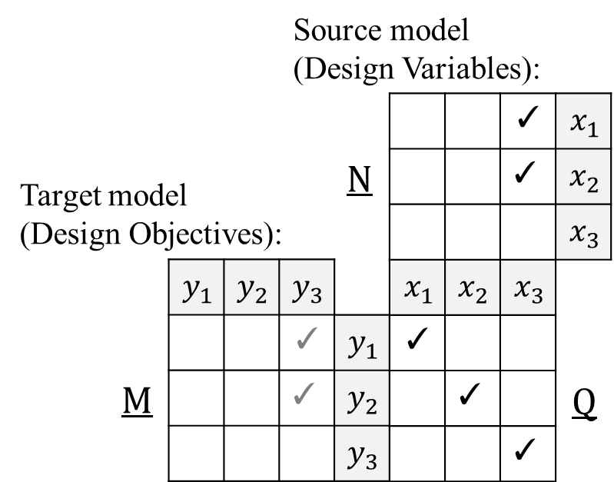
ROSETTA Framework
A mathematical framework, depicted in matrices. (See Clause 6.2 for more details [2], and [3-6] for research publications)
Relational Transformation
(see ad/2022-03-13)
  CDD: Unary
  Binary
Structure preserving
$$\left(y_{i},y_{j}\right)∈M \text{with} \left(y_{i},x_{k}\right),(y_{j},x_{l})∈Q \text{implies} \left(x_{k},x_{l}\right)∈N$$
CDD: constraint driven design

Slide 5
Architecture Specification
OMG Mathematical Formalisms SIG
How to Architect a System?
  Experience/Reuse?
  Intuition/Innovation?
Modelling vs Architecting
Semantic Structure
  A ‘clean’ structure that one would find in any model developed using standardised language such as UML/SysML:
Semantic Transformation
  provides a way to preserve semantic structures from one view to another
Domain Structure
  Semantic structure filled with domain knowledge
Interpretation
  Interpret domain knowledge into a semantic structure

Slide 6
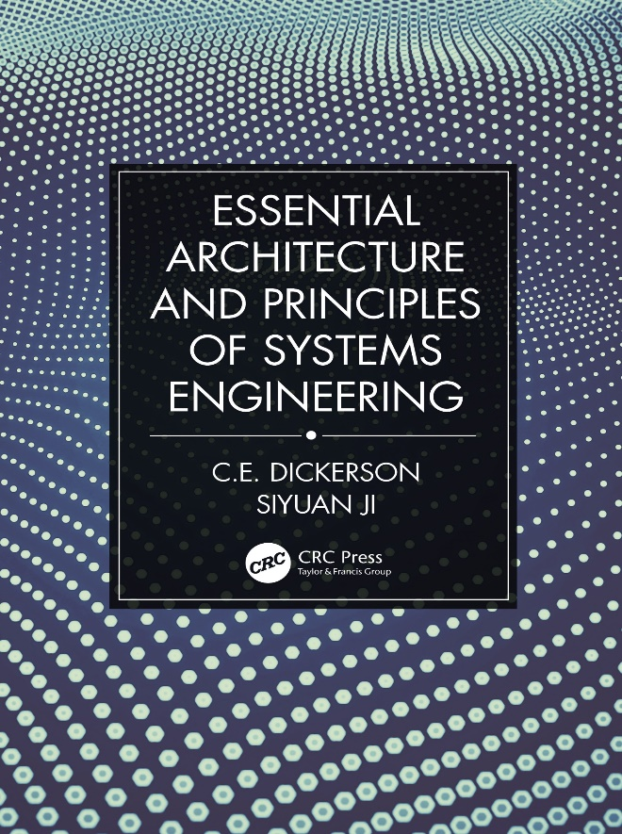
“Essential Architecture and Principles of Systems Engineering” [7]
OMG Mathematical Formalisms SIG
Rigorous commercial quality approach to architecture and systems
Embodies a decade of research and research-based teaching
Real world case studies and tutorials
Examples and figures are mostly taken from the book.

Slide 7
Agenda
Background
Architecture Specification
  Semantic Structure & Transformation
  Domain Structure & Interpretation
Discussion on ways forward (in the ontology space)

Slide 8
Semantic Structure
A ‘clean’ structure that one would find in any model developed using standardised language such as UML/SysML:
System Name
Use Case Name
Actor Name

Slide 9
Semantic Transformation
Structure developed in different views (diagrams) of the system model are interconnected based on semantics of the underlying modelling languages
  e.g., A set of Actions structured in a specific way to achieve the functionality as modelled in a Use Case
Transforming from a diagram (e.g. Use Case Diagram) to a semantically richer diagram (e.g. Activity Diagram) requires engineering
But, semantic transformation provides a way to preserve semantic structures from one view to another
  Ensuring consistency
  Guiding engineering effort

Slide 10
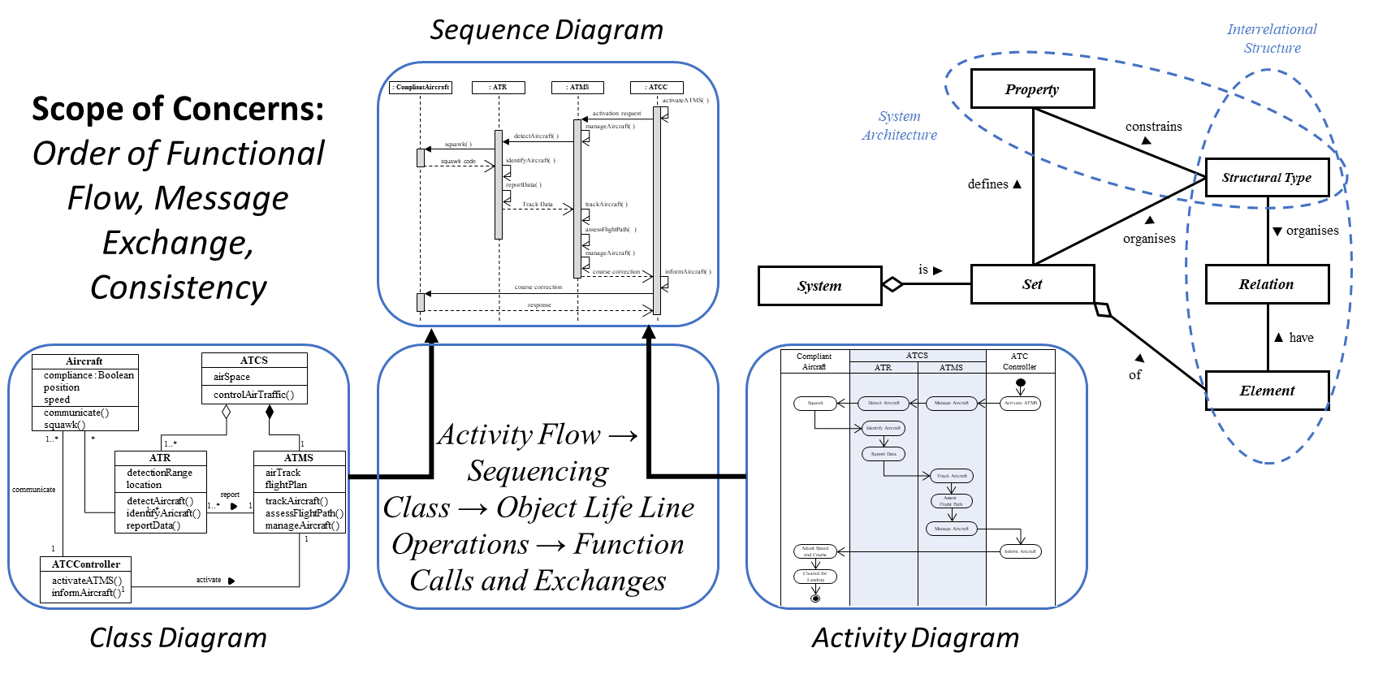
Class + Activity -> Sequence

Slide 11
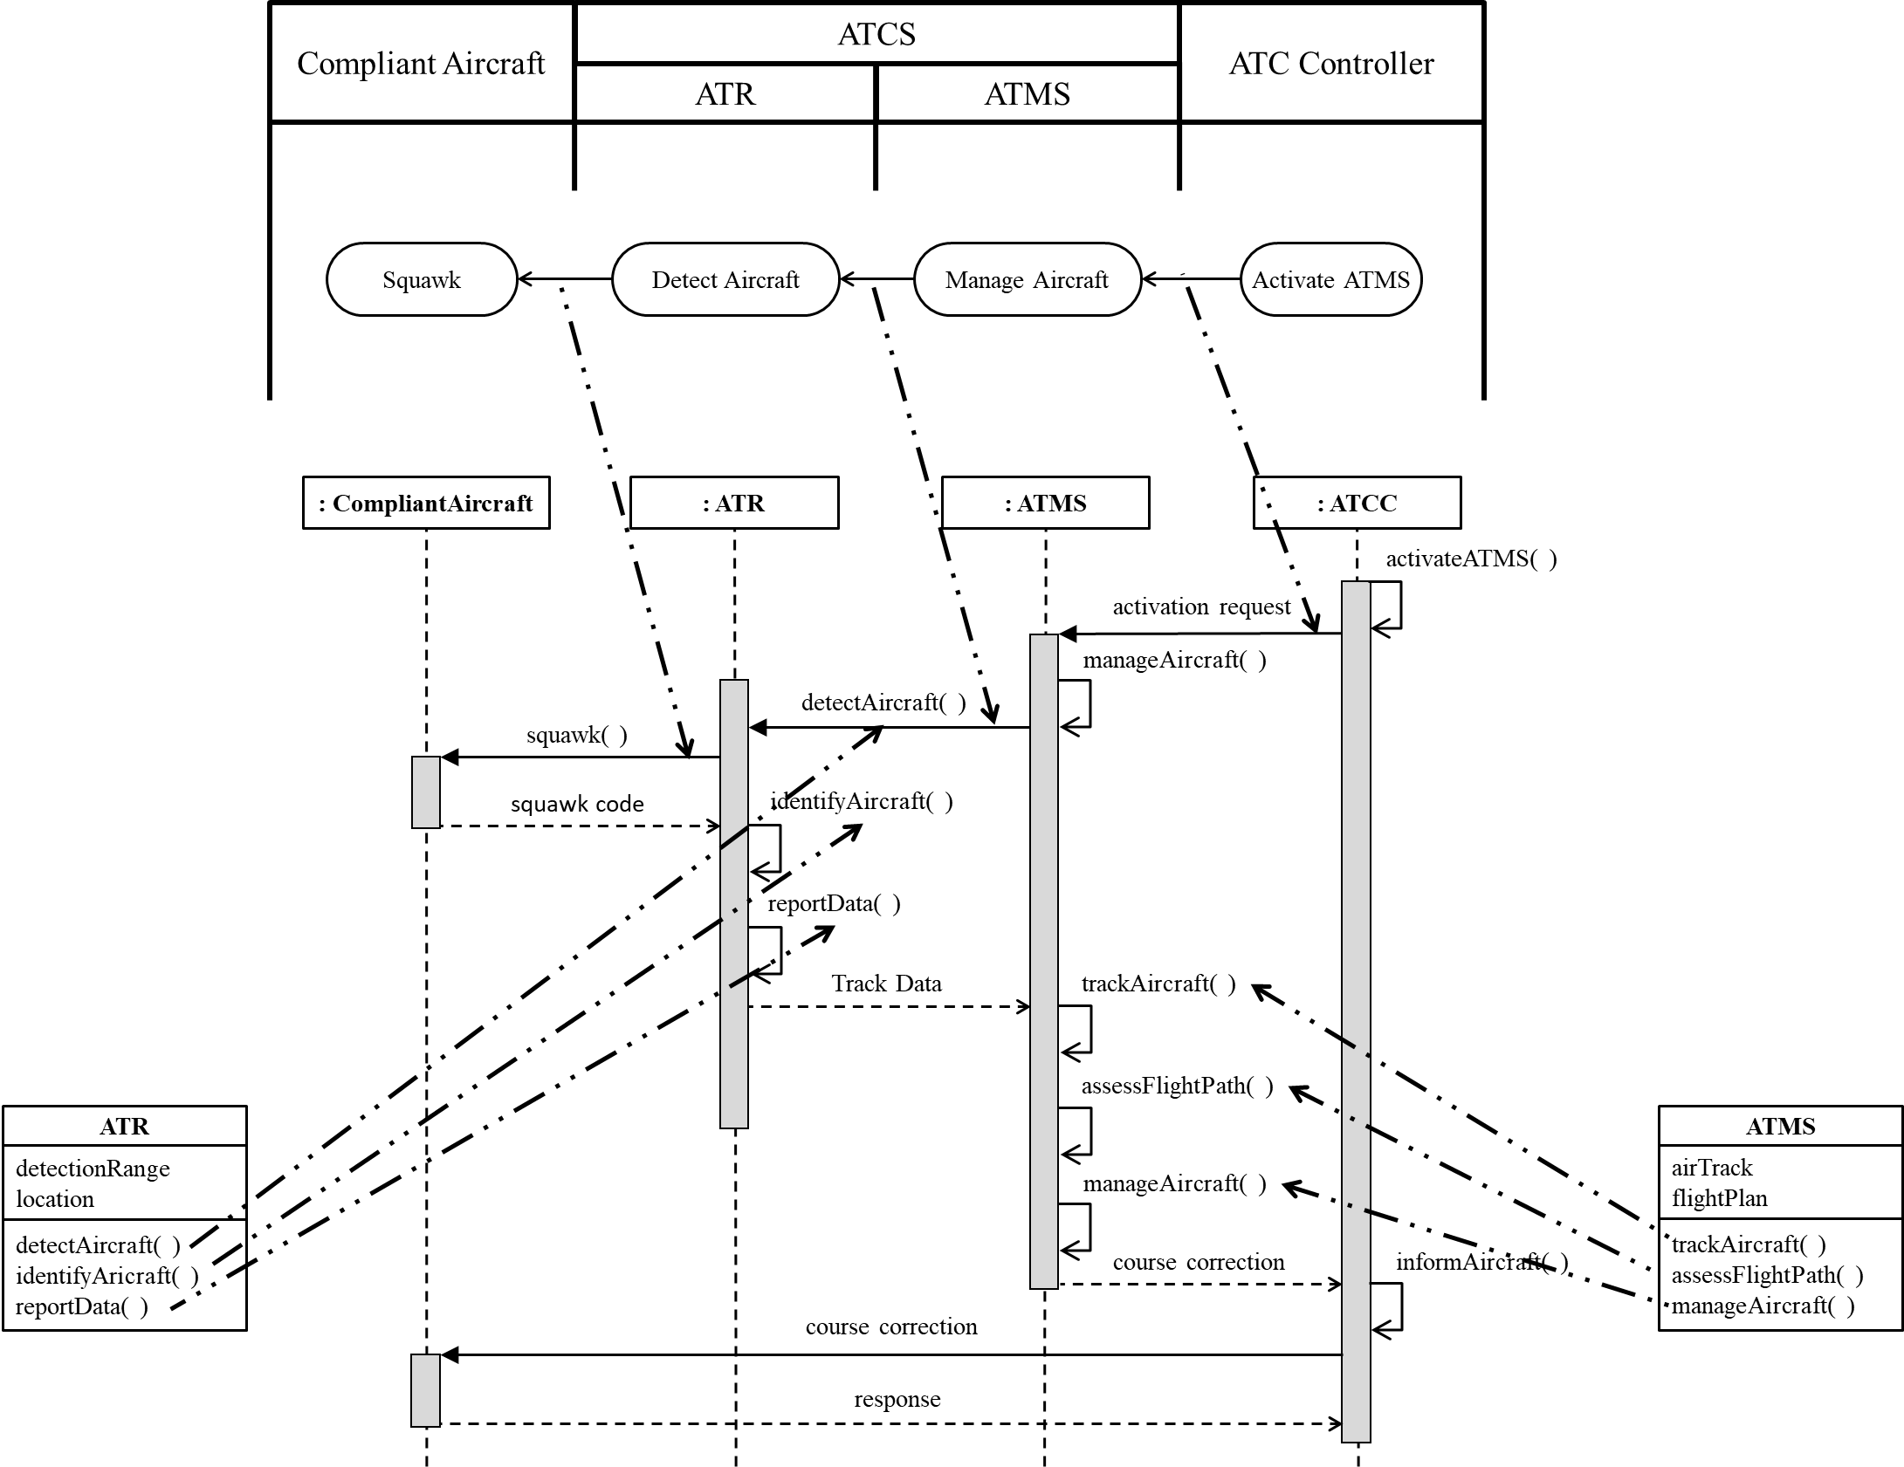

Slide 12
Domain Structure
Semantic structure filled with domain knowledge
ATC
Control Air Traffic
Air Traffic

Slide 13
Interpretation
To create domain structures from semantic structures, we interpret domain knowledge into a semantic structure
  Rooted in the Predicate Calculus
Domain knowledge comes from
  Requirements, tacit knowledge, legacy designs, …
Generic Examples:
  Functional requirements interpreted into use cases
  Use case scenarios interpreted into action flow
  …

Slide 14
Air Traffic Control System
Requirement Narrative[7, p65]
“The purpose of the ATC service is to manage the flow of aircraft through the airport airspace and to prevent accidents (especially air-to-air collisions). The operational activities of the ATCS include:
  Track the aircraft entering and departing the controlled airspace.
  Assess the flight paths against: (i) the flight plans, (ii) the tempo of the airport, and (iii) the risk of air-to-air collisions.
  Control the aircraft to manage their relative positions and flow through the airspace.
The ATR must be suitably positioned e.g., at the airport to provide tracking of all aircraft entering and departing the controlled airspace (which is also referred to as the ATC airspace).”

Slide 15
ATCS, Requirement Narrative with highlights
“The purpose of the ATC service is to manage the flow of aircraft through the airport airspace and to prevent accidents (especially air-to-air collisions). The operational activities of the ATCS include:
  Track the aircraft entering and departing the controlled airspace.
  Assess the flight paths against: (i) the flight plans, (ii) the tempo of the airport, and (iii) the risk of air-to-air collisions.
  Control the aircraft to manage their relative positions and flow through the airspace.
The ATR must be suitably positioned e.g., at the airport to provide tracking of all aircraft entering and departing the controlled airspace (which is also referred to as the ATC airspace).”

Slide 16
Domain Structure: ATCS Use Case
«subsystem»
ATCS
Track
Aircraft
«include»
Non-compliant
Aircraft
Assess
Flight Path
Manage
Air Traffic
«include»
Air Traffic
«include»
Manage
Aircraft
Compliant
Aircraft

Slide 17
Observations
Not all information can be interpreted into just one semantic structure
  Domain knowledge interpreted in to a set of semantic structure, representing different views -> full system model
  Information interpreted into different semantic structures, with guided rules (MBSE methodologies!)
One semantic structure can contain more information than what is provided
  Tacit knowledge and innovation
  Increasing design commitment
Semantic Transformation and Interpretation are NOT done in a series fashion

Slide 18
Agenda
Background
Architecture Specification
  Semantic Structure & Transformation
  Domain Structure & Interpretation
Discussion on ways forward (in the ontology space)

Slide 19
What Next?
Ontological approach
  To UPR?
  To the relational transformations underpinning the ROSETTA Framework?
  To architecting?
How does this work alongside with a modelling language, say SysML 2?
  Not the ontology of a modelling language
  But the ontology of a MBSE methodology facilitated by the language

Slide 20
References (1 of 2)
OMG Mathematical Formalisms SIG
[1] Dickerson, Charles E. et al, 2021. “Architecture definition in complex system design using model theory.” IEEE Systems Journal 15, no. 2: 1847 – 1860.
[2] (OMG) Object Management Group 2019, UML Profile for ROSETTA (UPR) Version 1.0
[3] Dickerson, C.E. and D. Mavris, “Relational Oriented Systems Engineering (ROSE): Preliminary report,” in Proc. IEEE SoSE '11, Albuquerque, 2011.
[4] Dickerson, C.E., “A relational oriented approach to system of systems assessment of alternatives for data link interoperability,” IEEE Systems Journal, 16 May 2013.
[5] Mavris, D., K. Griendling and C. Dickerson, “Relational-Oriented Systems Engineering and Technology Trade-off Analysis Framework,” AIAA Journal of Aircraft, 28 August 2013.
[6] Dickerson, C.E., and D. Mavris, “A Brief History of Models and Model Based Systems Engineering and the Case for Relational Orientation,” IEEE Systems Journal, vol. 7, no. 4, 2013.
[7] Dickerson, C.E. and Siyuan Ji, Essential Architecture and Principles of Systems Engineering. Boca Raton Florida: CRC Press Auerbach Publication, September 2021.

