Slide 1



UPR 2.0
OMG Mathematical Formalisms SIG
Review, Update and Pathway for UPR 1.0 Evolution
UPR: UML Profile for ROSETTA
2022-06-20
Charles Dickerson
Michael Wilkinson
Siyuan Ji

Slide 2
Key Milestones
A Decade of research leading to the ROSETTA* Framework [1-4]
Programme for Simulation Innovation by EPSRC and Jaguar Land Rover, sponsored the research, leading to Constraint Driven Design (CDD)
[5]
AMiCC Project by Innovate UK, application of UPR in electric vehicle charging
[9]
UPR ‘discovered on MARS’ – a joint work between Loughborough, Airbus and ZTI Systems
[6]
UPR RFC formally submitted at ADTF
[7]
UPR 1.0 adopted and RTF since then
[8]
Ongoing MBSE research between Loughborough, York and BAE systems
Milestone journal paper and book publications[10, 11]
UPR 2.0, a new journey began
[12-14]
Today at SE DSIG
2010 to 2013
Sept 2016
Jan 2019
June 2021
June 2022
June 2013
Dec 2017
Sept 2020
Sept 2021 – March 2022
ROSETTA: Relational Oriented Systems Engineering and Technology Trade-off Analysis

Slide 3
Agenda
OMG Mathematical Formalisms SIG
An Overview of UPR 1.0
Current Work and Strategy
  Complex Constraints
  Model Synchronisation
Discussions

Slide 4
UPR 1.0
The aims of UPR 1.0 were to
  Fill the gaps by accessing, structuring and integrating information across multiple system models for support of CDD
  Identify conflicting and harmonious requirements
  Support optimization and transformation of System Architecture into Detailed Design
UPR 1.0 proposed
  10 stereotypes, and 1 library
  Facilitating annotation of models to identify information
  But the intent is Not to define new analysis techniques
CDD: constraint driven design

Slide 5
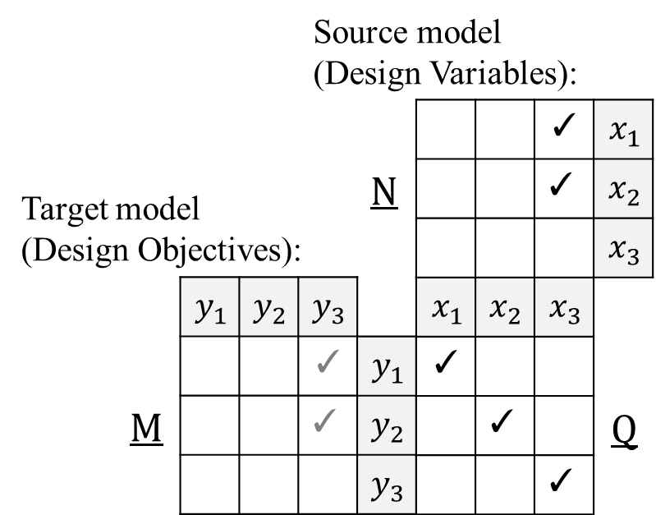
The ROSETTA Framework
A mathematical framework, depicted in matrices. (See Clause 6.2 for more details [6], and [1-4] for research publications)
Relational Transformation
(see ad/2022-03-13)
  Unary
    CDD
  Binary
    Requirement dependency
$$\left(y_{i},y_{j}\right)∈M \text{with} \left(y_{i},x_{k}\right),(y_{j},x_{l})∈Q \text{implies} \left(x_{k},x_{l}\right)∈N$$

Slide 6
OMG Mathematical Formalisms SIG
Constraint Driven Design (CDD) in UPR 1.0
UPR 1.0 facilitates the modelling of metric constraints for CDD [6]
A Variable is a measurable attribute that represents an element being constrained and can take on a range of real values.
A Constraint is a constant that limits the values of a variable.
A Comparison Operator, such as ‘<‘, is used to model constraints.
A Design Objective is a measurable attribute of a system that the system is intended to have or achieve e.g., a requirement.
A Design Variable is a variable under the design authority of the engineer. It imparts system properties that achieve objectives e.g., a vehicle speed of > 100 mph can be achieved by reduced weight.

Slide 7
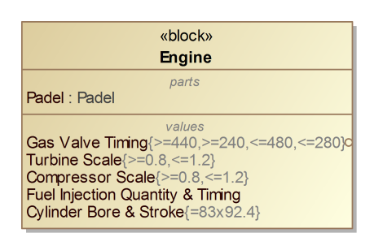
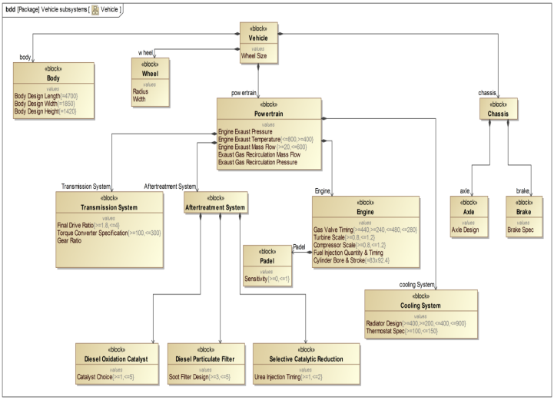
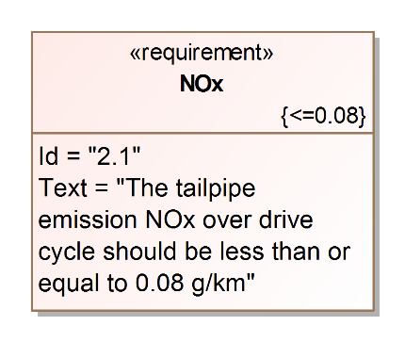
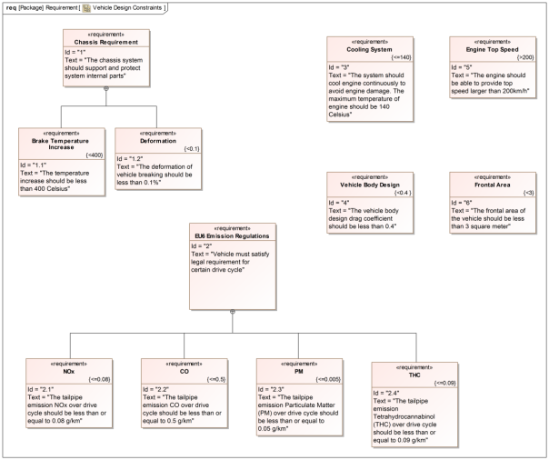
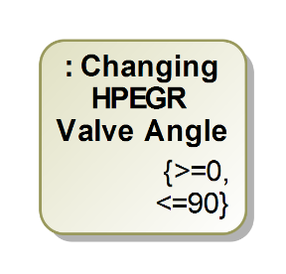
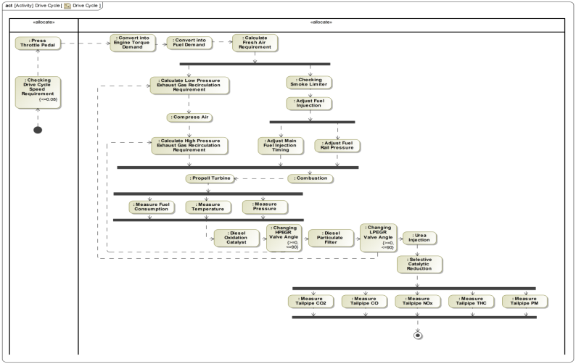
UPR for CDD Modeling
Model annotation for information extraction
OMG Mathematical Formalisms SIG
Design
Variable
Constraints
UPR Stereotypes
DOtoDV
Sensitivities
Design
Objective Constraints
Annotation
Design
Variable
Constraints
Existing System Model
Notes:
r

Slide 8
OMG Mathematical Formalisms SIG
Constraint Driven Design
Information required
Mathematical Viewpoint
ROSETTA seeks to access and annotate key information from MBSE System Model.
Design algorithms use the information a Feasible Design Space to seek solutions.
Information Required
Design Objective Constraints: y₁, …, y_{m}
Design Variables: x₁, …, x_{n}
with Design Ranges
S₁ , S₂ , …
Analytic Equations:
y₁ = W₁(x₁, …, x_{n})
y₂ = W₂(x₁, …, x_{n})
…
y_{m} = W_{m}(x₁, …, x_{n})
Feasible Design Space expressed in terms of
Feasible Ranges
x₂
y₂ < 30
Feasible Design Space
x₁
y₁ > 20

Slide 9
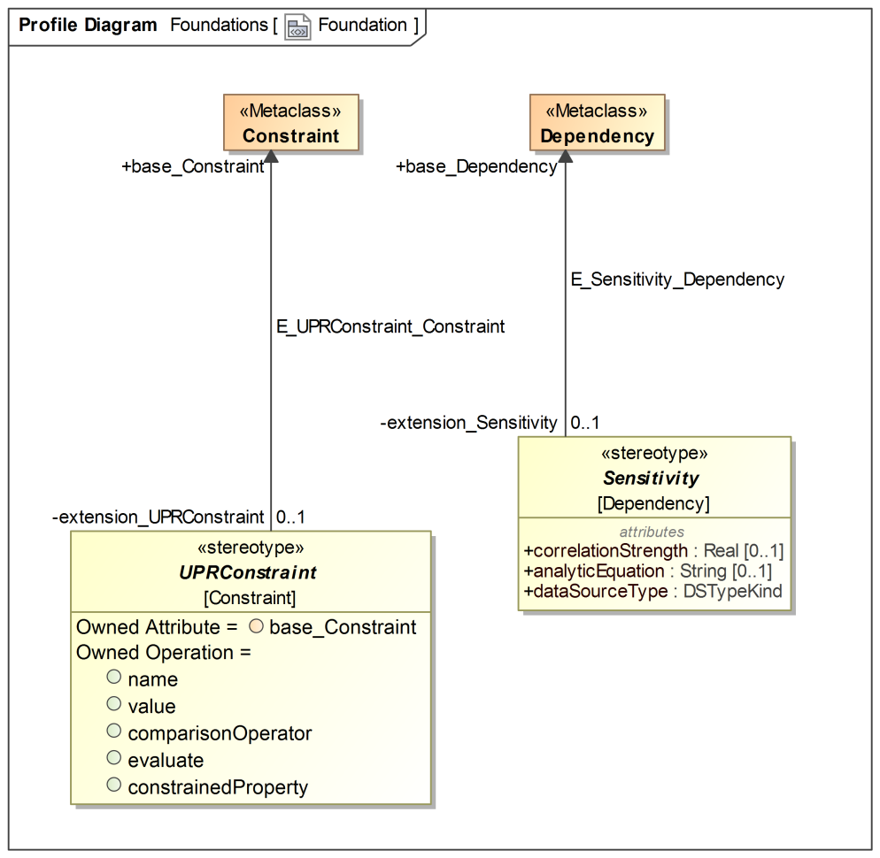
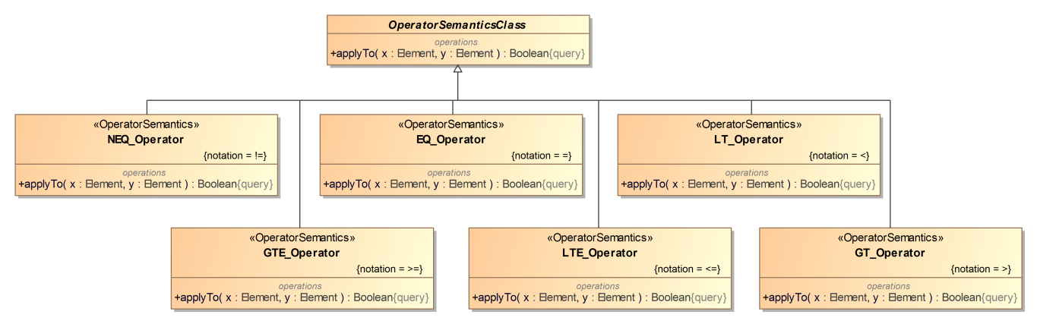
Capturing CDD information using UPR Stereotypes
UPR Foundation & Operator Library
OMG Mathematical Formalisms SIG
UPRConstraint & Sensitivity (Clause 7)
    Extend UML Constraint and UML Dependency to facilitate the modeling of Design Constraint and Design Variable; the mathematical relations between them.
Operator Library (Clause 8)
    A library of comparison operators to be used for modeling a UPRConstraint
    e.g. =, >, <, etc.

Slide 10
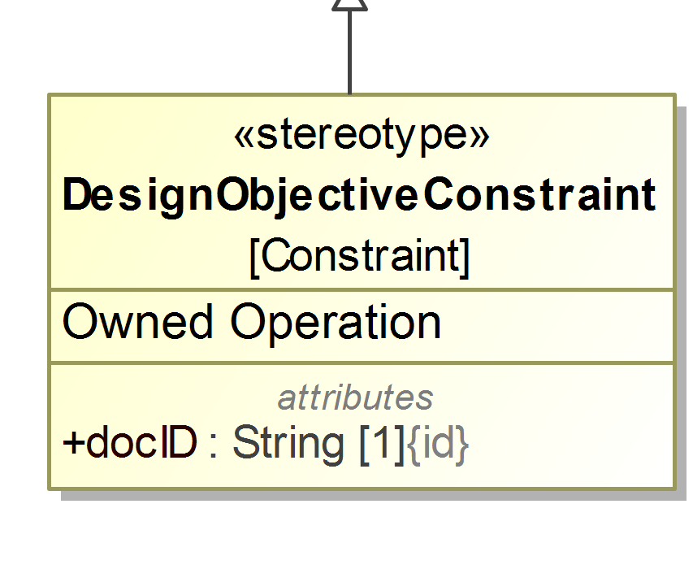
Capturing CDD information using UPR Stereotypes
Design Constraints
OMG Mathematical Formalisms SIG
Design Constraints Package (Clause 9):
  Design Constraint extends UPRConstraint using
  2 additional operations and 1 attribute for model annotation and traceability
Mathematical Element Traceability
DOC, y₁:
y₁ > 20
System Elements Traceability
Constrains the Property of
Class (SysML Requirement)
UseCase
DOC, y₂:
y₂ < 30
DOC: Design Objective Constraint

Slide 11
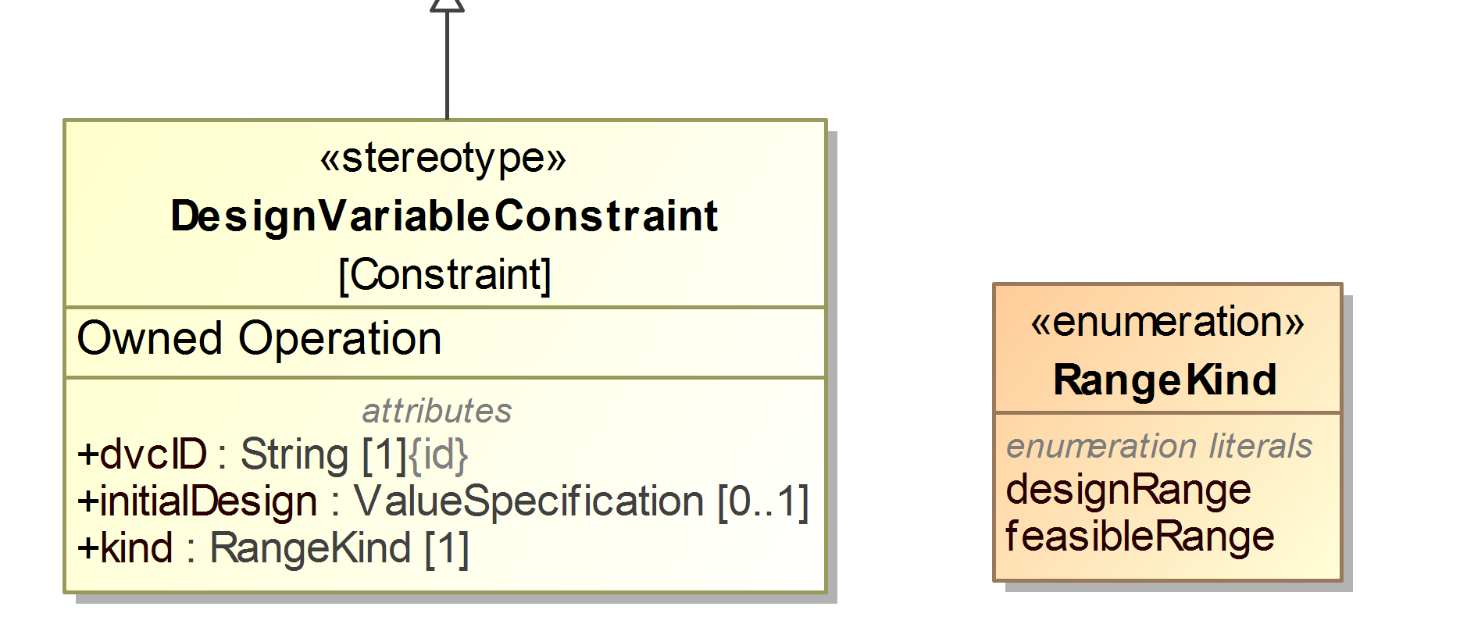
Capturing CDD information using UPR Stereotypes
Design Variables
OMG Mathematical Formalisms SIG
Design Variable Package (Clause 10):
  Design Variable extends UPRConstraint using
  2 additional operations and 3 attributes for model annotation and traceability
Mathematical Element Traceability
Design Ranges:
DR₁: x₁ > 0
DR₂: x₁ < 40
System Elements Traceability
Constrains the Property of
Class
State
Action
Initial Design:
ID: x₁ = 20
Feasible Ranges:
FR₁: x₁ > 15
FR₂: x₁ < 30

Slide 12
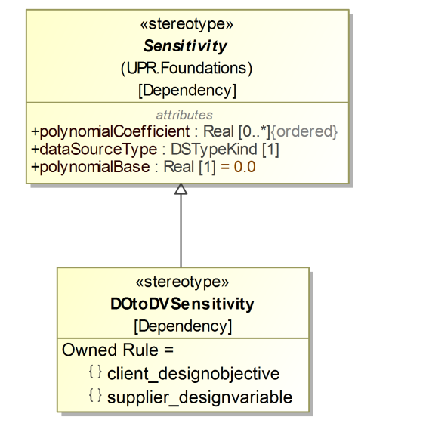
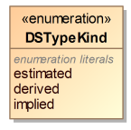
Capturing CDD information using UPR Stereotypes
Analytic Equations
OMG Mathematical Formalisms SIG
Relational Structure and Design Modeling (Clause 11):
  DO to DV Sensitivity extends Sensitivity to model relations between Design Constraint and Design Variable using
  3 additional rules and 1 (refined) attributes for model annotation and traceability
  Object oriented modeling of “mathematical models” *
Analytic Equation(s):
y₁ = W₁(x₁, x₂) = x₁ + 2x₂
DO: Design Objective
DV: Design Variable
* ... using constants, variables, and types of
mathematical expressions (e.g. RSE)

Slide 13
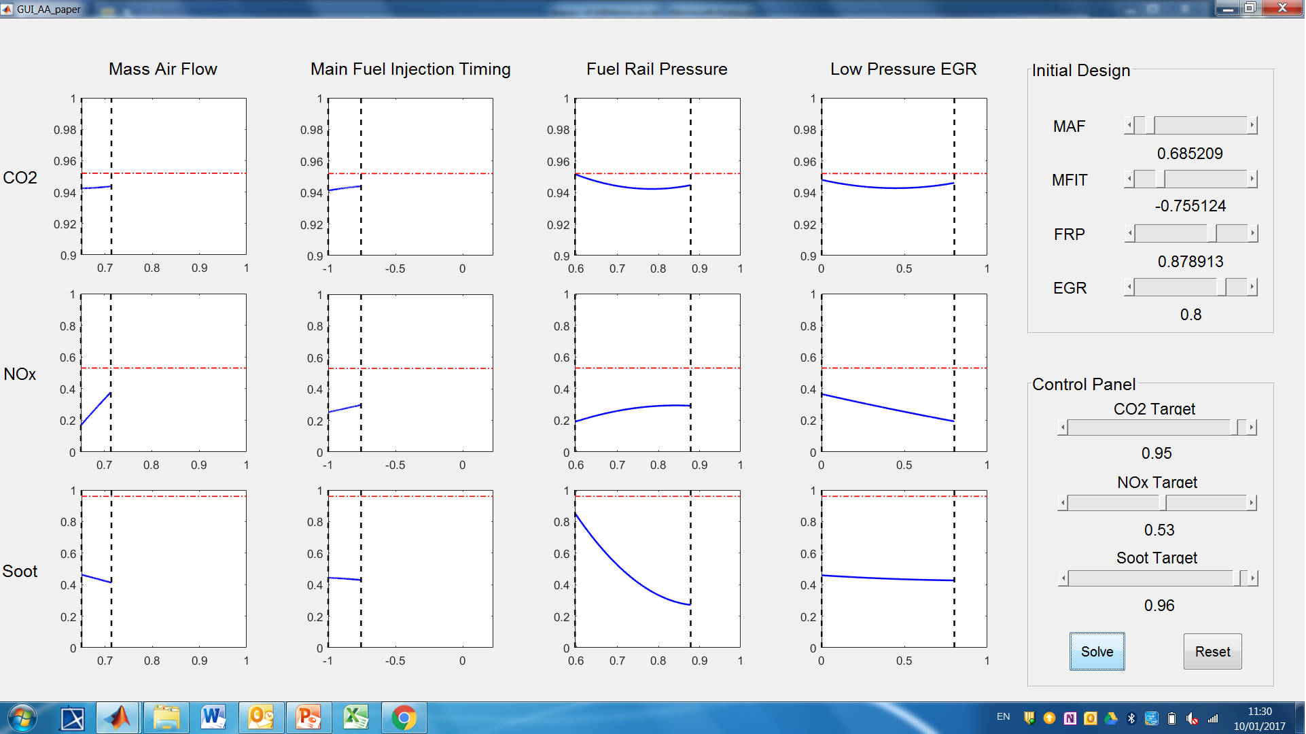
ROSETTA Mathematical Analyses Capability*
Implementation algorithms for RT-U transformations
OMG Mathematical Formalisms SIG
*A multi-design objective and multi-design variable design problem with three engine emission targets: CO2, NOx and Soot

Slide 14
Agenda
OMG Mathematical Formalisms SIG
An Overview of UPR 1.0
Current Work and Strategy
  Complex Constraints
  Model Synchronisation
Discussions

Slide 15
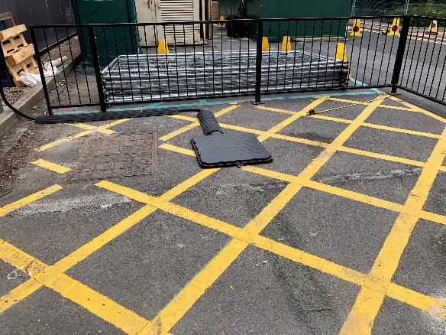
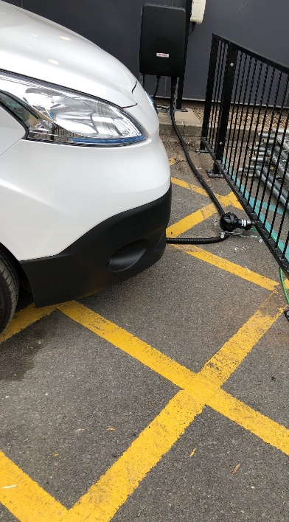
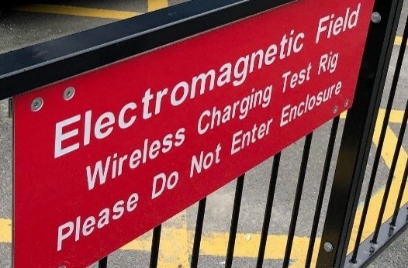
Application of UPR to Electric Vehicle(EV) Charging
Home - AMiCC - Amicable Charging Research Project (projectamicc.com)
OMG Mathematical Formalisms SIG
AMiCC is a commercialisation project for EV wireless charging supported by Innovate UK and funded by the Office for Zero Emission Vehicles (OZEV).
UPR facilities are being developed for metric constraints but are also needed for logical constraints (e.g., topologies).
Design objective constraints include
  Rate of power transfer
  Electromagnetic field strength
Design variable constraints include
  VA size and circuit topologies
  Cooling for power transfer
  Communication protocols
Ground assembly for WPT
EV retrofitted with VA, VIU and HMI for WPT
VA: Vehicle assembly GA: Ground assembly
WPT: Wireless power transfer
VIU: Vehicle interface unit
HMI: Human Machine Interface

Slide 16
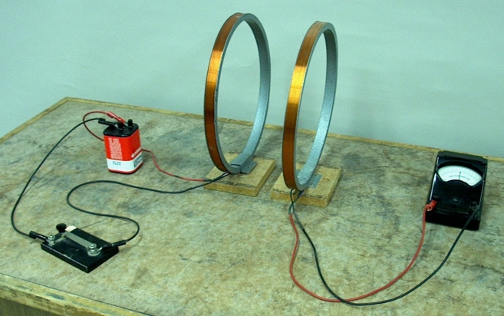
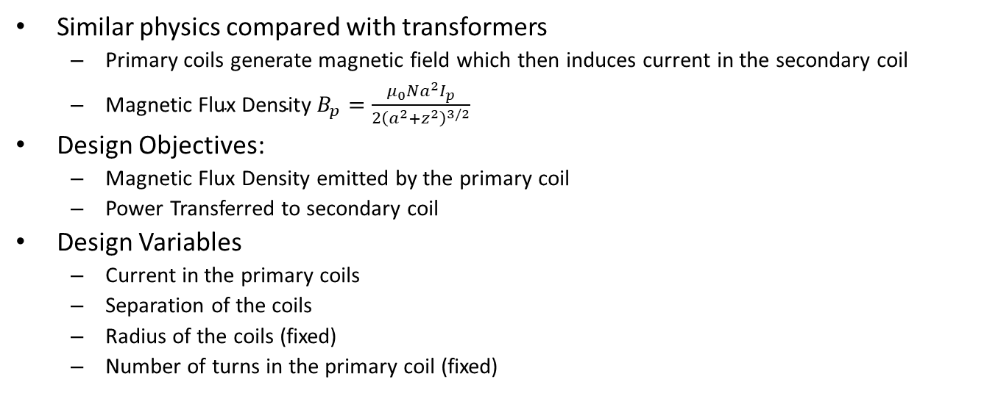

Experimental Setup for Wireless Power Transfer (WPT)
OMG Mathematical Formalisms SIG
Similar physics compared with transformers
  Primary coils generate magnetic field which then induces current in the secondary coil
  $\text{Magnetic} \text{Flux} \text{Densit}$y $B_{p}=\frac{μ_{0}Na^{2}I_{p}}{2{\left(a^{2}+z^{2}\right)}^{3/2}}$
Design Objectives:
  Magnetic Flux Density emitted by the primary coil
  Power Transferred to secondary coil
Design Variables
  Current in the primary coils
  Separation of the coils
  Radius of the coils (fixed)
  Number of turns in the primary coil (fixed)
$$z$$

Slide 17
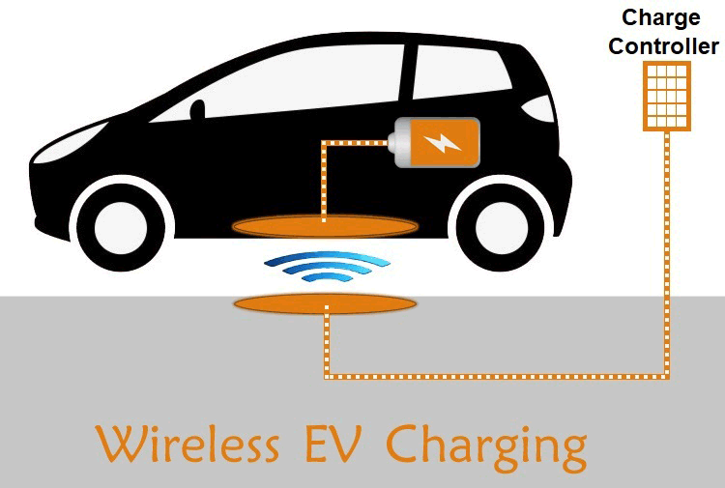
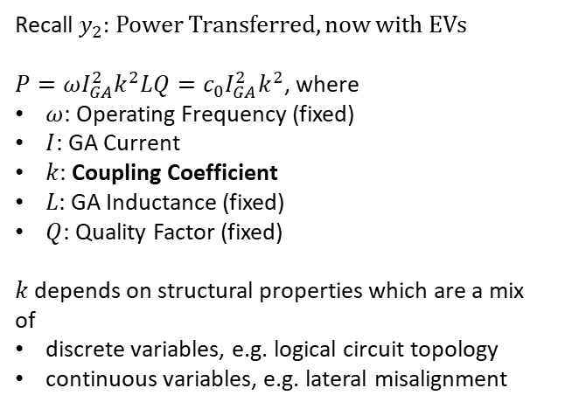
Wireless Charing for Electric Vehicle (EV)
OMG Mathematical Formalisms SIG
Recall $y_{2}$: Power Transferred, now with EVs
$P=ωI_{GA}^{2}k^{2}LQ=c_{0}I_{GA}^{2}k^{2}$, where
$ω$: Operating Frequency (fixed)
$I$: GA Current
$k$: Coupling Coefficient
$L$: GA Inductance (fixed)
$Q$: Quality Factor (fixed)
$k$ depends on structural properties which are a mix of
discrete variables, e.g. logical circuit topology
continuous variables, e.g. lateral misalignment
VA: Vehicle Assembly
GA: Ground Assembly
Wireless Charging for EV

Slide 18
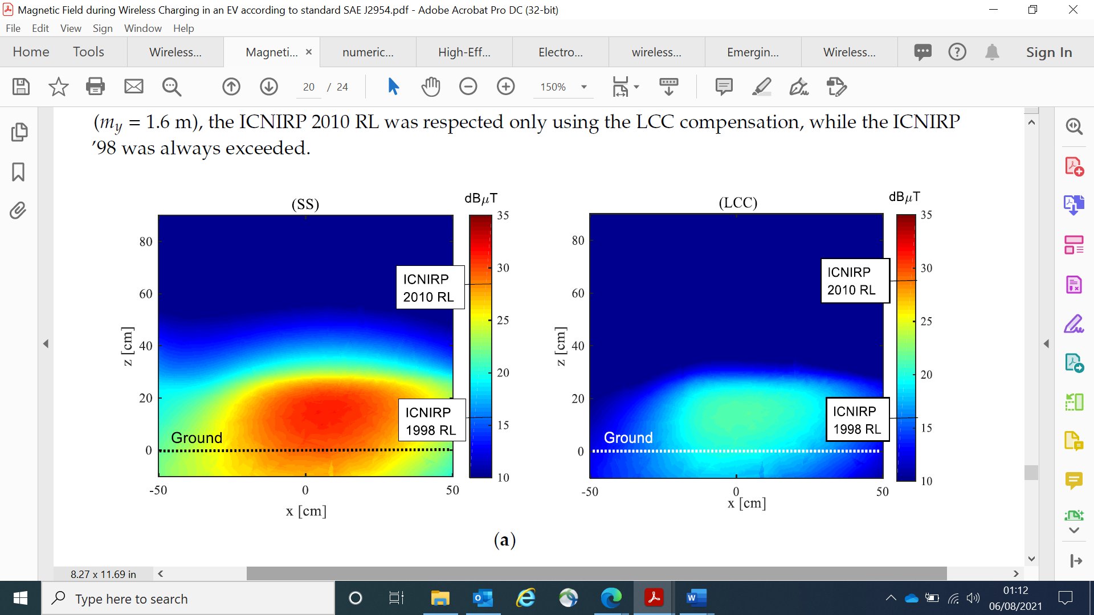
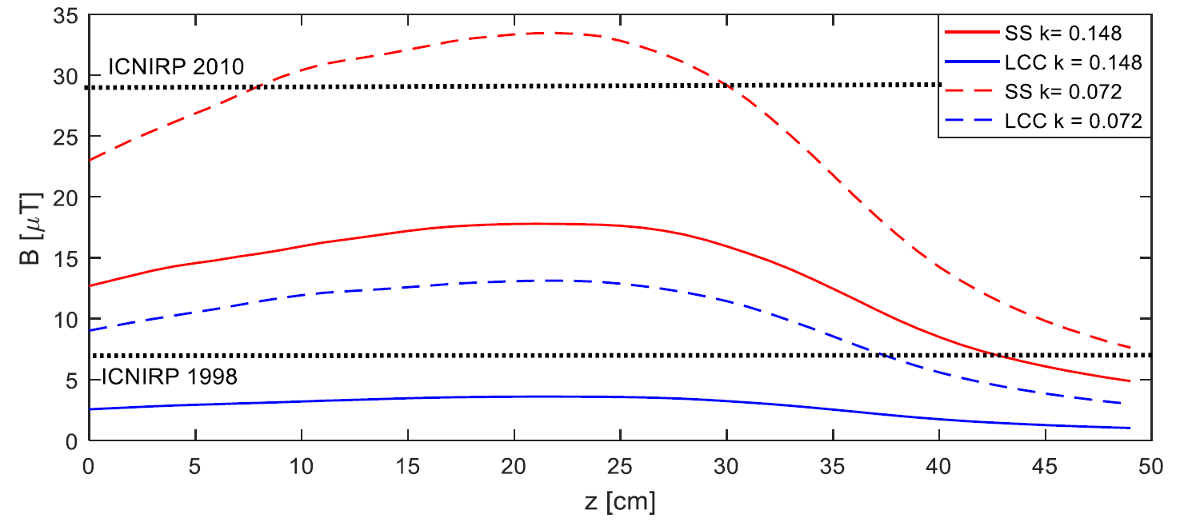
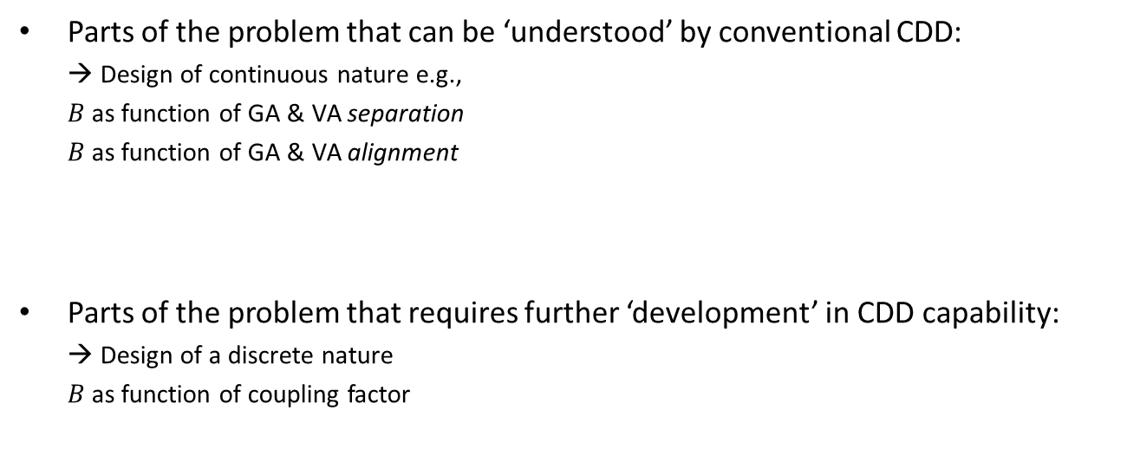
Complex System Design Solutions
Example of Electromagnetic Field Emissions¹
OMG Mathematical Formalisms SIG
Parts of the problem that can be ‘understood’ by conventional CDD:
  → Design of continuous nature e.g.,
  $B$ as function of GA & VA separation
  $B$ as function of GA & VA alignment
Parts of the problem that requires further ‘development’ in CDD capability:
  → Design of a discrete nature
  $B$as function of coupling factor
¹Campi T, Cruicani S, Maradei F, Feliziani M. Magnetic Field during Wireless Charging in an Electric Vehicle According to Standard SAE J2954. Energies. 2019;12:1795

Slide 19
Agenda
OMG Mathematical Formalisms SIG
An Overview of UPR 1.0
Current Work and Strategy
  Complex Constraints
  Model Synchronisation
Discussions

Slide 20
Context & Motivation
Model-based Systems Engineering offers machine readable, traceable models
Models enable the realisation of Digital Threads
Practical Challenge:
  How to handle changes?
What we would like to explore:
  How could the UPR formalism facilitate synchronisation of models?

Slide 21



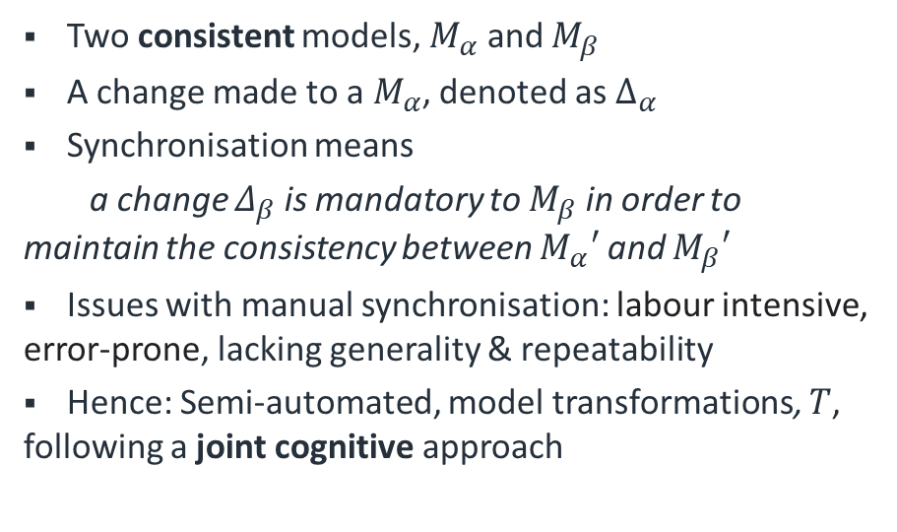




Model Synchronisation
Two consistent models, $M_{α}$ and $M_{β}$
A change made to a $M_{α}$, denoted as $Δ_{α}$
Synchronisation means
a change $Δ_{β}$ is mandatory to $M_{β}$ in order to maintain the consistency between $M_{α}′$ and $M_{β}′$
Issues with manual synchronisation: labour intensive, error-prone, lacking generality & repeatability
Hence: Semi-automated, model transformations, $T$, following a joint cognitive approach
$$Δ_{α}$$
$$M_{α}$$
$$M_{α}′$$
$$T$$
$$Δ_{β}$$
$$M_{β}$$
$$M_{β}′$$

Slide 22
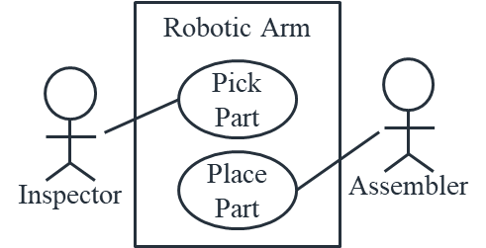
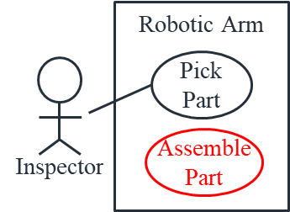
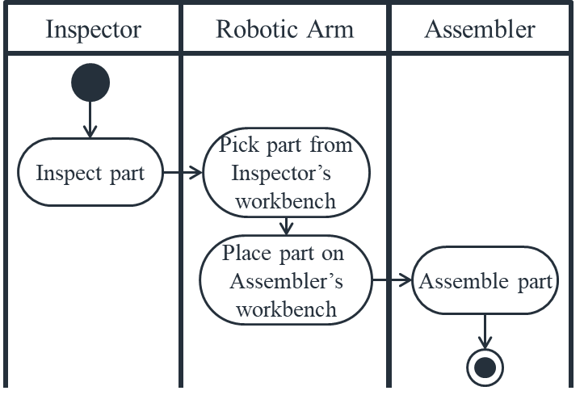
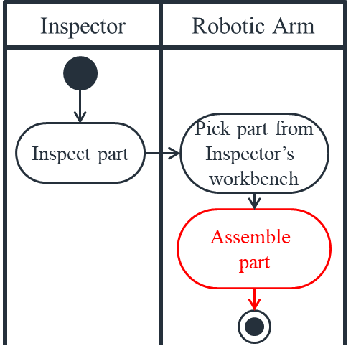







A Concrete Example
Scenario:
  Inspector checks the part, if OK
  Robotic Arm then picks the part and places it on Assembler’s workbench
  Assembler finally assembles the part
Change to functionality:
  From Pick & Place, to Pick & Assemble
Benefit:
  Higher efficiency with reduced safety risks
$M_{α}$: Use Cases
$M_{α}′$: Revised Use Cases
$$Δ_{α}$$
$T$¹
$M_{β}$: Activities
$M_{β}′$: Revised Activities
$$Δ_{β}$$
¹Dickerson & Ji, Essential Architecture and Principles of Systems Engineering, Chapter 5

Slide 23

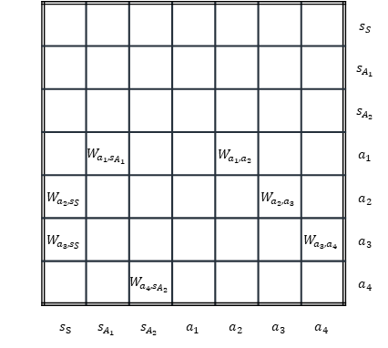



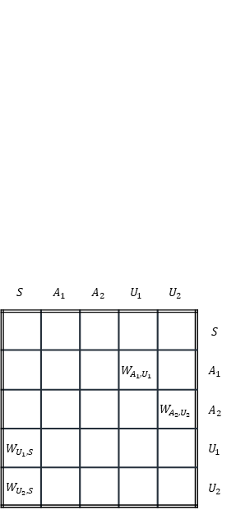




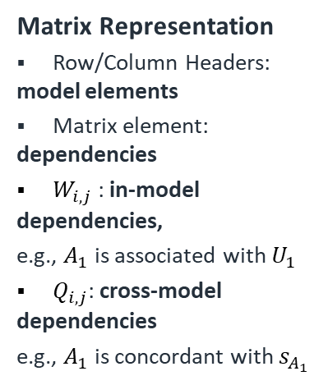






Synchronising Models
$$S$$ | $$A_{1}$$ | $$A_{2}$$ | $$U_{1}$$ | $$U_{2}$$
 |  |  |  |  | $$S$$
 |  |  | $$W_{A_{1},U_{1}}$$ |  | $$A_{1}$$
 |  |  |  | $$W_{A_{2},U_{2}}$$ | $$A_{2}$$
$$W_{U_{1},S}$$ |  |  |  |  | $$U_{1}$$
$$W_{U_{2},S}$$ |  |  |  |  | $$U_{2}$$
 |  |  |  |  |  |  |  | $$s_{S}$$
 |  |  |  |  |  |  |  | $$s_{A_{1}}$$
 |  |  |  |  |  |  |  | $$s_{A_{2}}$$
 |  | $$W_{a_{1},s_{A_{1}}}$$ |  |  | $$W_{a_{1},a_{2}}$$ |  |  | $$a_{1}$$
 | $$W_{a_{2},s_{S}}$$ |  |  |  |  | $$W_{a_{2},a_{3}}$$ |  | $$a_{2}$$
 | $$W_{a_{3},s_{S}}$$ |  |  |  |  |  | $$W_{a_{3},a_{4}}$$ | $$a_{3}$$
 |  |  | $$W_{a_{4},s_{A_{2}}}$$ |  |  |  |  | $$a_{4}$$
 | $s_{S}$ | $$s_{A_{1}}$$ | $$s_{A_{2}}$$ | $$a_{1}$$ | $$a_{2}$$ | $$a_{3}$$ | $$a_{4}$$
 |  |  |  |  |  |  |  |  |  |  |  |  | $$s_{S}$$
 |  |  |  |  |  |  |  |  |  |  |  |  | $$s_{A_{1}}$$
 |  |  |  |  |  |  |  |  |  |  |  |  | $$s_{A_{2}}$$
 |  |  |  |  |  |  | $$W_{a_{1},s_{A_{1}}}$$ |  |  | $$W_{a_{1},a_{2}}$$ |  |  | $$a_{1}$$
 |  |  |  |  |  | $$W_{a_{2},s_{S}}$$ |  |  |  |  | $$W_{a_{2},a_{3}}$$ |  | $$a_{2}$$
 |  |  |  |  |  | $$W_{a_{3},s_{S}}$$ |  |  |  |  |  | $$W_{a_{3},a_{4}}$$ | $$a_{3}$$
 |  |  |  |  |  |  |  | $$W_{a_{4},s_{A_{2}}}$$ |  |  |  |  | $$a_{4}$$
$$S$$ | $$A_{1}$$ | $$A_{2}$$ | $$U_{1}$$ | $$U_{2}$$ |  | $s_{S}$ | $$s_{A_{1}}$$ | $$s_{A_{2}}$$ | $$a_{1}$$ | $$a_{2}$$ | $$a_{3}$$ | $$a_{4}$$
 |  |  |  |  | $$S$$ | $$Q_{S,s_{S}}$$
 |  |  | $$W_{A_{1},U_{1}}$$ |  | $$A_{1}$$ |  | $$Q_{A_{1},s_{A_{1}}}$$ |  | $$Q_{A_{1},a_{1}}$$
 |  |  |  | $$W_{A_{2},U_{2}}$$ | $$A_{2}$$ |  |  | $$Q_{A_{2},s_{A_{2}}}$$ |  |  |  | $$Q_{A_{2},a_{4}}$$
$$W_{U_{1},S}$$ |  |  |  |  | $$U_{1}$$ |  |  |  |  | $$Q_{U_{1},a_{2}}$$
$$W_{U_{2},S}$$ |  |  |  |  | $$U_{2}$$ |  |  |  |  |  | $$Q_{U_{2},a_{3}}$$
$M_{α}$: Use Cases
$$M_{β}$$
$$U_{1}$$
Matrix Representation
Row/Column Headers: model elements
Matrix element: dependencies
$W_{i,j}$ : in-model dependencies,
e.g., $A_{1}$ is associated with $U_{1}$
$Q_{i,j}$: cross-model dependencies
e.g., $A_{1}$ is concordant with $s_{A_{1}}$
$$U_{2}$$
$$A_{1}$$
$$A_{2}$$
$T$
$T$
$$M_{α}$$
$M_{β}$: Activities
$$a_{2}$$
$$a_{1}$$
$$a_{4}$$
$$a_{3}$$

Slide 24






















Synchronising Changes
 |  |  |  |  |  |  |  |  |  |  |  |  | $$s_{S}$$
 |  |  |  |  |  |  |  |  |  |  |  |  | $$s_{A_{1}}$$
 |  |  |  |  |  |  |  |  |  |  |  |  | $$s_{A_{2}}$$
 |  |  |  |  |  |  | $$W_{a_{1},s_{A_{1}}}$$ |  |  | $$W_{a_{1},a_{2}}$$ |  |  | $$a_{1}$$
 |  |  |  |  |  | $$W_{a_{2},s_{S}}$$ |  |  |  |  | $$W_{a_{2},a_{3}}$$ |  | $$a_{2}$$
 |  |  |  |  |  | $$W_{a_{3},s_{S}}$$ |  |  |  |  |  | $$W_{a_{3},a_{4}}$$ | $$a_{3}$$
 |  |  |  |  |  |  |  | $$W_{a_{4},s_{A_{2}}}$$ |  |  |  |  | $$a_{4}$$
$$S$$ | $$A_{1}$$ | $$A_{2}$$ | $$U_{1}$$ | $$U_{2}$$ |  | $s_{S}$ | $$s_{A_{1}}$$ | $$s_{A_{2}}$$ | $$a_{1}$$ | $$a_{2}$$ | $$a_{3}$$ | $$a_{4}$$
 |  |  |  |  | $$S$$ | $$Q_{S,s_{S}}$$
 |  |  | $$W_{A_{1},U_{1}}$$ |  | $$A_{1}$$ |  | $$Q_{A_{1},s_{A_{1}}}$$ |  | $$Q_{A_{1},a_{1}}$$
 |  |  |  | $$W_{A_{2},U_{2}}$$ | $$A_{2}$$ |  |  | $$Q_{A_{2},s_{A_{2}}}$$ |  |  |  | $$Q_{A_{2},a_{4}}$$
$$W_{U_{1},S}$$ |  |  |  |  | $$U_{1}$$ |  |  |  |  | $$Q_{U_{1},a_{2}}$$
$$W_{U_{2},S}$$ |  |  |  |  | $$U_{2}$$ |  |  |  |  |  | $$Q_{U_{2},a_{3}}$$
 |  |  |  |  |  |  |  |  |  |  |  |  | $$s_{S}$$
 |  |  |  |  |  |  |  |  |  |  |  |  | $$s_{A_{1}}$$
 |  |  |  |  |  |  |  |  |  |  |  |  | $$s_{A_{2}}$$
 |  |  |  |  |  |  | $$W_{a_{1},s_{A_{1}}}$$ |  |  | $$W_{a_{1},a_{2}}$$ |  |  | $$a_{1}$$
 |  |  |  |  |  | $$W_{a_{2},s_{S}}$$ |  |  |  |  | $$W_{a_{2},a_{3}}$$ |  | $$a_{2}$$
 |  |  |  |  |  | $$W_{a_{3},s_{S}}$$ |  |  |  |  |  | $$W_{a_{3},a_{4}}$$ | $$a_{3}$$
 |  |  |  |  |  |  |  | $$W_{a_{4},s_{A_{2}}}$$ |  |  |  |  | $$a_{4}$$
$$S$$ | $$A_{1}$$ | $$A_{2}$$ | $$U_{1}$$ | $$U_{2}$$ |  | $s_{S}$ | $$s_{A_{1}}$$ | $$s_{A_{2}}$$ | $$a_{1}$$ | $$a_{2}$$ | $$a_{3}$$ | $$a_{4}$$
 |  |  |  |  | $$S$$ | $$Q_{S,s_{S}}$$
 |  |  | $$W_{A_{1},U_{1}}$$ |  | $$A_{1}$$ |  | $$Q_{A_{1},s_{A_{1}}}$$ |  | $$Q_{A_{1},a_{1}}$$
 |  |  |  | $$W_{A_{2},U_{2}}$$ | $$A_{2}$$ |  |  | $$Q_{A_{2},s_{A_{2}}}$$ |  |  |  | $$Q_{A_{2},a_{4}}$$
$$W_{U_{1},S}$$ |  |  |  |  | $$U_{1}$$ |  |  |  |  | $$Q_{U_{1},a_{2}}$$
$$W_{U_{2},S}$$ |  |  |  |  | $$U_{2}$$ |  |  |  |  |  | $$Q_{U_{2},a_{3}}$$
 |  |  |  |  |  |  |  |  |  |  |  |  | $$s_{S}$$
 |  |  |  |  |  |  |  |  |  |  |  |  | $$s_{A_{1}}$$
 |  |  |  |  |  |  |  |  |  |  |  |  | $$s_{A_{2}}$$
 |  |  |  |  |  |  | $$W_{a_{1},s_{A_{1}}}$$ |  |  | $$W_{a_{1},a_{2}}$$ |  |  | $$a_{1}$$
 |  |  |  |  |  | $$W_{a_{2},s_{S}}$$ |  |  |  |  | $$W_{a_{2},a_{3}}$$ |  | $$a_{2}$$
 |  |  |  |  |  | $$W_{a_{3},s_{S}}$$ |  |  |  |  |  | $$W_{a_{3},a_{4}}$$ | $$a_{3}$$
 |  |  |  |  |  |  |  | $$W_{a_{4},s_{A_{2}}}$$ |  |  |  |  | $$a_{4}$$
$$S$$ | $$A_{1}$$ | $$A_{2}$$ | $$U_{1}$$ | $$U_{2}$$ |  | $s_{S}$ | $$s_{A_{1}}$$ | $$s_{A_{2}}$$ | $$a_{1}$$ | $$a_{2}$$ | $$a_{3}$$ | $$a_{4}$$
 |  |  |  |  | $$S$$ | $$Q_{S,s_{S}}$$
 |  |  | $$W_{A_{1},U_{1}}$$ |  | $$A_{1}$$ |  | $$Q_{A_{1},s_{A_{1}}}$$ |  | $$Q_{A_{1},a_{1}}$$
 |  |  |  | $$W_{A_{2},U_{2}}$$ | $$A_{2}$$ |  |  | $$Q_{A_{2},s_{A_{2}}}$$ |  |  |  | $$Q_{A_{2},a_{4}}$$
$$W_{U_{1},S}$$ |  |  |  |  | $$U_{1}$$ |  |  |  |  | $$Q_{U_{1},a_{2}}$$
$$W_{U_{2},S}$$ |  |  |  |  | $$U_{2}$$ |  |  |  |  |  | $$Q_{U_{2},a_{3}}$$
 |  |  |  |  |  |  |  |  |  |  |  |  | $$s_{S}$$
 |  |  |  |  |  |  |  |  |  |  |  |  | $$s_{A_{1}}$$
 |  |  |  |  |  |  |  |  |  |  |  |  | $$s_{A_{2}}$$
 |  |  |  |  |  |  | $$W_{a_{1},s_{A_{1}}}$$ |  |  | $$W_{a_{1},a_{2}}$$ |  |  | $$a_{1}$$
 |  |  |  |  |  | $$W_{a_{2},s_{S}}$$ |  |  |  |  | $$W_{a_{2},a_{3}}$$ |  | $$a_{2}$$
 |  |  |  |  |  | $$W_{a_{3},s_{S}}$$ |  |  |  |  |  | $$W_{a_{3},a_{4}}$$ | $$a_{3}$$
 |  |  |  |  |  |  |  | $$W_{a_{4},s_{A_{2}}}$$ |  |  |  |  | $$a_{4}$$
$$S$$ | $$A_{1}$$ | $$A_{2}$$ | $$U_{1}$$ | $$U_{2}$$ |  | $s_{S}$ | $$s_{A_{1}}$$ | $$s_{A_{2}}$$ | $$a_{1}$$ | $$a_{2}$$ | $$a_{3}$$ | $$a_{4}$$
 |  |  |  |  | $$S$$ | $$Q_{S,s_{S}}$$
 |  |  | $$W_{A_{1},U_{1}}$$ |  | $$A_{1}$$ |  | $$Q_{A_{1},s_{A_{1}}}$$ |  | $$Q_{A_{1},a_{1}}$$
 |  |  |  | $$W_{A_{2},U_{2}}$$ | $$A_{2}$$ |  |  | $$Q_{A_{2},s_{A_{2}}}$$ |  |  |  | $$Q_{A_{2},a_{4}}$$
$$W_{U_{1},S}$$ |  |  |  |  | $$U_{1}$$ |  |  |  |  | $$Q_{U_{1},a_{2}}$$
$$W_{U_{2},S}$$ |  |  |  |  | $$U_{2}$$ |  |  |  |  |  | $$Q_{U_{2},a_{3}}$$
 |  |  |  |  |  |  |  |  |  |  |  |  | $$s_{S}$$
 |  |  |  |  |  |  |  |  |  |  |  |  | $$s_{A_{1}}$$
 |  |  |  |  |  |  |  |  |  |  |  |  | $$s_{A_{2}}$$
 |  |  |  |  |  |  | $$W_{a_{1},s_{A_{1}}}$$ |  |  | $$W_{a_{1},a_{2}}$$ |  |  | $$a_{1}$$
 |  |  |  |  |  | $$W_{a_{2},s_{S}}$$ |  |  |  |  | $$W_{a_{2},a_{3}}$$ |  | $$a_{2}$$
 |  |  |  |  |  | $$W_{a_{3},s_{S}}$$ |  |  |  |  |  | $$W_{a_{3},a_{4}}$$ | $$a_{3}$$
 |  |  |  |  |  |  |  | $$W_{a_{4},s_{A_{2}}}$$ |  |  |  |  | $$a_{4}$$
$$S$$ | $$A_{1}$$ | $$A_{2}$$ | $$U_{1}$$ | $$U_{2}$$ |  | $s_{S}$ | $$s_{A_{1}}$$ | $$s_{A_{2}}$$ | $$a_{1}$$ | $$a_{2}$$ | $$a_{3}$$ | $$a_{4}$$
 |  |  |  |  | $$S$$ | $$Q_{S,s_{S}}$$
 |  |  | $$W_{A_{1},U_{1}}$$ |  | $$A_{1}$$ |  | $$Q_{A_{1},s_{A_{1}}}$$ |  | $$Q_{A_{1},a_{1}}$$
 |  |  |  | $$W_{A_{2},U_{2}}$$ | $$A_{2}$$ |  |  | $$Q_{A_{2},s_{A_{2}}}$$ |  |  |  | $$Q_{A_{2},a_{4}}$$
$$W_{U_{1},S}$$ |  |  |  |  | $$U_{1}$$ |  |  |  |  | $$Q_{U_{1},a_{2}}$$
$$W_{U_{2},S}$$ |  |  |  |  | $$U_{2}$$ |  |  |  |  |  | $$Q_{U_{2},a_{3}}$$
 |  |  |  |  |  |  |  |  |  |  |  |  | $$s_{S}$$
 |  |  |  |  |  |  |  |  |  |  |  |  | $$s_{A_{1}}$$
 |  |  |  |  |  |  |  |  |  |  |  |  | $$s_{A_{2}}$$
 |  |  |  |  |  |  | $$W_{a_{1},s_{A_{1}}}$$ |  |  | $$W_{a_{1},a_{2}}$$ |  |  | $$a_{1}$$
 |  |  |  |  |  | $$W_{a_{2},s_{S}}$$ |  |  |  |  | $$W_{a_{2},a_{3}}$$ |  | $$a_{2}$$
 |  |  |  |  |  | $$W_{a_{3},s_{S}}$$ |  |  |  |  |  | $$W_{a_{3},a_{4}}$$ | $$a_{3}$$
 |  |  |  |  |  |  |  | $$W_{a_{4},s_{A_{2}}}$$ |  |  |  |  | $$a_{4}$$
$$S$$ | $$A_{1}$$ | $$A_{2}$$ | $$U_{1}$$ | $$U_{2}$$ |  | $s_{S}$ | $$s_{A_{1}}$$ | $$s_{A_{2}}$$ | $$a_{1}$$ | $$a_{2}$$ | $$a_{3}$$ | $$a_{4}$$
 |  |  |  |  | $$S$$ | $$Q_{S,s_{S}}$$
 |  |  | $$W_{A_{1},U_{1}}$$ |  | $$A_{1}$$ |  | $$Q_{A_{1},s_{A_{1}}}$$ |  | $$Q_{A_{1},a_{1}}$$
 |  |  |  | $$W_{A_{2},U_{2}}$$ | $$A_{2}$$ |  |  | $$Q_{A_{2},s_{A_{2}}}$$ |  |  |  | $$Q_{A_{2},a_{4}}$$
$$W_{U_{1},S}$$ |  |  |  |  | $$U_{1}$$ |  |  |  |  | $$Q_{U_{1},a_{2}}$$
$$W_{U_{2},S}$$ |  |  |  |  | $$U_{2}$$ |  |  |  |  |  | $$Q_{U_{2},a_{3}}$$
 |  |  |  |  |  |  |  |  |  |  |  |  | $$s_{S}$$
 |  |  |  |  |  |  |  |  |  |  |  |  | $$s_{A_{1}}$$
 |  |  |  |  |  |  |  |  |  |  |  |  | $$s_{A_{2}}$$
 |  |  |  |  |  |  | $$W_{a_{1},s_{A_{1}}}$$ |  |  | $$W_{a_{1},a_{2}}$$ |  |  | $$a_{1}$$
 |  |  |  |  |  | $$W_{a_{2},s_{S}}$$ |  |  |  |  | $$W_{a_{2},a_{3}}$$ |  | $$a_{2}$$
 |  |  |  |  |  | $$W_{a_{3},s_{S}}$$ |  |  |  |  |  | $$W_{a_{3},a_{4}}$$ | $$a_{3}$$
 |  |  |  |  |  |  |  | $$W_{a_{4},s_{A_{2}}}$$ |  |  |  |  | $$a_{4}$$
$$S$$ | $$A_{1}$$ | $$A_{2}$$ | $$U_{1}$$ | $$U_{2}$$ |  | $s_{S}$ | $$s_{A_{1}}$$ | $$s_{A_{2}}$$ | $$a_{1}$$ | $$a_{2}$$ | $$a_{3}$$ | $$a_{4}$$
 |  |  |  |  | $$S$$ | $$Q_{S,s_{S}}$$
 |  |  | $$W_{A_{1},U_{1}}$$ |  | $$A_{1}$$ |  | $$Q_{A_{1},s_{A_{1}}}$$ |  | $$Q_{A_{1},a_{1}}$$
 |  |  |  | $$W_{A_{2},U_{2}}$$ | $$A_{2}$$ |  |  | $$Q_{A_{2},s_{A_{2}}}$$ |  |  |  | $$Q_{A_{2},a_{4}}$$
$$W_{U_{1},S}$$ |  |  |  |  | $$U_{1}$$ |  |  |  |  | $$Q_{U_{1},a_{2}}$$
$$W_{U_{2},S}$$ |  |  |  |  | $$U_{2}$$ |  |  |  |  |  | $$Q_{U_{2},a_{3}}$$
 |  |  |  |  |  |  |  |  |  |  |  |  | $$s_{S}$$
 |  |  |  |  |  |  |  |  |  |  |  |  | $$s_{A_{1}}$$
 |  |  |  |  |  |  |  |  |  |  |  |  | $$s_{A_{2}}$$
 |  |  |  |  |  |  | $$W_{a_{1},s_{A_{1}}}$$ |  |  | $$W_{a_{1},a_{2}}$$ |  |  | $$a_{1}$$
 |  |  |  |  |  | $$W_{a_{2},s_{S}}$$ |  |  |  |  | $$W_{a_{2},a_{3}}$$ |  | $$a_{2}$$
 |  |  |  |  |  | $$W_{a_{3},s_{S}}$$ |  |  |  |  |  | $$W_{a_{3},a_{4}}$$ | $$a_{3}$$
 |  |  |  |  |  |  |  | $$W_{a_{4},s_{A_{2}}}$$ |  |  |  |  | $$a_{4}$$
$$S$$ | $$A_{1}$$ | $$A_{2}$$ | $$U_{1}$$ | $$U_{2}$$ |  | $s_{S}$ | $$s_{A_{1}}$$ | $$s_{A_{2}}$$ | $$a_{1}$$ | $$a_{2}$$ | $$a_{3}$$ | $$a_{4}$$
 |  |  |  |  | $$S$$ | $$Q_{S,s_{S}}$$
 |  |  | $$W_{A_{1},U_{1}}$$ |  | $$A_{1}$$ |  | $$Q_{A_{1},s_{A_{1}}}$$ |  | $$Q_{A_{1},a_{1}}$$
 |  |  |  | $$W_{A_{2},U_{2}}$$ | $$A_{2}$$ |  |  | $$Q_{A_{2},s_{A_{2}}}$$ |  |  |  | $$Q_{A_{2},a_{4}}$$
$$W_{U_{1},S}$$ |  |  |  |  | $$U_{1}$$ |  |  |  |  | $$Q_{U_{1},a_{2}}$$
$$W_{U_{2},S}$$ |  |  |  |  | $$U_{2}$$ |  |  |  |  |  | $$Q_{U_{2},a_{3}}$$
$$M_{β}′$$
$M_{α}$: Use Cases
$M_{α}′$: Revised Use Cases
$$Δ_{α}$$
$$U_{1}$$
$$U_{2}$$
$T$
$$A_{1}$$
$$A_{2}$$
$$M_{α}′$$
$T$
$M_{β}$: Activities
$M_{β}′$: Revised Activities
$$a_{2}$$
$$Δ_{β}$$
$$a_{1}$$
$$a_{4}$$
$$a_{3}$$

Slide 25











A Supporting Mathematical Formalism [15]*
Synchronisation achieved through structure preserving transformations:
Semantic Transformation, $Q_{α→β}$ that preserves one structure into another, e.g. Use Case to Activity Diagram, but without populated content
Interpretation, $I_{α}$ and $I_{β}$, that interpret domain knowledge into the structure to make them models
$$I_{α}$$
$$W_{α}$$
$$M_{α}(S_{α})$$
$$𝟙_{W_{α,β}}$$
$$Q_{α→β}∘I_{α}$$
$$Q_{α→β}$$
$$𝟙_{W_{α,β}}∘I_{β}$$
$$W_{β}$$
$$M_{β}(S_{β})$$
$$I_{β}$$
*Preprint available soon

Slide 26
Agenda
OMG Mathematical Formalisms SIG
An Overview of UPR 1.0
Current Work and Strategy
  Complex Constraints
  Model Synchronisation
Discussions

Slide 27
Pathway for UPR 1.0 Evolution
OMG Mathematical Formalisms SIG
Scope of evolution is beyond UPR 1.0 RTF due to
  Inclusion of logical constraints, as seen in EV studies
  Supporting CDD automation
  Exploring structure preserving transformations for
    Model Synchronisation
    Model Synthesis
Pathways
  UPR 2.0; or
  Merge into with SysML 2 in a later RTF?
  Collaboration with SE DSIG & Ontology PSIG

Slide 28
References, up to UPR 1.0 adoption
OMG Mathematical Formalisms SIG
[1] Dickerson, C.E. and D. Mavris, “Relational Oriented Systems Engineering (ROSE): Preliminary report,” in Proc. IEEE SoSE '11, Albuquerque, 2011.
[2] Dickerson, C.E., “A relational oriented approach to system of systems assessment of alternatives for data link interoperability,” IEEE Systems Journal, 16 May 2013.
[3] Mavris, D., K. Griendling and C. Dickerson, “Relational-Oriented Systems Engineering and Technology Trade-off Analysis Framework,” AIAA Journal of Aircraft, 28 August 2013.
[4] Dickerson, C.E., and D. Mavris, “A Brief History of Models and Model Based Systems Engineering and the Case for Relational Orientation,” IEEE Systems Journal, vol. 7, no. 4, 2013.
[5] D. Battersby, C. Dickerson, and S. Ji (with Jaguar Land Rover), “Calibration system and method”, U.K. patent publication number GB2555617A, 9th May 2018
[6] Profiling a Software Architecture for the Relational Oriented Systems Engineering Technology Trade-off and Analysis Framework (ROSETTA), OMG Document No. mars/16-09-14, https://www.omg.org/members/cgi-bin/doc?mars/16-09-14.pptx
[7 UPR: UML Profile for ROSETTA Summary Report OMG Document No. mars/17-12-16, https://www.omg.org/members/cgi-bin/doc?mars/17-12-16.pptx
[8]“UPR: UML Profile for ROSETTA”, adopted by the OMG on 22nd June 2018, https://www.omg.org/spec/UPR/1.0/PDF

Slide 29
References, the new journey
OMG Mathematical Formalisms SIG
[9] AMiCC (AMiCalbe Charging), www.projectamicc.com
[10] Dickerson, Charles E. et al, 2021. “Architecture definition in complex system design using model theory.” IEEE Systems Journal 15, no. 2: 1847 – 1860.
[11] Dickerson, C.E. and Siyuan Ji, Essential Architecture and Principles of Systems Engineering. Boca Raton Florida: CRC Press Auerbach Publication, September 2021.
[12] Update and Pathway for UPR 1.0 Evolution, OMG Document No. mars/21-09-19, https://www.omg.org/members/cgi-bin/doc?mars/21-09-19.pptx
[13] Review, Update and Pathway for UPR 1.0 Evolution, OMG Document No. ad/22-03-13, https://www.omg.org/members/cgi-bin/doc?ad/22-03-13.pptx
[14] UML Profile for ROSETTA (UPR), Architecture Specification with Structures and Transformations, OMG Document No. ontology/22-03-02, https://www.omg.org/members/cgi-bin/doc?ontology/22-03-02.pptx
[15] S. Ji, C. Dickerson and M. Wilkinson, ‘Structure Preserving Transformations for Practical Model-based Systems Engineering’, to be submitted to ISSE2022

