Slide 1
MVF Use Cases

Slide 2
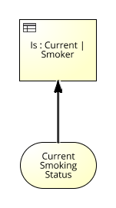
DMN/BPMN/CMMN Vendor 1
<dmn:decision name="isCurrentSmoker label="Is : Current | Smoker">
<dmn:extensionElements>
<vendor:diagramMetaData name=“(user Tag)" value="[&quot;/glossary/113dc42a4f6844f892d2aa2e4b8782e8&quot;]"/>
</dmn:extensionElements>
<(standard DMN elements)/> </dmn:decision>
<dmn:itemDefinition isCollection="false" name="currentSmokingStatus" label="Current Smoking Status" vendor:glossaryId="cb84baf3f45b4ac2bd4d64eab2a4fbf0"/>

Slide 3
DMN/BPMN/CMMN Vendor 2
<dmn:inputData name="Smoking Status"> <dmn:extensionElements> <vendor:semanticLink name="Smoke Test Dictionary – Current Smoking Status" modelURI="http://www.vendor.com/discovery/_d491da62-7201-41e6-8ef3-524af0c8add4" uri="http://www.vendor.com/discovery/_d491da62-7201-41e6-8ef3-524af0c8add4#_b06a1544-b3ac-4cbe-a28a-66341820f6da"/> </dmn:extensionElements> <dmn:variable name=“Current Smoking Status" typeRef="string"/> </dmn:inputData>

Slide 4
Options
Leverage the extensibility of the language, defining a standard micro-object that can be injected as needed

Slide 5
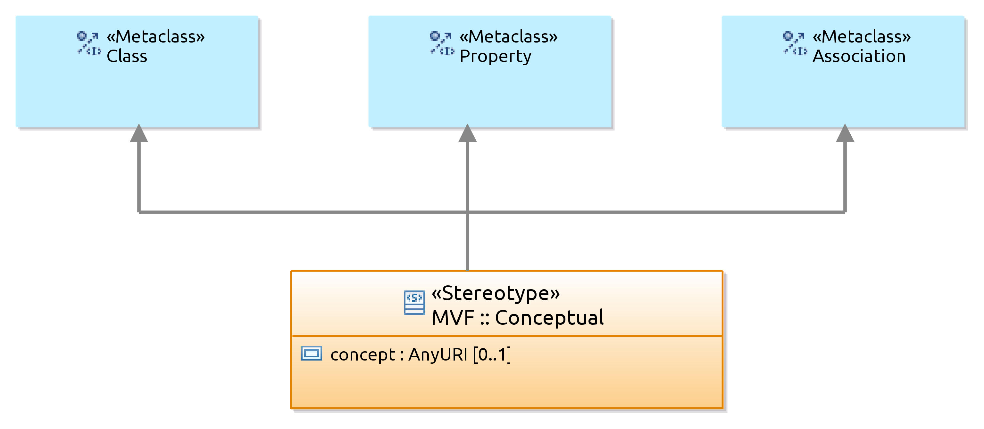
API4KP - UML Stereotype

Slide 6
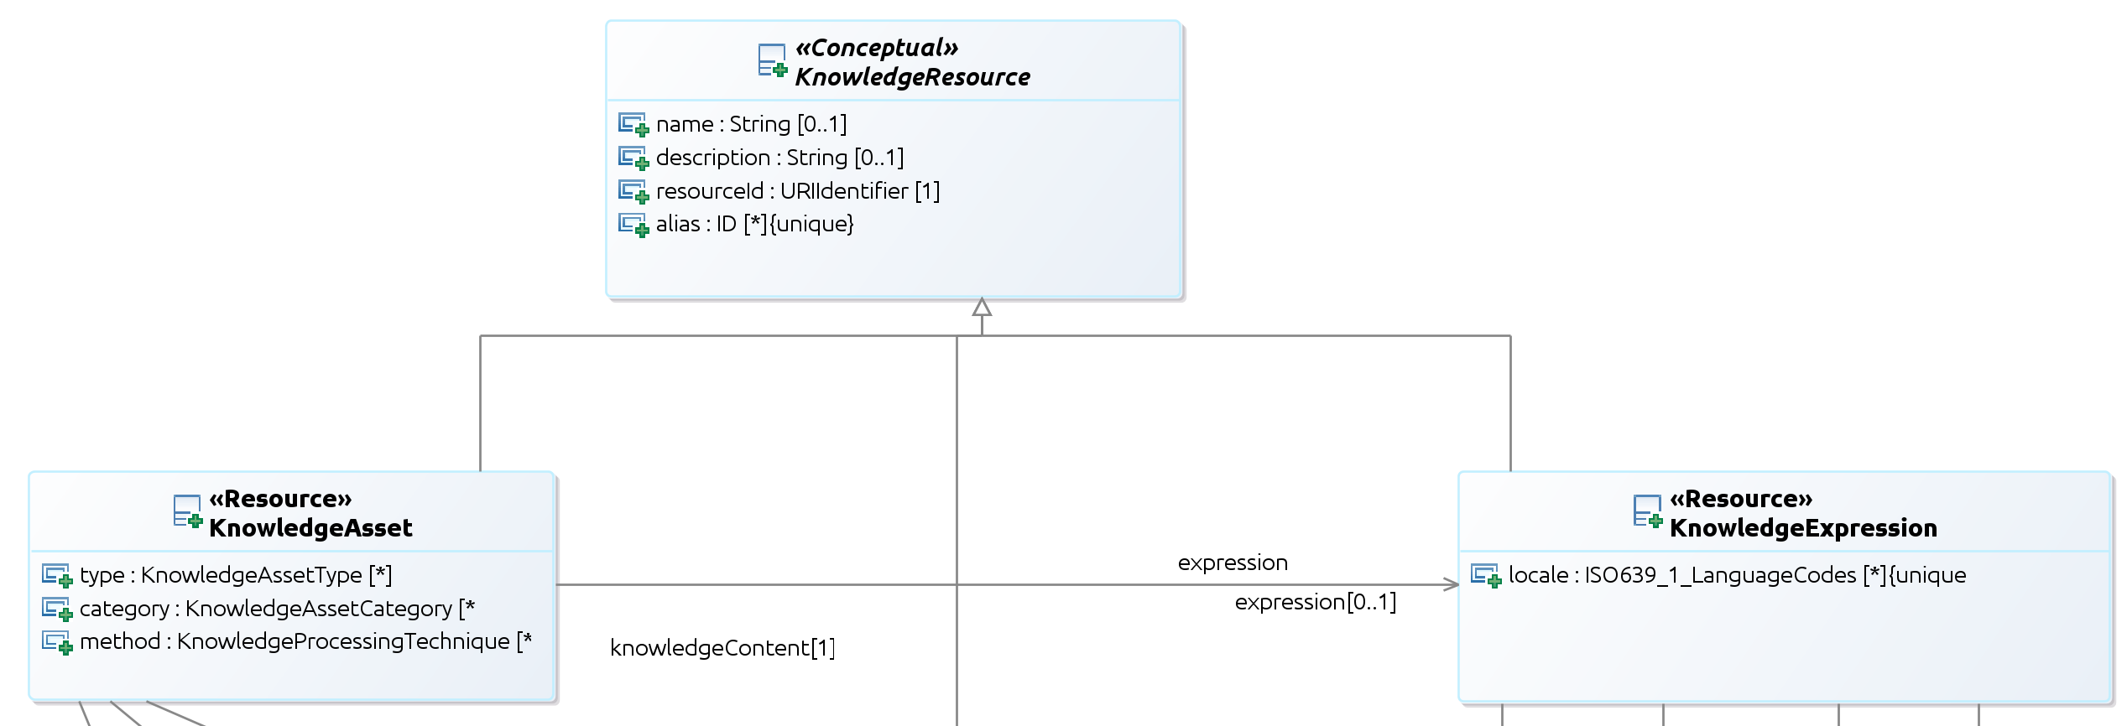
Stereotype
<MVF:Conceptual concept=http://omg.org/spec/API4KP/KnowledgeResource base_Class=“(KnowledgeResource)” />
Bonus: can drive a RDF/Object Mapping when Classes (e.g. Java) are generated from the UML model

Slide 7
Useful Operations

Slide 8
Background - Terminology
Healthcare is the primary domain that has evolved terminology services
CTS-2 (abandoned)
FHIR Terminology
Useful
Not the best API design
Absolutely general purposes, but PSM** and Domain-specific
Unless the FHIR metamodel is taken as UML 3.0, that is ☺

Slide 9
Background – “Concepts”
Hard to implement pure abstractions ☺
Implementations should be faithful to the semiotic notion
Respect the boundaries with “expressions” and “referents”
Concepts as “units of abstraction”
Units of Knowledge Generically Dependent Continuants – everyone’s shared idea of X
Units of Thought Specifically Dependent Continuants – any one’s idea of X
(Terminology Servers assume the former)

Slide 10
Alignment
Assume:
Concept == MVFEntry
Term/Label = MVF DictionaryEntry.Term

Slide 11
Operations
Lookup( ConceptId ) : Concept Returns a representation of the Concept with the given Id, usually including terms/labels, a definition and relationships to other “neighbour” concepts.
Resolve( Term ) : List<Concept> Returns a (prioritized) list of Concepts that are evoked by the provided term – usually performed by string matching on the concept’s label, but can be more sophisticated and leverage e.g. NLP

Slide 12
Operations
GetTerm( ConceptId, Vocabulary* ) : Map<String,Term> Retrieves the label(s) of a given concept in the given vocabularies.
GetCloud( ConceptId, Depth?, RelationshipType ) : Graph Returns the neighbors of a given concept, possibly filtered by the type of relationship between concepts, and up to a certain number of steps in the graph

Slide 13
Model Operations
Translation( Model, TargetLanguage ) : Model Given a model expressed in a modelling language and using one or more lexicon (aka MVFDictionary), returns a new model that carries the same information content, but is expressed using a different modelling language and/or lexicon
???-translation A translation that preserves the modelling language (grammar) but changes the underlying lexicon
Localization( Model, TargetVocabulary ) : Model Given a model expressed in a modelling language and using one or more lexicon (aka MVFDictionary), returns a model expressed in the same language and lexicon, but using a different vocabulary for that lexicon

