Slide 1
VCoI Update
Tuesday 28 September
OMG Quarterly Meeting

Slide 2
Overview
The problem
The principles
Practical guidance
Participation

Slide 3
Strategy
Why are we here?
The problem we are trying to solve (why VCoI exists)
Each TC has some vocabulary or concept definitions
And abbreviations, references etc.
OMG–wide approach to defining group vocabularies
Overlaps
Reusability
May be differences among the TCs on how you manage terms and concepts
Common problem is to manage the terminologies in each of the contexts in which you are working

Slide 4
What we do
Set down a strategy
Put down guidelines for how you can maintain a vocabulary and concepts resource
Will then create a guide for implementation
We are here to enlist partners from among you in completing and testing this work
Start with a basic MVP
Proof of Concept (as done for GovDTF)

Slide 5
Pieces
The Principles
The potential standards
MVF
SKOS
API4KP (to query such a resource)
DOL
The Tools
Are there tools
for API4KP?
DOL is part of API4KP
Are there DOL tools?
Or MVF (no?); may be some initial implementation? See BFQ for statement of intent
The Guidelines
How to use SKOS, MVP etc. within the guidelines
Annotation metadata
Process for TC articulation of terms and concepts

Slide 6
Concepts Re-use Calculus
W
C
Word
means
Concept
in context
Is one or a set of
Context
X
Re-use
Ontology
Concept Library
Concept
Concept
Concept
Concept
Concept

Slide 7
Requirement Overview
TF Conceptual ontology
Vocabulary Resource
Terms and Definitions
Wiki Table
Document insert
Industry ontologies
Individual Wiki Pages
(with Index)
IOF
FIBO
Acronyms,
Abbreviations
& Nicknames
Taxonomies
Semantic Completeness
Vocabularies
Wiki Table
Other Structured Resources (US Gov, industry etc.)
Document inserts
Vocabulary for Models
References
Wiki Table
References
Document insert

Slide 8
Implementation
There is a variety of mechanisms that exist
We are not re-inventing any of that
Whatever guidelines we propose to TCs will use existing standards
When there are available tools
E.g. MVF, SKOS, API4KP/DOL, SBVR, RDFS/OWL etc.
What is extra from VCoI?
How to use each of these in the relevant places in the protocol
Process recommendations

Slide 9
Process
We have started to map out some detailed process
Based on the IIC Process diagram (can show as an example)
We want to fit in with what people already do
There will be interactive sessions on that during the Q4 regular meetings
VCoI will …
Rules for Inclusion
Is this unique to our domain
Is this well understood and defined I regular dictionaries
These rules cover (separately)
The use of a term (words)
The need for a concept
The context in which the TC may or may not need to capture its own contextual use of a term for a define OR new concept

Slide 10
Process examples / so far
We will aim for consistency witih the process from the IIC and the Digital Twin Consortium

Slide 11
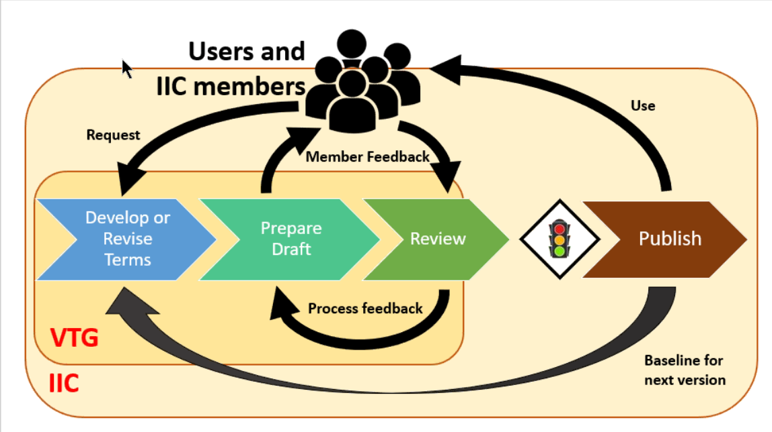
IIC Process
This exists explicitly in the Context of IIC – single Speech Community

Slide 12
Top level ‘triage’ process
Identity if this is a word strong that already exists in our concept-base already
New Concept in Concepts List
Process 1: Terms
Concept Exists
Update concepts Synonyms
Update context ontology
Analyze Input
Process 2: Abbrev
Refers to
Outputs
(all 3)
Define ‘Term’: A lexical representation of a Concept
Process 3: Refs
Reference: Background material we may want to point to for the meaning of some basic term (symbol grounding)
- makes the Foundational Ontology really simple
- document this for other groups
Might refer to

Slide 13
Process for Term AND for Concept (by Context)
Inputs
Concepts
+
Defns
See other page
Analyze inputs
Definition
Identify Term
Identify Concept
Formalize meaning
Review
Publish
Ensure aligned
Identify Usage Context
Ontology
Ontology
Ontology
Terms Usage
Context Ontology
Usage Context

Slide 14
Discussion
How to characterize a well formed concept ontology
Use the VCoI ‘context’ forming ontology as examplar
Classification
Guizzardi ‘Tessellation of Kinds’ – use that
Keep more arbitrary categories
Sets that can span categories
Sets that ‘tesselate’ – can never change, are fundamental
Be able to challenge e.g. industry ontologies for fitness of purpose
As a practical way of teasing out those principles
What about SBRM?
This also aims to set out how concepts are defined (for reporting)
The Financial Report Knowledge Graph
Uses RDF/OWL with SHACL, Prolog, SQL and others
Closer to what we want than another data dictionary

Slide 15
Communicating
Not assuming that any given TF or SIG is forced to create an ontology
May have a term list they use
But if they do have an ontology – it should conform with these (to be produced) guidelines
How to allow for a TC to evolve up the LHS of that main diagram
You design it yourself
We provide a framework for doing this
That itself will evolve and improve over time
Have an MVP rather than wait to have it complete (small enough to not be wrong, big enough to be improved upon)
How to avoid the default of getting data models (as we see with some approaches to ontologies)?
MVP needs to at least make those distinctions
Can then evolve from e.g. a more data-facing ontology to something as specified
How to specify that

Slide 16
Moving it Forward
How to get to the MVP in the next quarter?
Get more interest
Time and day
Currently Monday 5 – 6 ET (doesn’t work for everyone)
What is a good time?
What a good meeting cadence e.g. bi-weekly, weekly, monthly
1h 1x a week up to now – may be a bit much
How about 1.5h every other week – Better
How to find it?
Mail list: vcoi@omg.org
How do we publicise it across the various TCs?
Via the OMG PR
Send an exciting intro thing
Include in the post-OMG public publicity blast
Distinguish public v OMG
How to get it on the OMG lists
Membership list (all members list)
TF Chairs list
IIC did a thing to get their dictionary off the ground by approaching the various groups individually
Do that (also)
Ask for 5 min on each TF to give them the brief overview e.g. System Assurance TF
Get on these agendas at December TF
Keep track of which TCs we have connected with – program for future QMs

Slide 17
Next Meetings
How to organize the time slot / participation
Reach out to TFs with where we are now
Use the Friday Plenary to announce this
Let the Chairs know we will be approaching them about 5 min for Dec / March
Book a slot on the agenda on Friday – 5 min slot, we can ask for this; if not, mention as part of FDTF
Also ask them how to make it useful for them
Got past incubation
Get to Engagement
Would they use it?
What would be most useful (what components to focus on)
Aim to start the series of Q4 meetings in 2 weeks (week off after this QM)
Schedule during this time scale
Mail blast for this initial planning in Q4
TF Chairs (and ask them to pass it along)
All members – not a list but staff has that if needed
With permission from OMG authorities – MB to reach to them with a brief message
Then each member can decide whether to participate
Can be advocate to their TC and their company

Slide 18
Other Comments / MVF Next Actions etc.

