Slide 1
VCoI Deliverables and Status
Prepared for: GovDTF, 15 June 2021
Submitted to OMG as:
finance/2021-06-04

Slide 2
Outline
Concepts Re-use Calculus
Content requirements
Metamodel
Annotation requirements
Output formats (presentation)
Context Ontology
Process
Summary document for the whole package (coversheet / ToC)

Slide 3
History
Initial PoC exercises
GovDTF
Blockchain PSIG
Further Ps of C:
AI PTF

Slide 4
Other PoCs not in VCoI
AI PTF
Taxonomy – interesting findings
Different kinds of organizing principle
Desirable to finish the taxonomy in e.g. Excel
See also AI PTF – reinforces the fact that 2 perfectly legitimate notions of ‘what is a taxonomy
And tat the 1st is valuable in gathering SME knowledge
But needs later segregation of the organizing principles
Facets?
Contact Loehrlein et al
AI, Blockchain, Others
Nick Wiki stuff

Slide 5
Concepts Re-use Calculus
W
C
Word
means
Concept
in context
Is one or a set of
Context
X
Re-use
Ontology
Concept Library
Concept
Concept
Concept
Concept
Concept

Slide 6
History outcome
Audiences
Individual SGs
For their own use
Outward facing eg for government use, conferences etc.
OMG as a whole
Sharing across TFs and SIGs
Reuse across documents

Slide 7
The OMG Proposition
Objective: make it possible for people to declare terms v concepts they use so others can use or be aware.
How it works:
Expose Terms, Abbreviations, References to other SGs
SG have a concept, a term; expose this to the wider OMG
People then know elsewhere in the OMG when there is a new meaning of a given word
e.g. 'Activity' in some new context
e.g. Occurrences in one standard, versus 'Event' in BPMN, expressing the same concept as different words in those distinct contexts.
Also when there is a well-defined concept they can use
Without needing to use the same word for it

Slide 8
Proposition to wider OMG Audience
Ability for anyone to determine a concept or term already exists
Identify the needs for disambiguation entry
Applies to
Terms and definitions
Term: words or groups of words
Concept
Abbreviations
References
That is
When you come up with an acronym for a given term, you might choose to use a different acronyms
For a given concept you might choose a different primary label (term) for that

Slide 9
Open Question
Domain: no expectation of common terms alignment
Platform: potential for greater convergence
See e.g. Metamodel definitions
People can choose not to converge but it enables the make conscious decisions on these matters.
They know that a term exists
They know that a concept exists
Also exposing clashes
Provides disambigaution for terms that already clash
E.g. DTC within OMG has 2 meanings

Slide 10
Requirement Overview
TF Conceptual ontology
Vocabulary Resource
Terms and Definitions
Wiki Table
Document insert
Industry ontologies
Individual Wiki Pages
(with Index)
IOF
FIBO
Acronyms,
Abbreviations
& Nicknames
Taxonomies
Semantic Completeness
Vocabularies
Wiki Table
Other Structured Resources (US Gov, industry etc.)
Document inserts
Vocabulary for Models
References
Wiki Table
References
Document insert

Slide 11
Content requirements

Slide 12
Requirement Overview: Content
TF Conceptual ontology
Vocabulary Resource
Terms and Definitions
Wiki Table
Document insert
Industry ontologies
Individual Wiki Pages
(with Index)
IOF
FIBO
Acronyms,
Abbreviations
& Nicknames
Taxonomies
Semantic Completeness
Vocabularies
Wiki Table
Other Structured Resources (US Gov, industry etc.)
Document inserts
Vocabulary for Models
References
Wiki Table
References
Document insert

Slide 13
Content: Sections and Examples
Terms
Algorithmic Governance
Definitions
In Ontology not in Terms list!
E.g.:
“decision-making systems that regulate a domain of activity in order to manage risk or alter behavior through continual computational generation of knowledge by systematically collecting data (in real time on a continuous basis) emitted directly from numerous dynamic components pertaining to the regulated environment in order to identify and, if necessary, automatically refine (or prompt refinement of) the system's operations to attain a pre‐specified goal”
Abbreviations
Generally refer EITHER to a Term or to a Reference
If you add an Abbreviation that refers to a Term, you MUST add the Term to the Terms list
NIEM : National Information Exchange Model
References
There are TWO uses of References:
A reference to use in a Wiki, document etc. (a work)
The reference for a Definition in the VCoI-derived resource (The ‘VCoI’)
Example 1: as usable Reference (separate kinds; use standard established ones for this e.g. Chicago Manual)
Data Documentation Initiative: https://ddialliance.org/
RDF: W3C Recommendation 25 February 2014: "RDF Schema 1.1“
Example2: for VCoI
Algorithmic Regulation: https://beyondtransparency.org/chapters/part-5/open-data-and-algorithmic-regulation/

Slide 14
Metamodel

Slide 15
Requirement Overview: Metamodel
TF Conceptual ontology
Vocabulary Resource
Terms and Definitions
Wiki Table
Document insert
Industry ontologies
Individual Wiki Pages
(with Index)
IOF
FIBO
Acronyms,
Abbreviations
& Nicknames
Taxonomies
Semantic Completeness
Vocabularies
Wiki Table
Other Structured Resources (US Gov, industry etc.)
Document inserts
Vocabulary for Models
References
Wiki Table
References
Document insert

Slide 16
Implementation: Syntaxes
Context has to be represented somehow
CSV?
Wikistuff
TF Conceptual ontology
Vocabulary Resource
Terms and Definitions
Wiki Table
SKOS/MVF
DL
Word
Document insert
OWL
Industry ontologies
Wikistuff
Individual Wiki Pages
(with Index)
IOF
FIBO
Acronyms,
Abbreviations
& Nicknames
Taxonomies
Semantic Completeness
SKOS
Vocabularies
Wiki Table
SBVR
Other Structured Resources (US Gov, industry etc.)
Document inserts
Vocabulary for Models
MVF
References
Wiki Table
References
Document insert

Slide 17
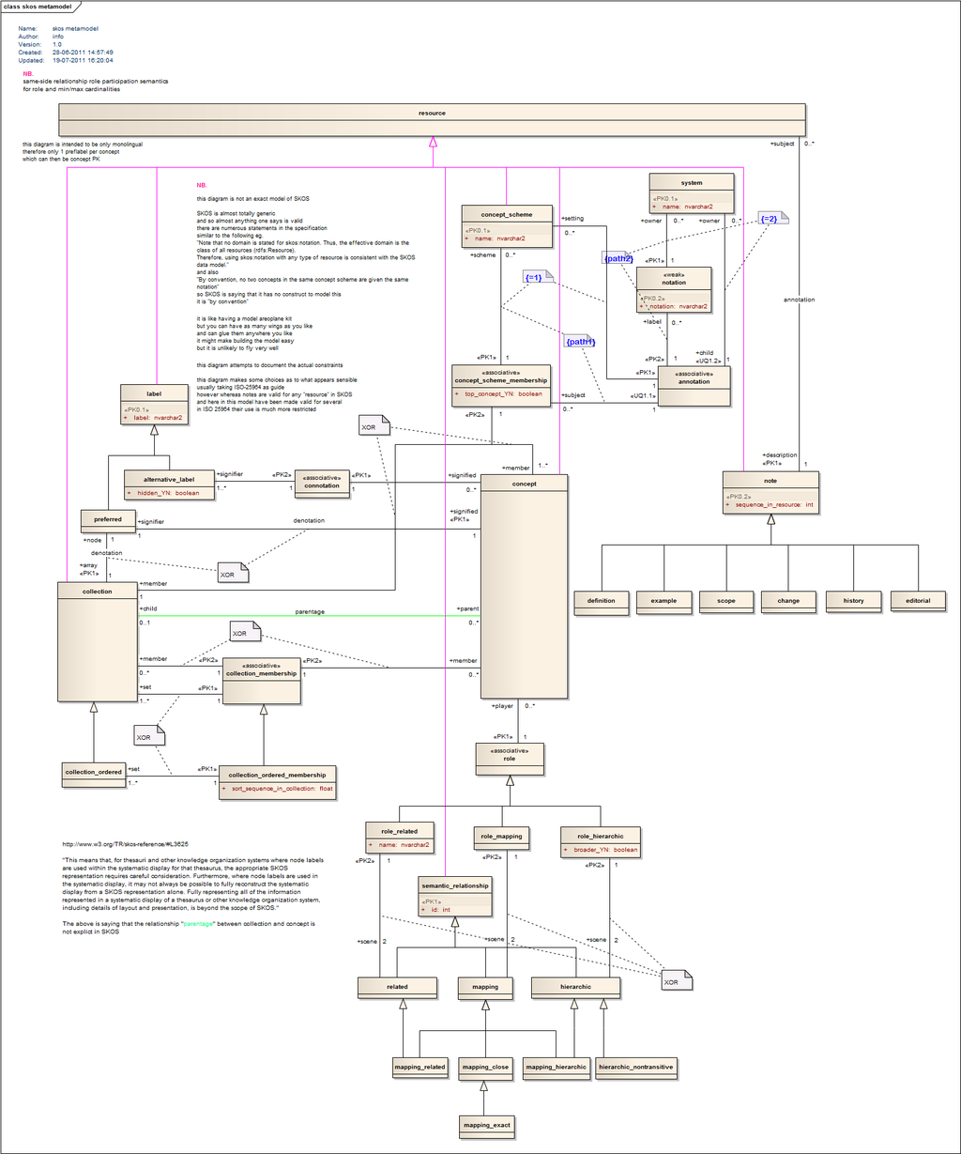
SKOS
By Ottomachin - Own work, CC0, https://commons.wikimedia.org/w/index.php?curid=15941736

Slide 18
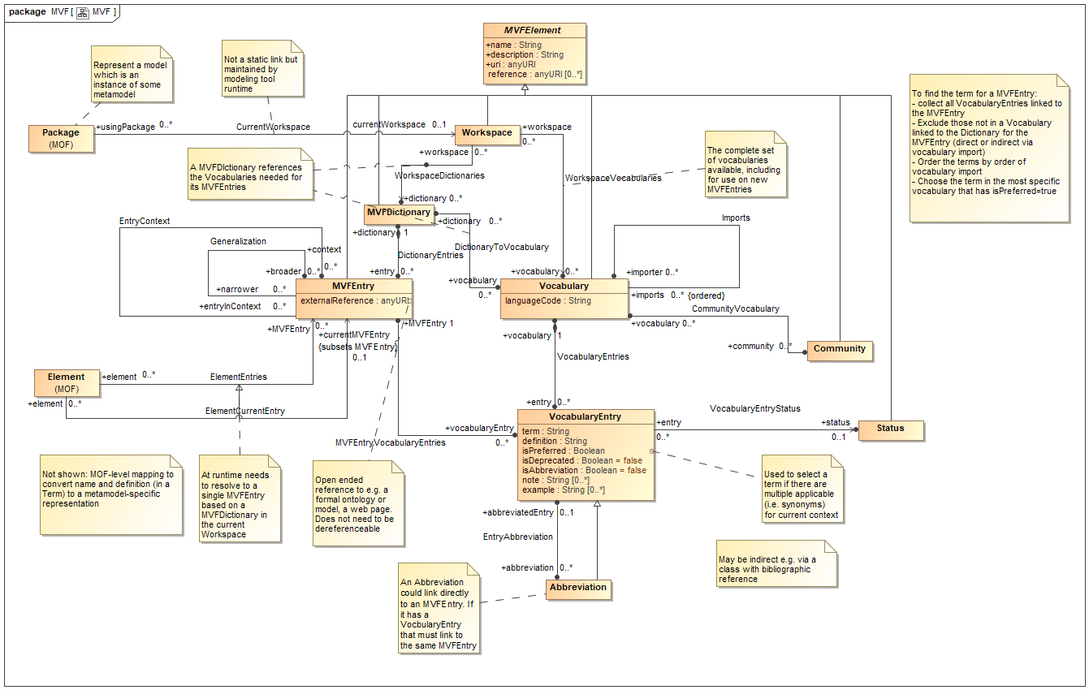
MVF Latest:

Slide 19
Annotations
Define ‘annotations’:
Those items needed for Terms/Definitions, Abbreviations or References, that take the form of text rather than other data or ‘things’
Status: we are working through an ‘Annotations Wishlist’
Findings
Experiment One (spreadsheet of GovDTF initial 11 terms)
Later PoC work
Discussions
Status: To be de-duplicated and cleaned up
Many of the terms available in FIBO AV and OMG AB SM

Slide 20
Output formats (presentation)

Slide 21
Requirement Overview: Outputs
TF Conceptual ontology
Vocabulary Resource
Terms and Definitions
Wiki Table
Document insert
Industry ontologies
Individual Wiki Pages
(with Index)
IOF
FIBO
Acronyms,
Abbreviations
& Nicknames
Taxonomies
Semantic Completeness
Vocabularies
Wiki Table
Other Structured Resources (US Gov, industry etc.)
Document inserts
Vocabulary for Models
References
Wiki Table
References
Document insert

Slide 22
Context Ontology

Slide 23
Kinds of Contexts
Contexts Grid
Who | What | When | Where | Why | hoW | Granularity

Slide 24
Complex Context
Thing
Identifiable Thing
Mediating Thing (Context)
Relative Thing
(qua entity)
Who
“played by”
What
“In context ”
When
hoW
Why
Where
Recall
inContextOf is sometimes an Independent Thing (aspect)
More often it is a Mediating Thing (multi-aspect)
Relator (Mediating Thing) is also an Existentially Dependent Thing

Slide 25
Process

Slide 26
Top level ‘triage’ process
Identity if this is a word strong that already exists in our concept-base already
New Concept in Concepts List
Process 1: Terms
Concept Exists
Update concepts Synonyms
Update context ontology
Analyze Input
Process 2: Abbrev
Refers to
Outputs
(all 3)
Define ‘Term’: A lexical representation of a Concept
Process 3: Refs
Reference: Background material we may want to point to for the meaning of some basic term (symbol grounding)
- makes the Foundational Ontology really simple
- document this for other groups
Might refer to

Slide 27
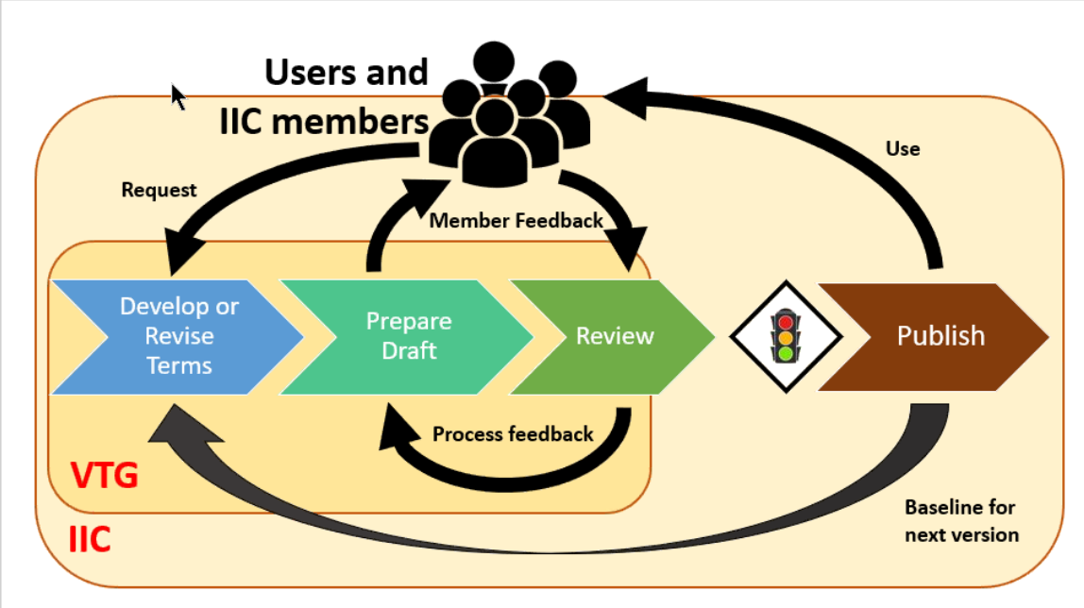
Process for ‘Term’? (or core, for Concept)
Inputs
Concepts
+
Defns
See other page
Analyze inputs
Definition
Identify Term
Identify Concept
Formalize meaning
Review
Publish
Ensure aligned
Identify Usage Context
Ontology
Ontology
Ontology
Terms Usage
Context Ontology
Usage Context

Slide 28
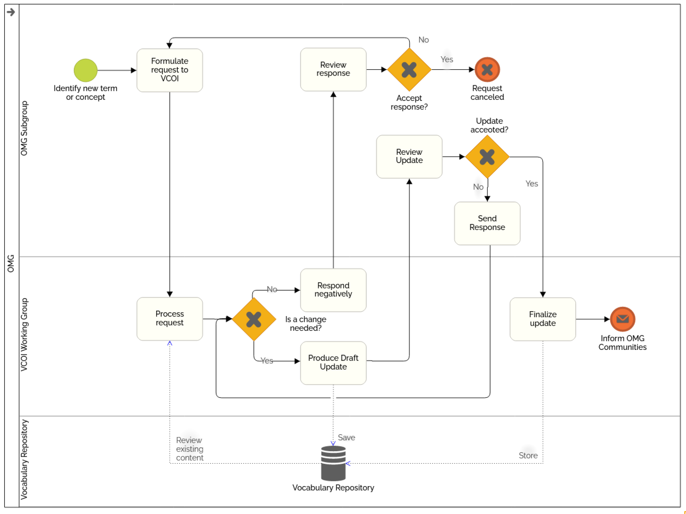
BPMN Process Initial Draft

Slide 29
Summary document for the whole package (coversheet / ToC)
To be done last

Slide 30
Questions?

